Slide 1
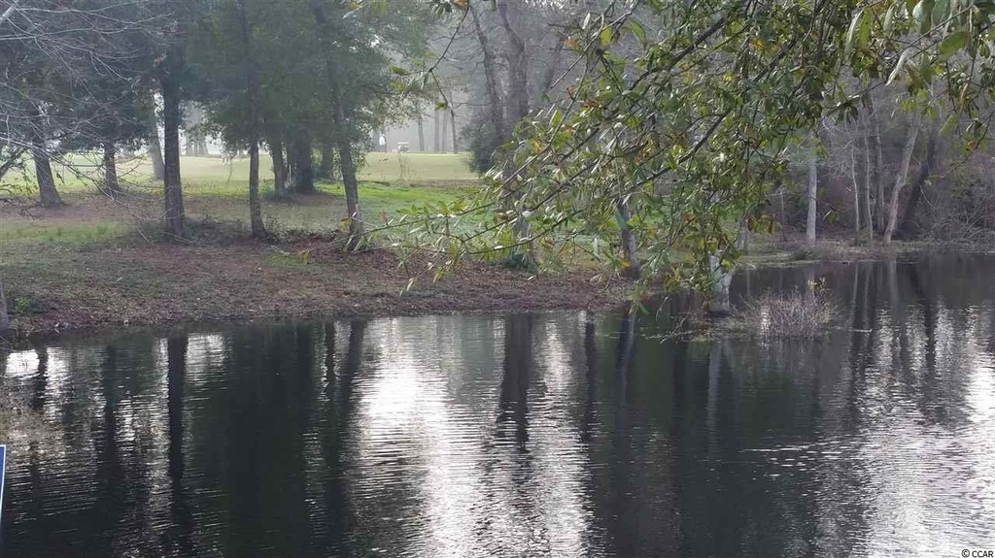
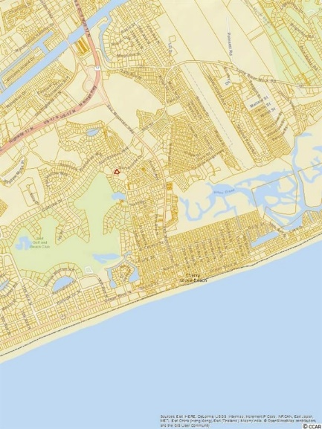
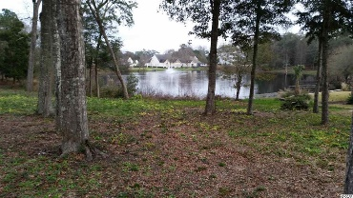
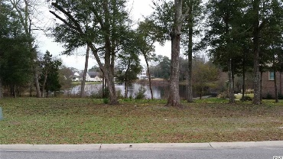
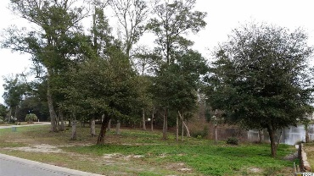
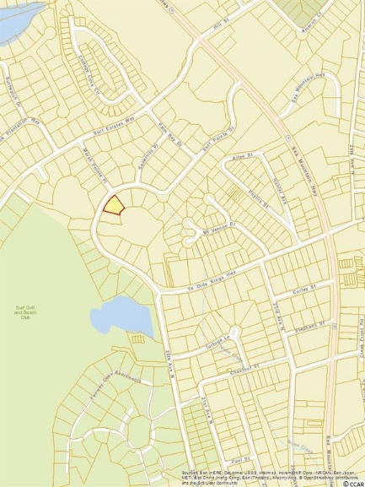
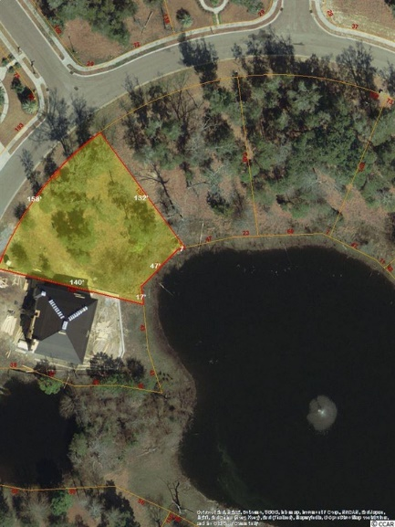
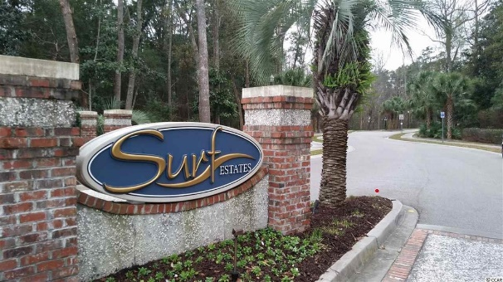
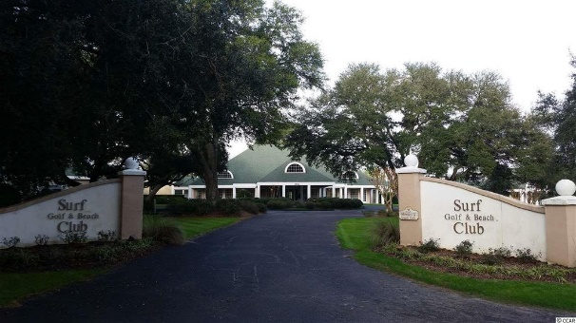


1110 Surf Pointe Dr
North Myrtle Beach, SC 29582
MLS# 1600023
$199,900
0.34 acres
Come build your dream home
Surf Estates is an easy walk or golf cart ride to the beach, only about a mile away; Surf Club; and new popular shopping center, featuring brand-name shopping, dining, and professional and other services. There are even two wonderful, walk-able grocery stores and the charming ambience of homey Cherry Grove itself. This lot is one of the best of the best in Surf Estates, large road frontage at 158', right on the lake with enchanting views of the soothing foundation to the rear and another lake and fountain view in the front, even peaking at the golf course. This spacious property allows great flexibility of home design to maximize the diversity and serenity of its unique waterscapes. Perfect for a discriminating buyer or builder! Do not pass up this rare opportunity to build in one of the best locations in popular North Myrtle Beach.
Deborah Collins
843-424-9013
dctidewater@yahoo.com
Connie Ross-Karl
702-306-2643
conniesross@aol.com
NEW WAY PROPERTIES MYRTLE BEACH

