Slide 1
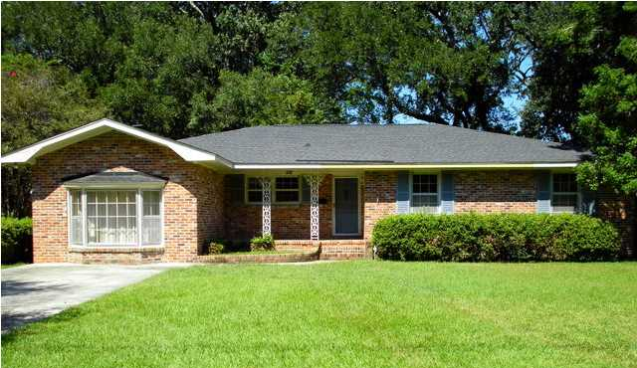
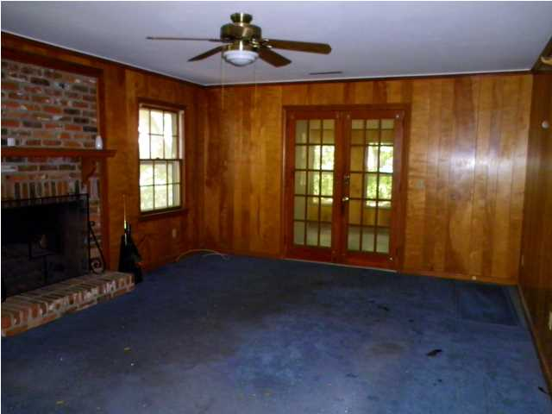
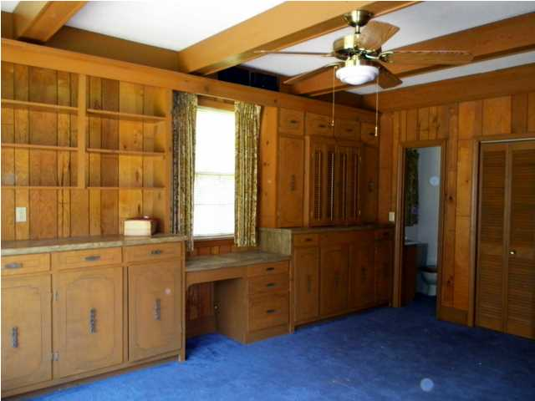
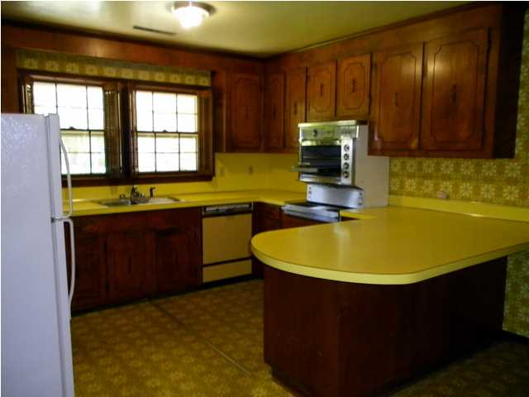
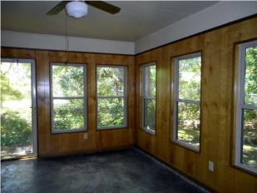
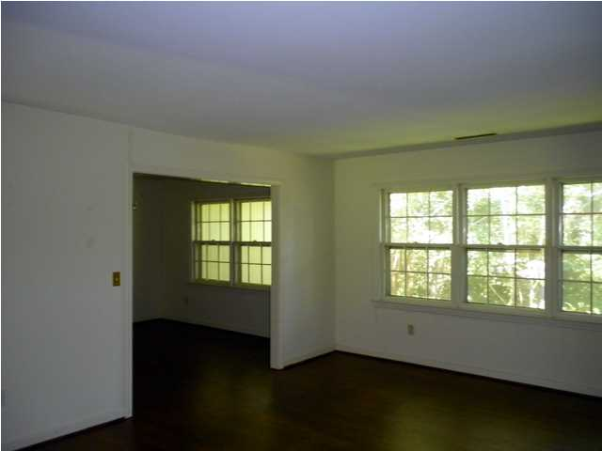
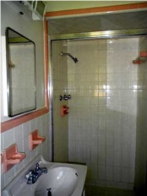
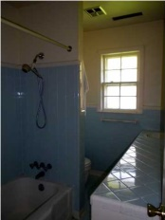
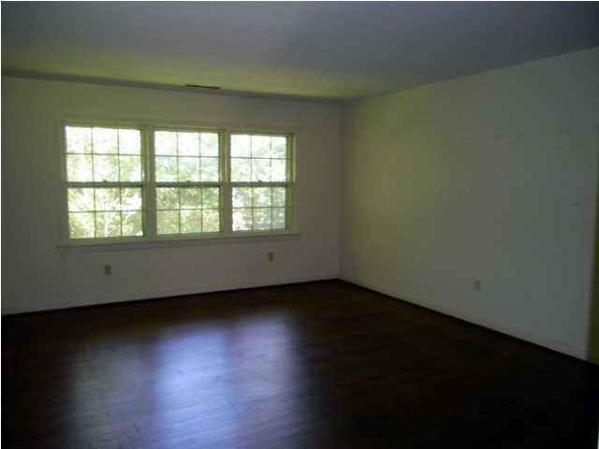


1112 Lining Ln Charleston ~ MLS# 1425427 ~ $295,000
Great Opportunity in Farmfield
Awesome opportunity to transform this 2250+ sqft ranch into the ultimate dream home. Only 2 miles from downtown and less than a mile to trendy Avondale, Farmfield is a highly desirable neighborhood with large lots, grand oaks and quiet streets. Tennis Center and West Ashley Greenway are a short walk away. This house has great bones and has been well cared for by the same owners for over 40 years. Floor plan offers separate living room and dining room as well as a large family room with fireplace, plus an additional den/office/playroom room in the converted garage. Original hardwood floors are in excellent shape. Floor plan flows well in existing form or it could easily be renovated into an open concept kitchen, living, and dining room. House is structurally sound and being sold "as is". Enclosed sunroom/back porch square footage is not included in the square foot totals.
Jeanne Jamme
(843) 343-1934 M
jjamme@carolinaone.com www. carolinaone.com

