Slide 1
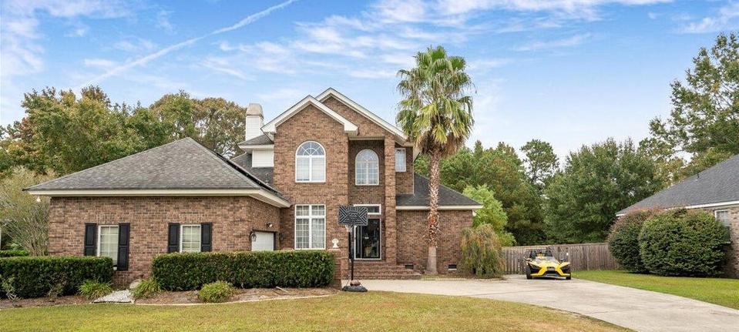
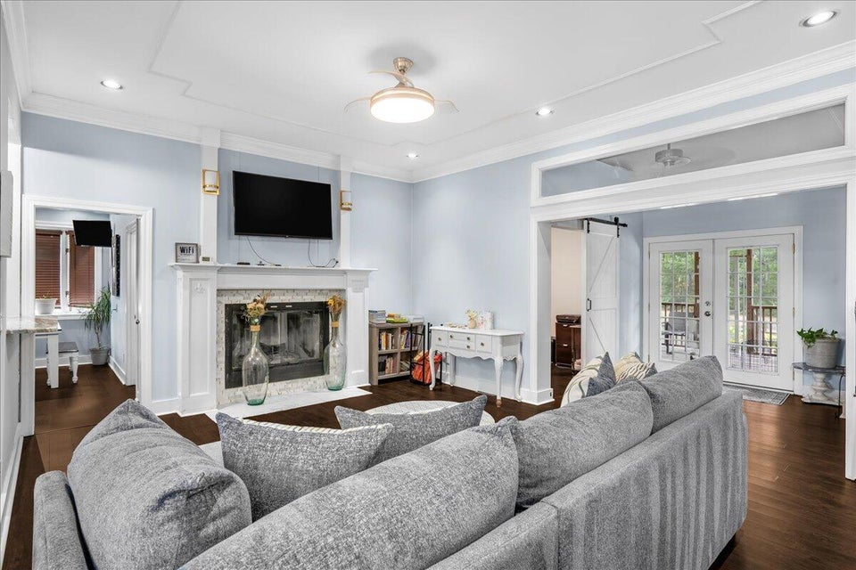
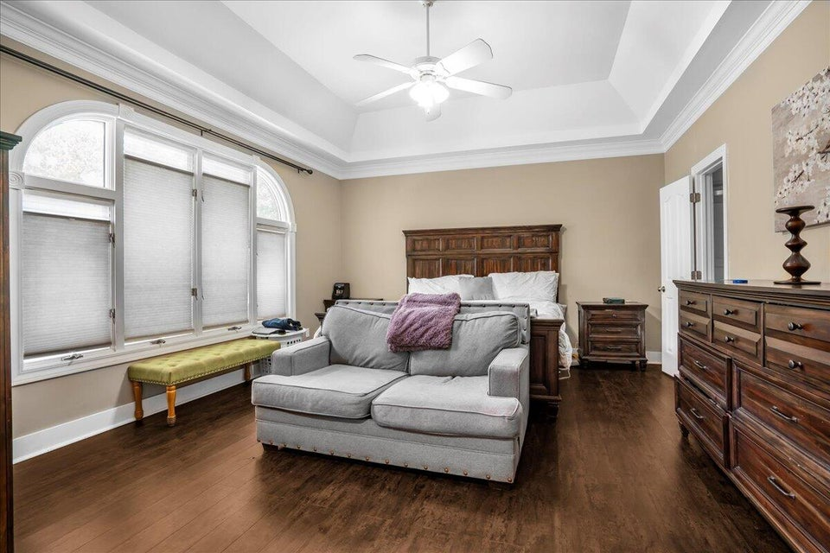
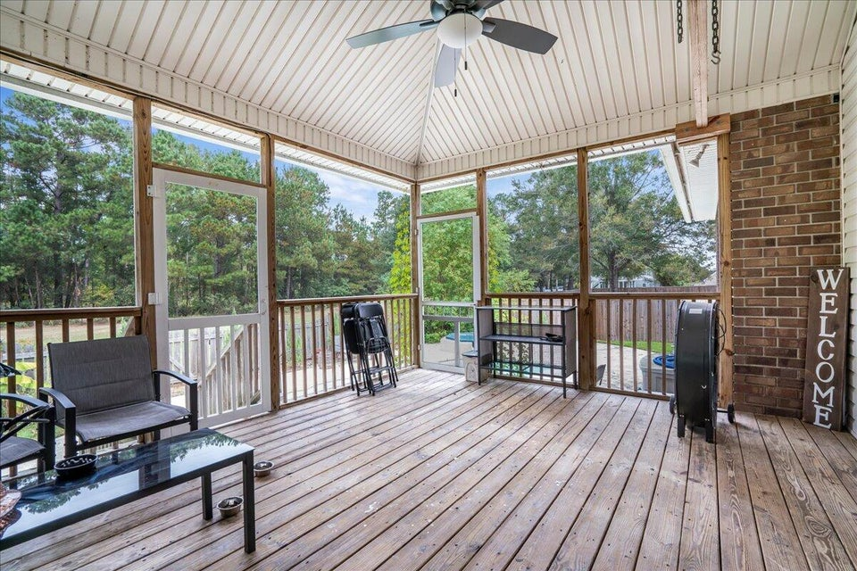



1112 EAGLE LANDING BOULEVARD, HANAHAN, SC 29410
11/
3 BEDROOMS
2½ BATHS
2,902 SF
� 1753
piiq 2
PRICE IMPROVEMENT!
EAGLE LANDING
MLS# 24027925 | $599,000
CHARLESTON
WEST ASHLE
KELLERWILLIAMS.

