Slide 1

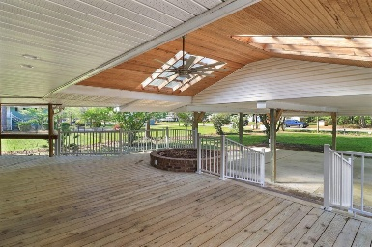
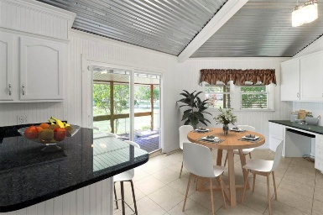
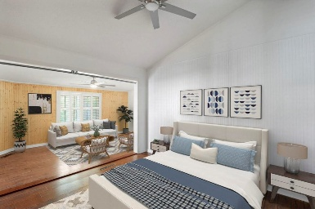
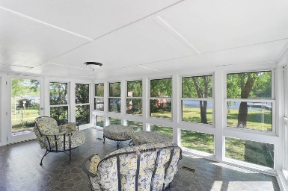
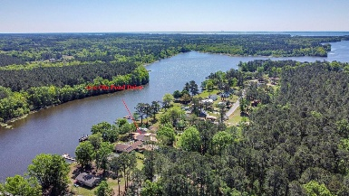


1112 Gin Pond Drive Gin Pond | Summerton, SC 29148 | MLS# 25022498 | $649,900
Waterfront on Lake Marion!
Open House
Wednesday, 7/20
3-5PM
Your Lake Marion Lakefront Escape Awaits! If you've been dreaming of a home that combines character, privacy, and the ultimate lake lifestyle—this is your chance! This distinctive 1976 octagonal home offers over 3,100 sq. ft. of living space, 3 bedrooms, 2 bathrooms, and a rare lakefront location with your own private dock. Whether you're looking for a full-time residence or a weekend getaway, this property delivers both charm and function.
From the moment you arrive, the mature landscaping and generous off-street parking make a welcoming first impression. The two-car attached carport with an adjoining workshop is perfect for storing lake gear, tools, or outdoor essentials. Inside, natural light pours in, highlighting the dramatic two-story brick fireplace as the centerpiece of a spacious, open floor plan - ideal for relaxing, entertaining, and enjoying lake views from every angle.
The kitchen features timeless white cabinetry, a handy peninsula for casual meals, a built-in desk, and a functional butler's pantry with a second sink. A spacious laundry room and lower-level drop zone make lake life easy and organized. The primary suite offers dual closets, a dressing area, and a private bath. Two additional bedrooms provide flexibility for guests or hobbies, one of which offers direct outdoor access for added convenience.
The glass-enclosed sunroom frames year-round views of Lake Marion, while the large covered deck with skylights is the perfect spot to entertain or unwind after a day on the water. The level backyard leads straight to your private dock, ready for boating, fishing, or simply enjoying the peaceful lakeside setting.
Opportunities like this are rare on Lake Marion - schedule your private showing today and start your next chapter in this truly unique waterfront retreat!
VIDEO TOUR
Brandon Ray
(843) 499-1928
brandon.ray@carolinaone.com
www.lakelifescstyle.com
Carolina One Real Estate
900 N Main St
Summerville, SC 29483

