Slide 1
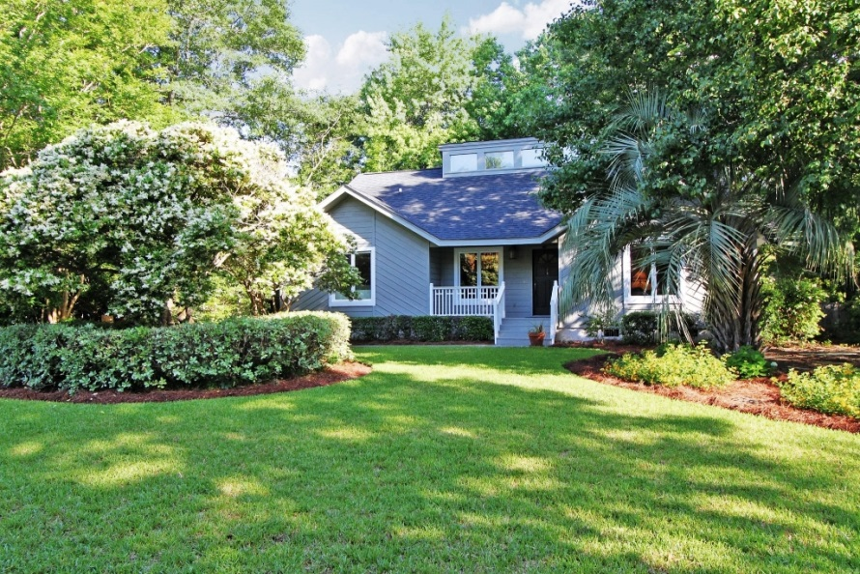
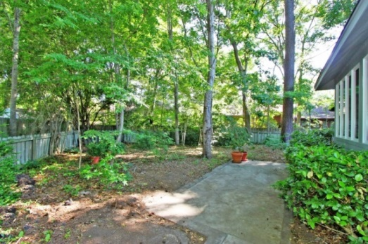
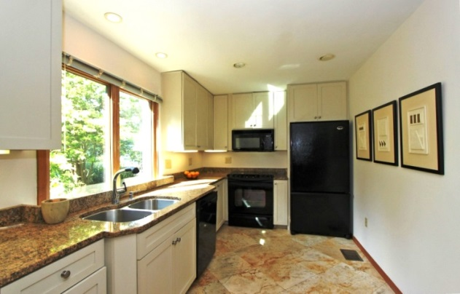
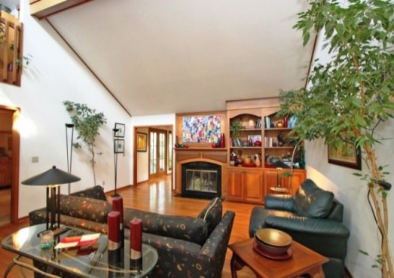
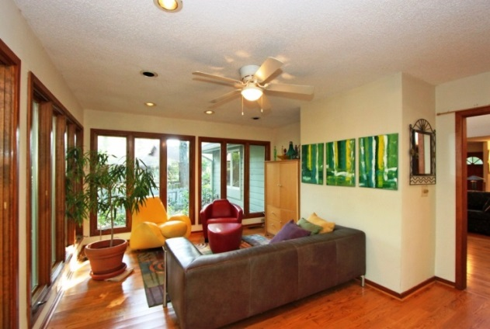
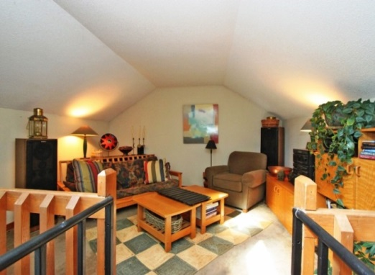


Ranch Style Living Snee Farm
Back on the Market
New Price $325,000
Rene Kramer
843-412-7060
rkramer@carolinaone.com
Renekramer.com
View this property: www.1113AmblingWay.com
MLS# 1413112

