Slide 1
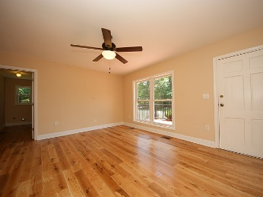
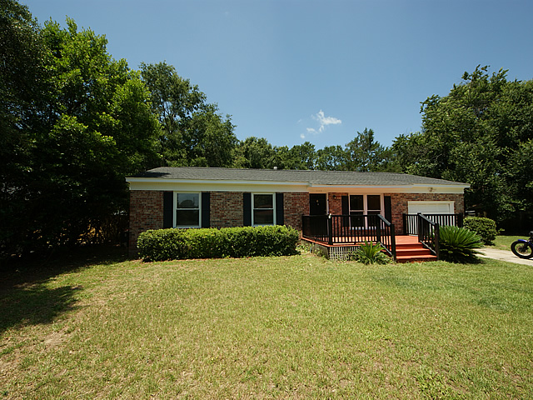
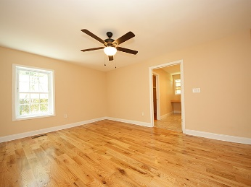
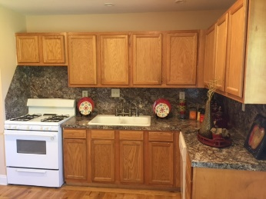
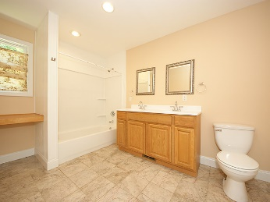
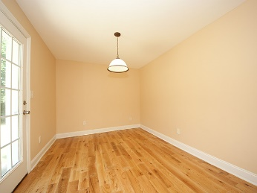
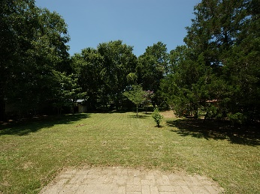
Great New Counter Tops and Great New Price!
1113 Mariner Drive Charleston, SC 29412 ~ MLS# 16018740
Recently Reduced to $249,900
Beautifully updated home in Lighthouse Point, this home has new red oak hardwood floors throughout the house. Freshly painted and well maintained, you will love the eat in kitchen and family room. The master suite has a large bathroom and a walk in closet. The 2 additional bedrooms are good sized and the laundry room is big enough it could serve as a pantry also. With a 1/3 acre yard and no HOA you can bring your boat home with you. There is a 1/2 car garage which is great for lawnmowers, motorcycles etc. Schedule your showing today!
Mike Goldston, Realtor
mikesellscharleston@gmail.com | 843-343-7026 | www.cometocharlestonsc.com
Brand Name Real Estate | 4 Carriage Lane, Suite 106 | Charleston, SC 29407

