Slide 1
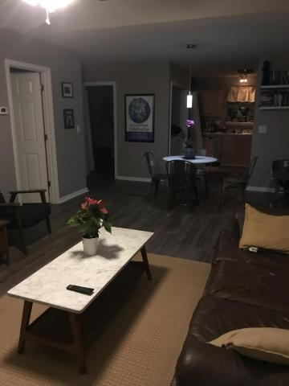
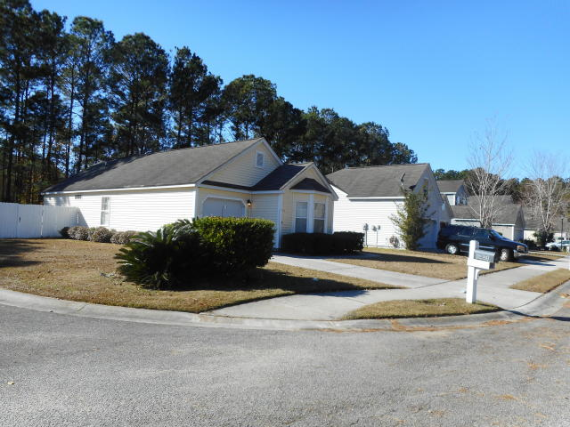
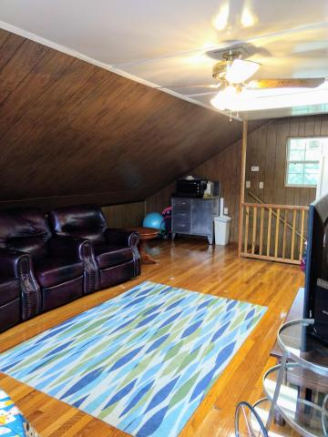
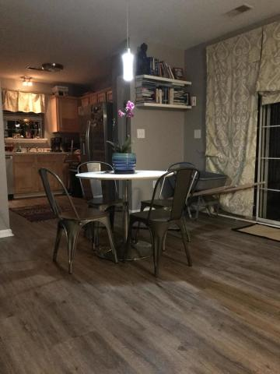
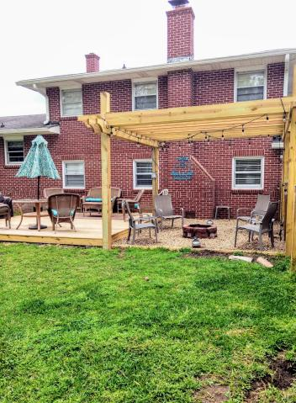
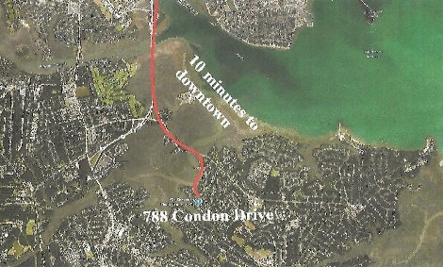
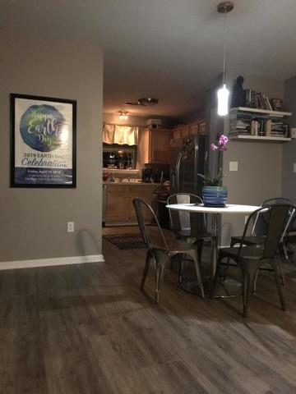
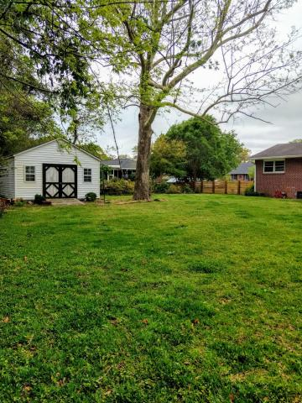

William S. Smith, Broker wssmith@hartnettrealty.com
843-906-5620
Lowest Priced House in The Peninsula Subdivision!
Convenient to Clements Ferry Rd & major arteries.
Setup your showing today!
1113 Peninsula Cove Drive
The Peninsula | Charleston, SC 29492
MLS# 19034498 | $265,000
Sharply priced 3 bed/2 bath home directly across from neighborhood pool/park. Stainless steel refrigerator, dishwasher, stove and oven, microwave. New laminate flooring covers all three bedrooms, kitchen, living and dining areas. Fenced backyard. One car garage.
1156 Bowman Road, Suite 200
Mt. Pleasant, SC 29464

