Slide 1
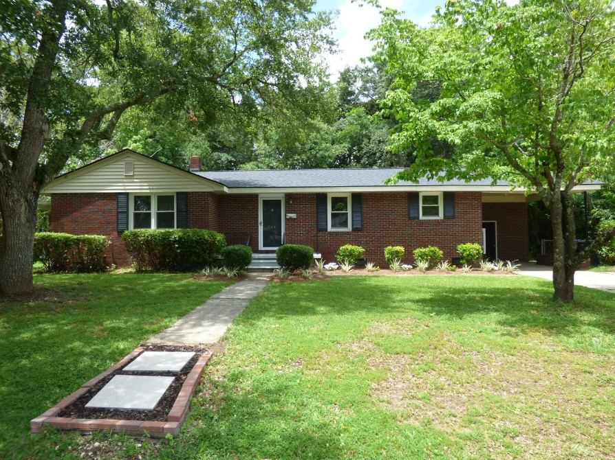
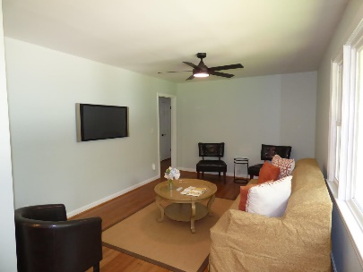
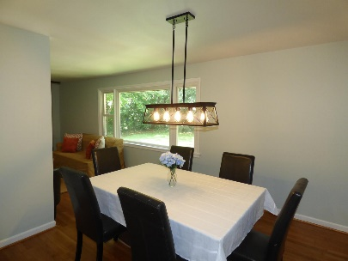
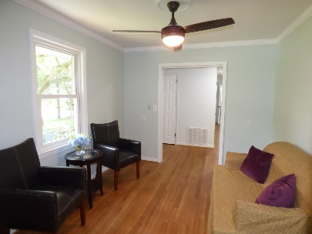
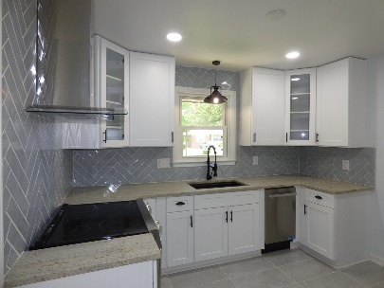
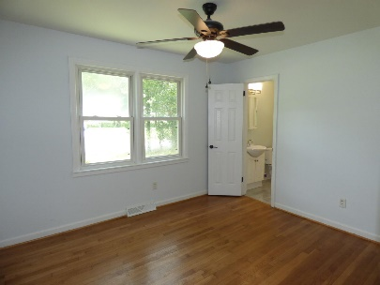
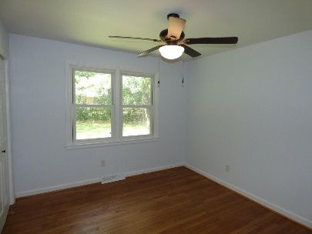
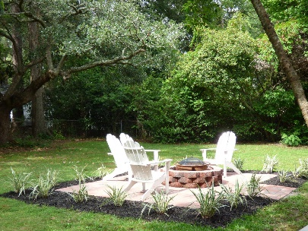

1114 Barrett Road
East Oak Forest
Charleston, SC 29407
MLS# 23016273
$600,000
3 Bed · 2 Bath · 1,272 sf
3.5% AGENT COMPENSATION BEING OFFERED IF A CONTRACT IS RATIFIED PRIOR TO OCTOBER 22, 2018.
3.5% AGENT COMP IF CONTRACT IS RATIFIED BY AUGUST 21, 2023!
This is a newly renovated home well located in highly desirable East Oak Forest Subdivision. You can literally walk on a shaded, tree lined sidewalk to the heart of Avondale in less than 15 minutes to enjoy all the shops, restaurants, and nightlife of the lively area. The West Ashley Greenway is just a short walk around the corner for the walking, jogging, and biking enthusiasts, and the back entrance to the W. L. Stephens Aquatic Center, playground, basketball courts, and tennis courts is just a short stroll away at the end of Barrett Road. The drive to downtown Charleston is less than 10 minutes away without traffic as well. The home features all new architectural shingles, a brand new HEIL condensing unit and furnace, new ceiling fans and light fixtures, a fresh coat of paint throughout the interior, and newly sanded and refinished hardwood floors. The kitchen features all new stainless steel appliances, new all wood cabinets with a lazy susan and slow close doors and drawers, beautiful granite countertops, and a stylish herringbone tile backsplash. The master bathroom has gorgeous new marble floor tile and a newly tiled shower with wavy coastal style tile. The guest bathroom boasts beautiful new marble floor tile as well, a new vanity with a natural stone top, and a stunning marble tile tub surround. The huge backyard has a brand new brick patio and fire pit perfect for enjoying the Lowcountry weather, entertaining guests, and roasting marshmallows.
Bryant Pearson
(843) 860-7667
bryantpearson@gmail.com
Agent Group Realty
433 Plaza Real Suite 275
Boca Raton, FL 33432

