Slide 1
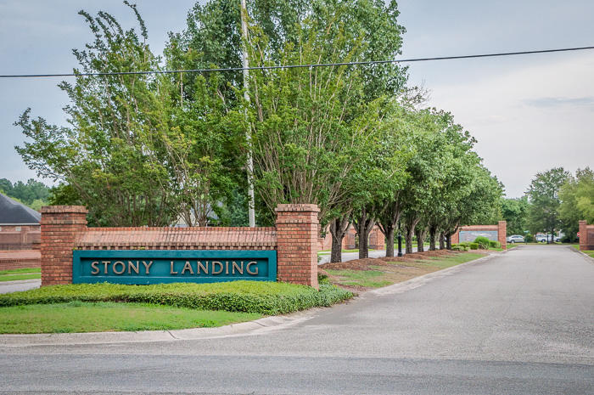
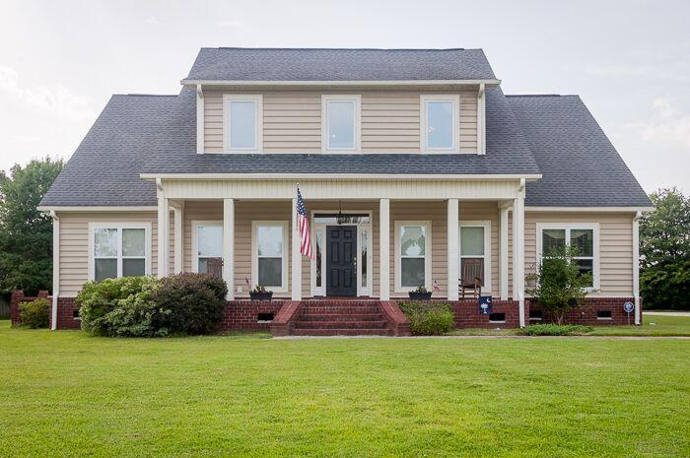
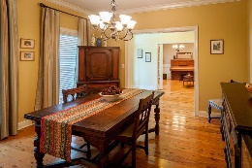
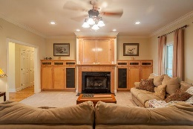
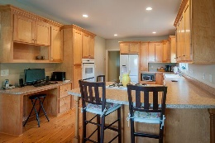
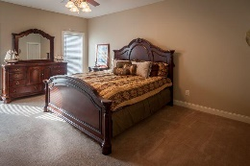
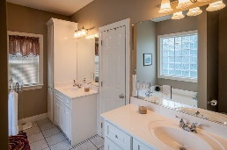
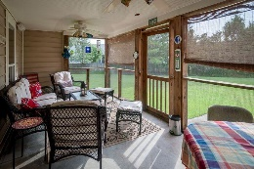
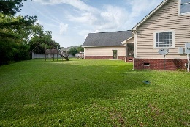
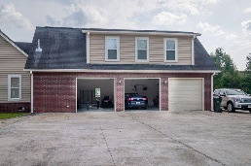


Estate-sized Lot
1115 Ole South Court
Stony Landing
Moncks Corner, SC 29461
MLS# 15018634
$365,000
Be ready to feel at home in this remarkable 4 or 5 Bedroom home COMPLETE with BONUS room (could be 5th BR)AND full bath over a 3 car garage in a beautiful established neighborhood! Sturdy, semi-custom feel with 4460 sf, 3 HVACs & inground sprinkler.
Wonderful layout of 1st level features master suite, guest suite, family room with built-ins & fireplace, office/media room w/French doors, separate dining rm & spacious kitchen with gathering bar*The gorgeous wood floors are amazing & the screened porch is a private & relaxing retreat!
Upstairs you'll find roomy secondary bedrooms PLUS 2 LARGE flex/media/play rooms AND storage galore! This home is available NOW-NO new construction debris-on a lush .6 acre cul de sac home site! Add to your ''must see'' list today!
Sheila Romanosky
(843) 224-0242
sromanosky@carolinaone.com

