Slide 1
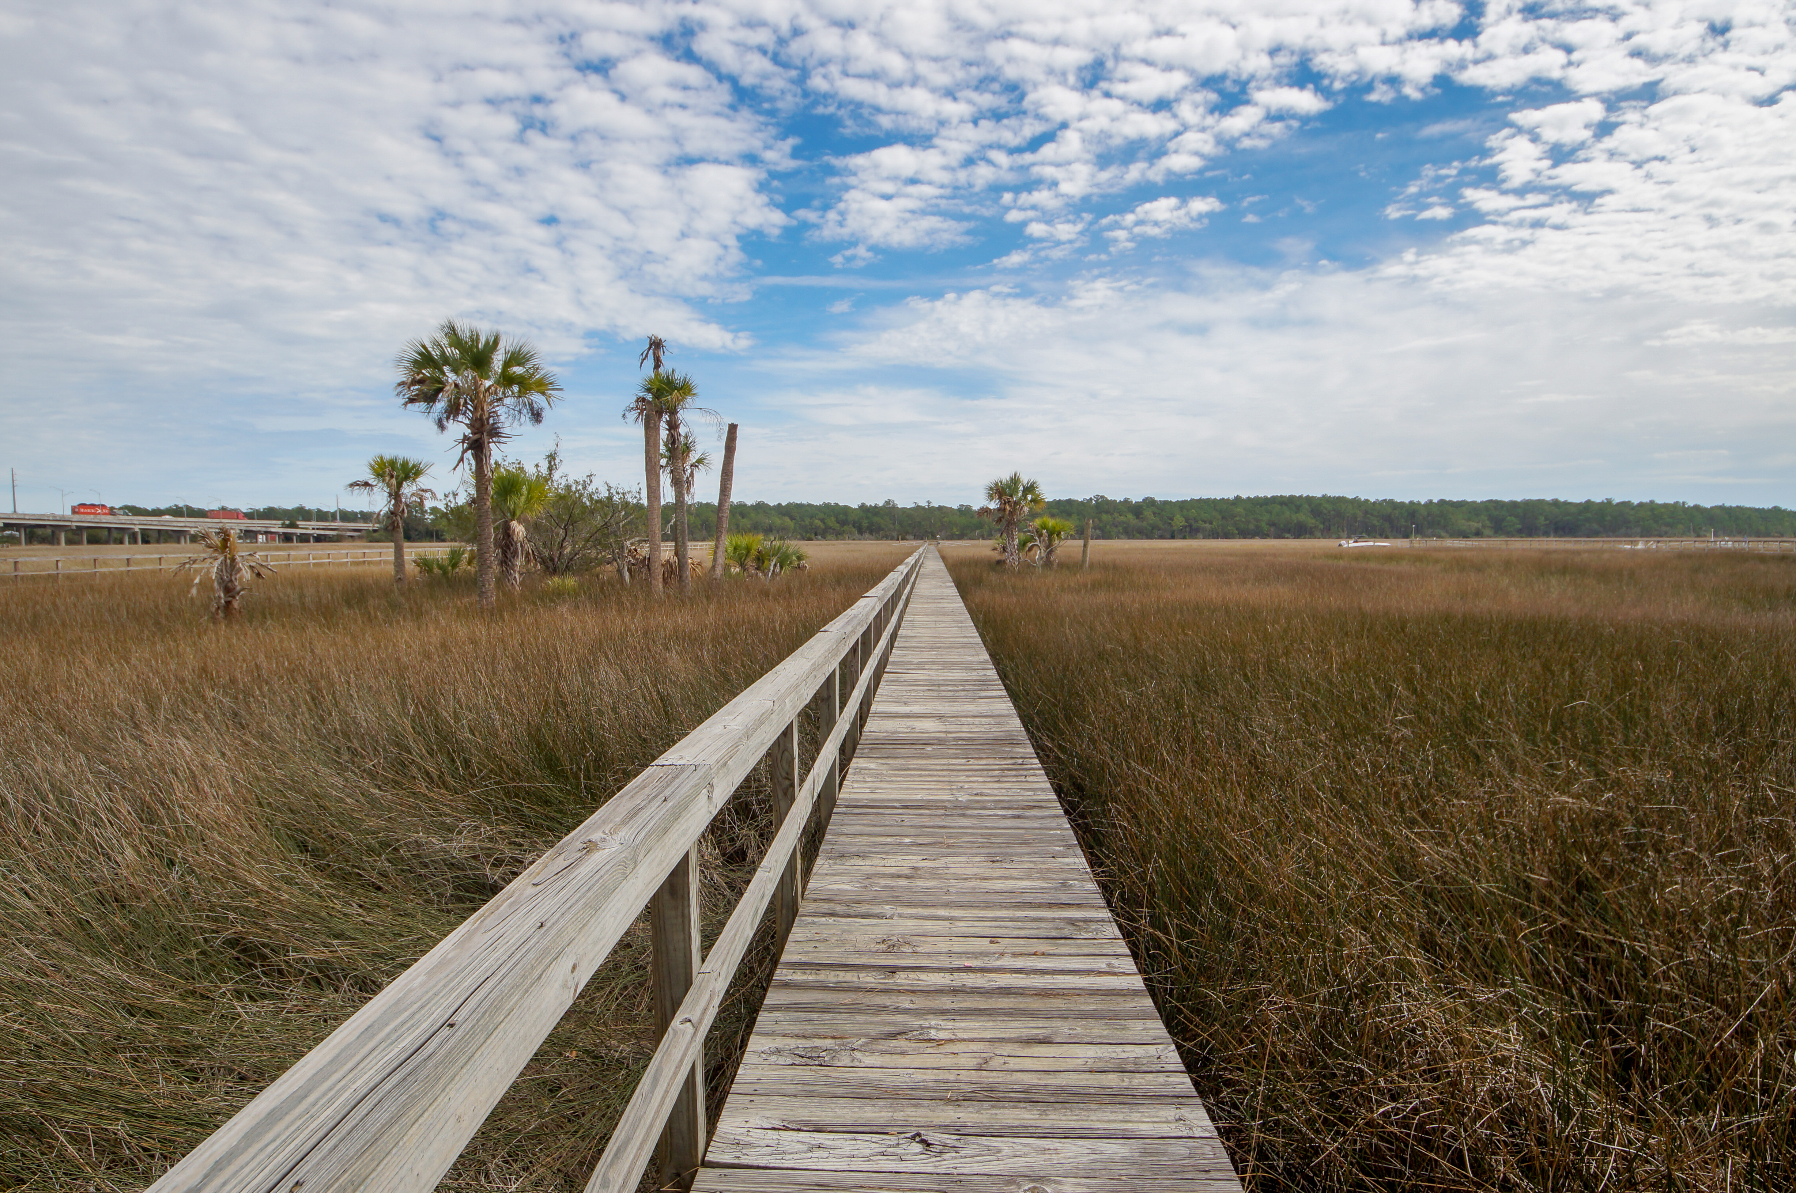
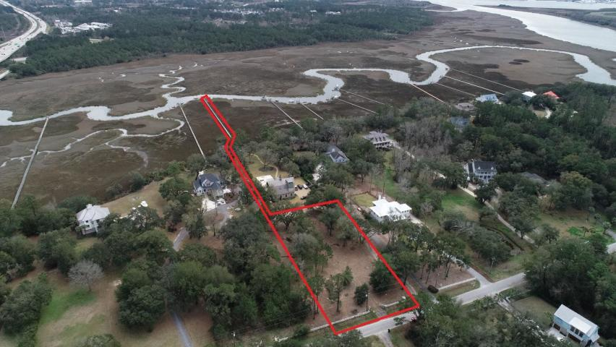
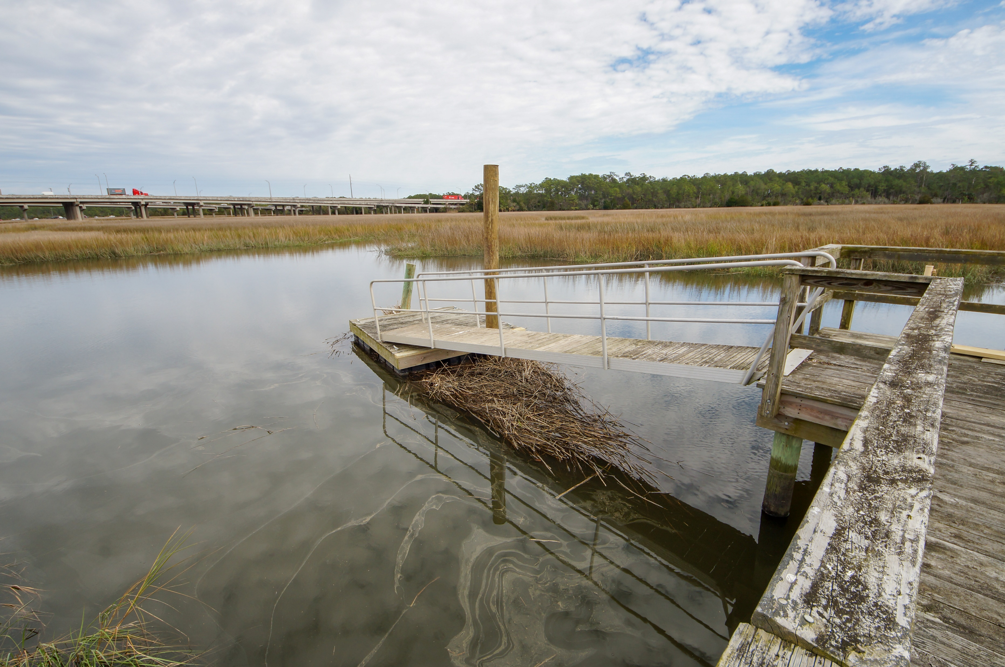
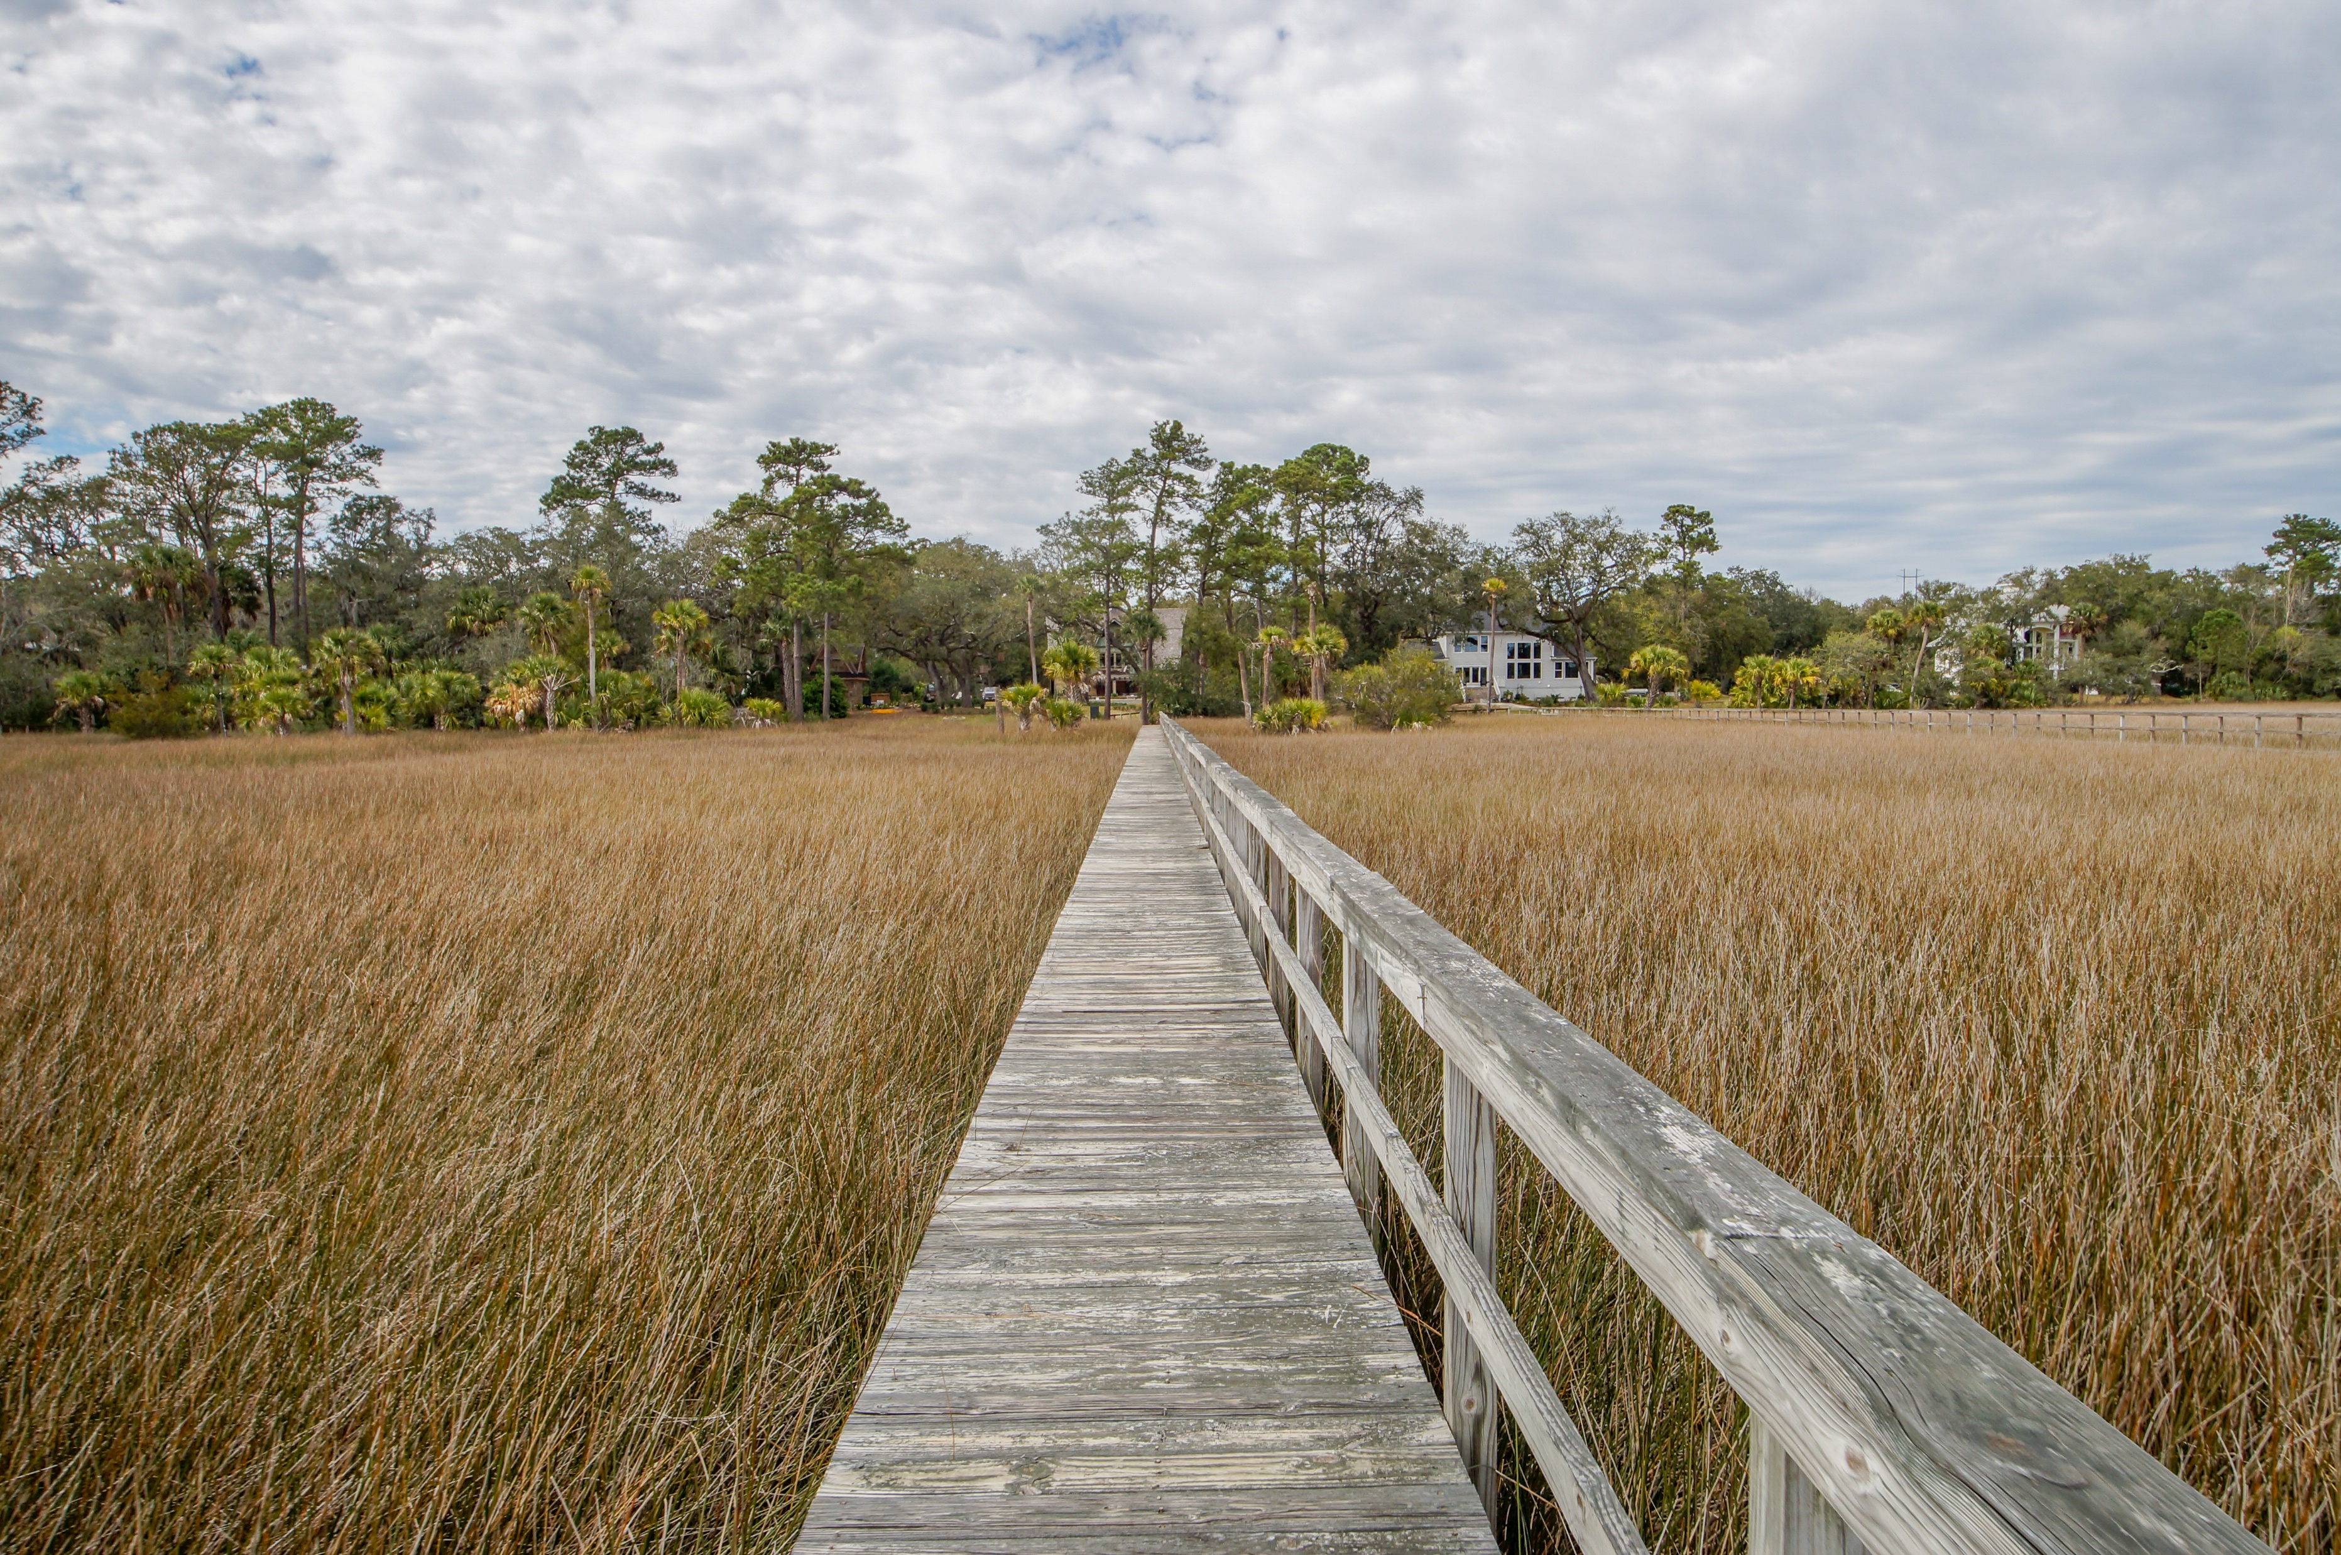
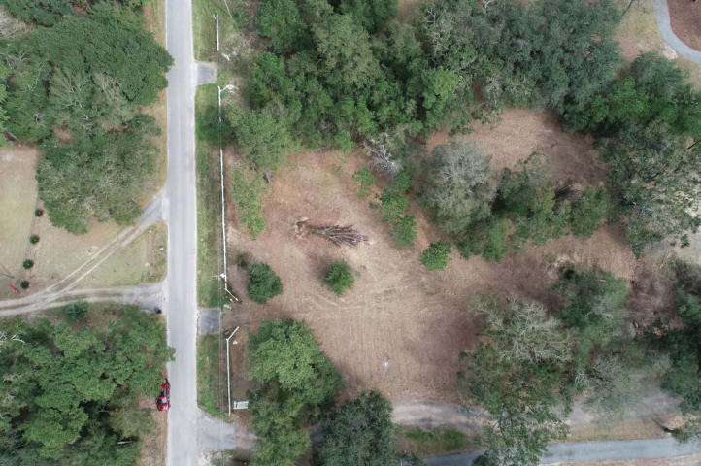
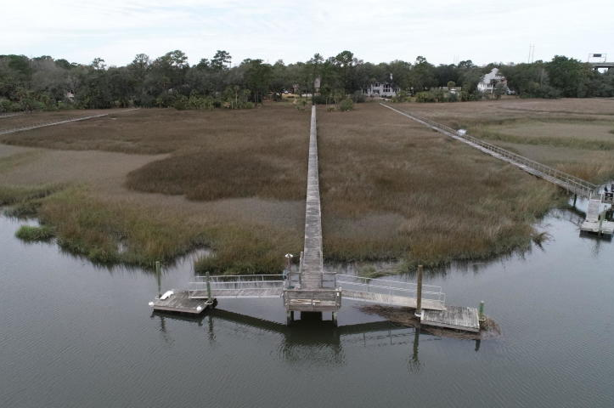
Deep Water Dock In Place!
1115 Pinefield Drive
Pinefield | Charleston, SC 29492
MLS# 19006017 | $398,000
Per Seller, there is approximately 4-5' water at low tide. The Seller's floating dock is on the left side of the walkway. Lot is cleared & septic tank permit is in hand, expires July 2019.
Charles Salmonsen
M (843) 224-0300 | O (843) 388-6613 | charles@salmonsen.com
Salmonsen Realty | 864 Lowcountry Blvd Ste B | Mt Pleasant, SC 29464

