Slide 1
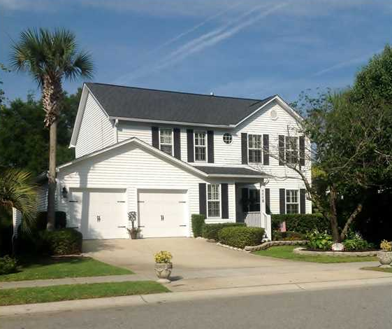
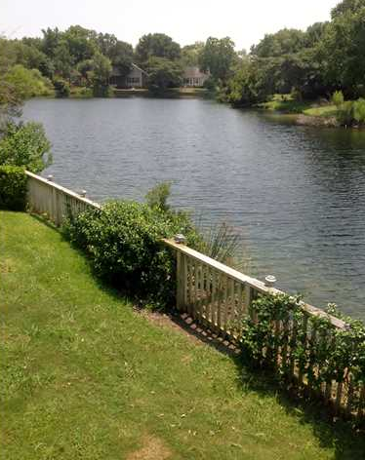
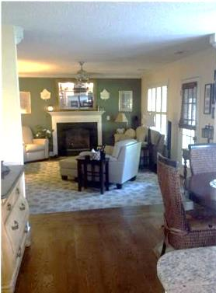
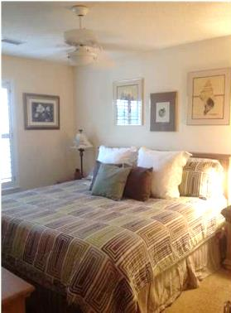
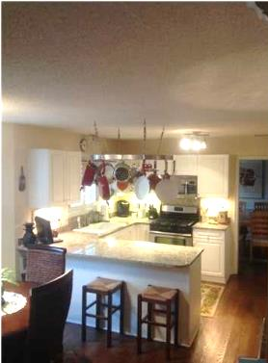
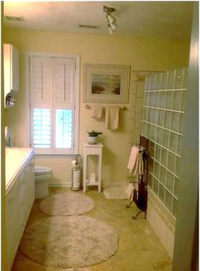
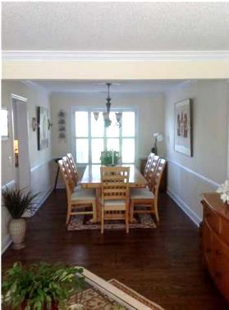
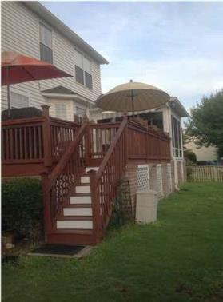


Reduced Waterfront Property
1115 Tidal View Ln
Bayview Farms
Charleston, SC
MLS# 1415716
$418,000
3 Bedrooms | 2½ Baths | 2,411 sf
Great lakefront location. Completely updated inside and out!
3 bedroom, 2 1/2 baths, living room, full dining room, dinning area off kitchen, family room, two car garage with new custom garage doors. New roof, new A/C, updated kitchen with granite countertops, gas cooktop and oven, built-in convection oven, new dishwasher, new French door refrigerator which conveys with purchase. Marble floors in both baths, custom hardwood floors on the first floor. Two working fireplaces- gas in family room and ventless gas in the sunroom. New large deck, irrigation system, landscape lighting front and back, fenced in backyard with sea wall. Master shower with 10 ft. Tile shower with corian double sink counter, vaulted ceiling, and two walk-in closets! Large guest bedrooms with plenty of closet space. Other features are a new hot water heater, encapsulated and humidity controlled crawlspace, and hardwood hurricane plantation blinds throughout the home. Move in ready-turn key. Many items to convey with home - refrigerators, appliances, plantation blinds, patio furniture, all window treatments. This is a beautiful home in the highly demanded Bayview Farms. Neighborhood pool, sidewalks throughout, play park, tennis court, picnic area, and clubhouse. All with a very low HOA fee. Home Warranty included!
Jeffrey Bell
jeffgbell@msn.com 843-412-6566 {M}
ERA Wilder Realty, 125 Wappoo Creek, Suite F, Charleston, SC 29412

