Slide 1
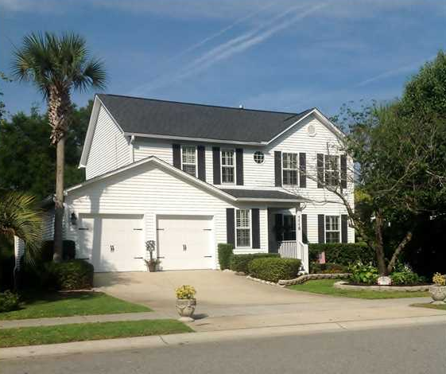
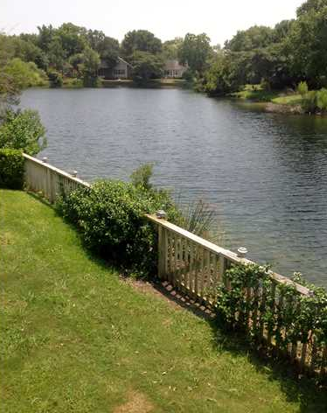
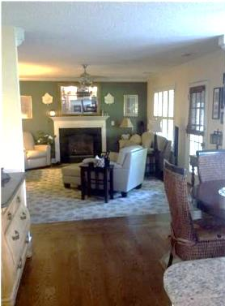
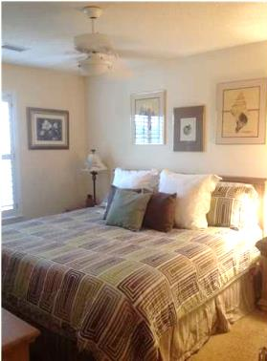
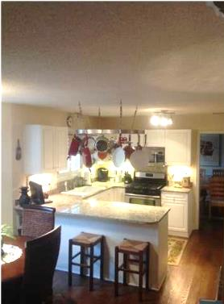
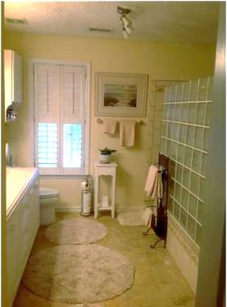
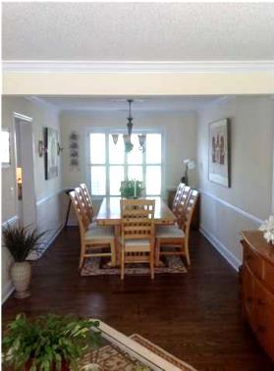
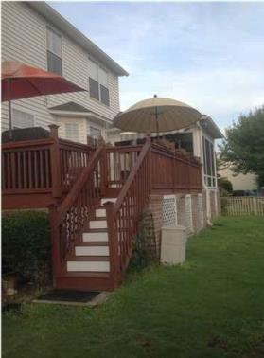


Waterfront Property
Reduced – Motivated Seller!
1115 Tidal View Ln
Bayview Farms
Charleston, SC
MLS# 1415716
$399,900
3 Bedrooms | 2½ Baths | 2,411 sf
Great lakefront location. Completely updated inside and out!
Waterfront! 100% move in ready - nothing to spend for years to come - completely renovated from top to bottom- updated inside and out- new roof, AC, kitchen, fencing, irrigation, garage doors, encapsulated crawlspace, master bath, carpeting, enclosed heated and cooled sunroom, deck and more!!! Beautiful 3 bedroom, 2 1/2 baths, living room, full dining room, dinning area off kitchen, family room, two car garage with new custom garage doors. Updated kitchen with granite countertops, gas cooktop and oven, built-in convection oven, new dishwasher, new French door refrigerator which conveys with purchase. Marble floors in both baths, custom hardwood floors on the first floor. Two working fireplaces- gas in family room and ventless gas in the sunroom. New large deck, and landscape lighting. Fenced in backyard with sea wall- rear gate with access to lake. Master shower with a 10 ft. Tile shower with corian double sink counter, vaulted ceiling, and two walk-in closets! Large guest bedrooms with plenty of closet space. Other features are a new hot water heater, encapsulated and humidity controlled crawlspace, and hardwood hurricane plantation blinds throughout the home. Again- completely renovated and updated inside and out!!! Move in ready-turn key. Many items to convey with home - refrigerators, appliances, plantation blinds, patio furniture, all window treatments. This is a beautiful home in the highly demanded Bayview Farms. Neighborhood pool, sidewalks throughout, play park, tennis court, picnic area, and clubhouse. All with a very low HOA fee.
Jeffrey Bell
jeffgbell@msn.com 843-412-6566 {M}
ERA Wilder Realty, 125-F Wappoo Creek, Charleston, SC 29412

