Slide 1
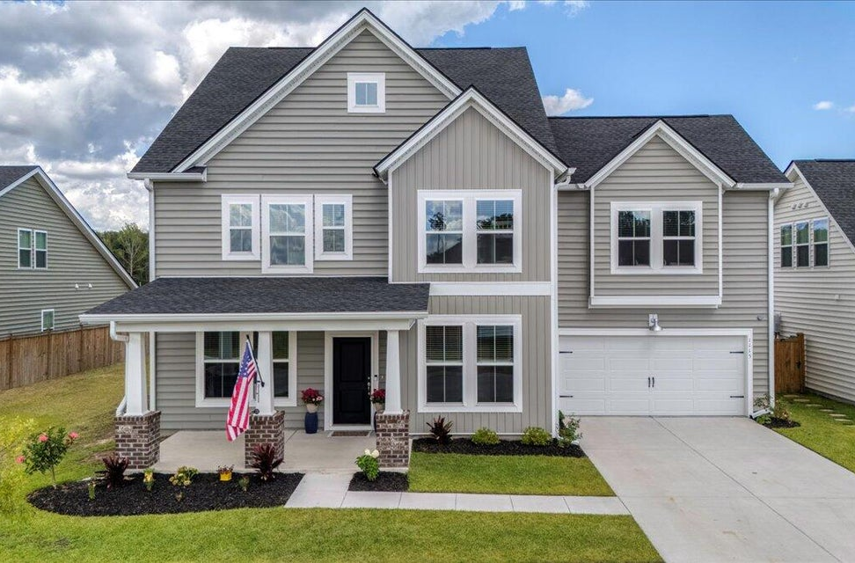
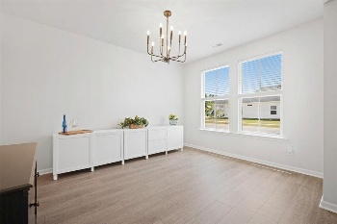
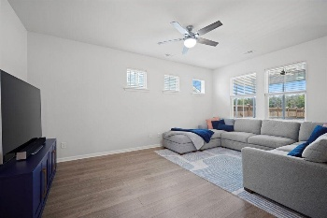
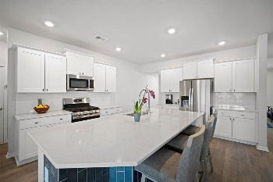
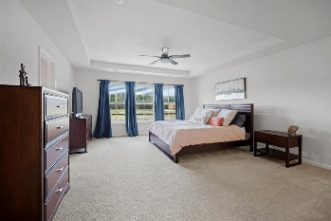
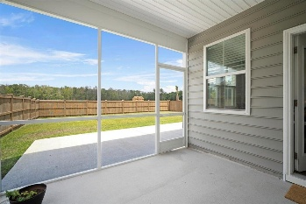

1115 Fitzgerald Court
Summers Corner · Summerville, SC 29485 · MLS# 25017978 · $550,000
6 Bedrooms 5 Full Baths-Open House Sunday 12-2
RARE 6-Bedroom, 5-Bath Home in Sought-After Summers Corner! This exceptional two-story home offers six true bedrooms and five full bathrooms, including a convenient main-level guest suite. With undeniable curb appeal, a spacious full front porch perfect for rocking chairs, and a thoughtfully designed interior, this home truly has it all. Step inside to find rich flooring, neutral tones, and an abundance of natural light. To the right, a flexible dining or formal living room features a stunning chandelier, large windows, and private access to the kitchen—ideal for entertaining. Just beyond the foyer, a versatile bedroom makes a perfect home office, gym, or guest room and connects to a full bathroom. The chef-inspired kitchen is a showstopper, featuring crisp white cabinetry, quartz countertops, a massive island with deep single-bowl sink, tiled backsplash, stainless steel appliances, pendant lighting, and a spacious pantry. An eat-in dining area, bathed in natural light, overlooks the backyard.
Open to the kitchen, the family room flows effortlessly into a screened-in porch and oversized patio, creating the perfect outdoor living space. The private, fenced backyard offers ample room for BBQs, gardening, or simply enjoying the outdoors. Upstairs, the expansive primary suite includes a separate sitting room, a walk-in closet big enough for a large wardrobe, and a luxurious en suite bath with dual vanities, oversized shower, tiled floor and elegant finishes. A spacious guest suite features its own full bath and living/play area, perfect for extended family or guests. Two additional bedrooms share a convenient Jack-and-Jill bathroom, while a final bedroom and hall bath complete the upper level. Additional features include a walk-in laundry room, blinds throughout, gutters, and a two-car attached garage. This move-in ready home comfortably accommodates multi-generational living or multiple home offices. Located in the vibrant Summers Corner community, residents enjoy access to fantastic amenities including a neighborhood pool, walking and jogging trails, a dog park, nearby schools, shops, restaurants...and a resort-style pool coming soon! Don't wait on new construction...this spacious and beautifully appointed home is available now!
Stan Huff
843-670-2835
stan.huff@agentowned.com
Jill Marcacci
843-297-5590
jill@agentowned.com
www.agentownedrealty.com
AgentOwned Realty Co. Preferred Group, Inc. | 824 Johnnie Dodds Blvd | Mt Pleasant, SC 29464

