Slide 1

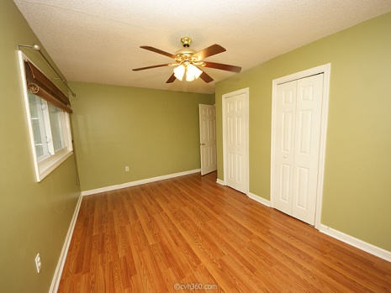
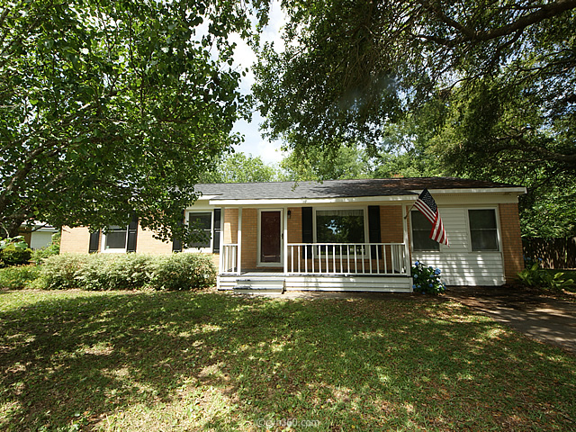
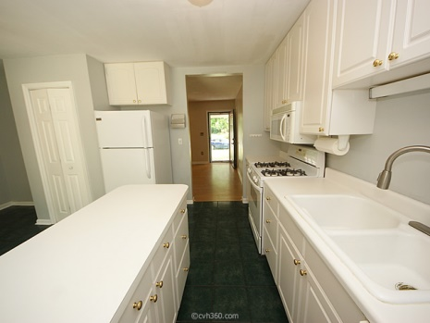
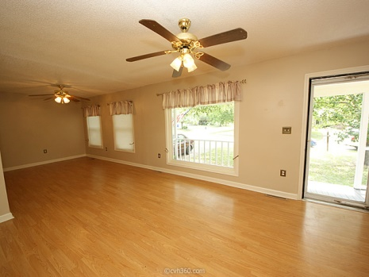
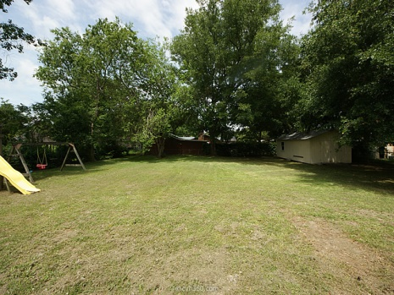


Affordable Family Home in James Island!
1119 Mariner Dr
Lighthouse Point ~ Charleston ~ MLS# 15013979 ~ $227,000
Beautiful brick ranch home in popular Lighthouse Point neighborhood. This house offers a massive .34 acre lot with a mature oak in the Stiles Point school district. Enjoy the convenience of living only minutes away from downtown and walks to the waterfront at an affordable price. The home includes 3 nice-sized bedrooms with one and one half bathrooms. There is also a bonus room located off of the enclosed laundry room. The new Roof, HVAC, and conditioned crawlspace. Add your personal touch to make this house your perfect family home!
Peter Stanley
M 843-300-8251 | O 843-885-6199
petermstanleyjr@gmail.com
Colony & Craft LLC
76-A Spring St
Charleston, SC 29403

