Slide 1
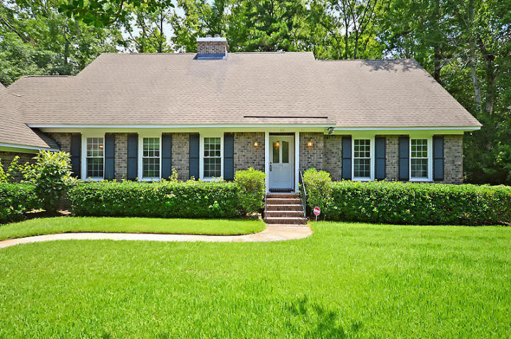
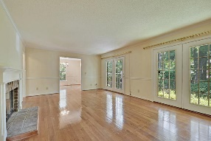
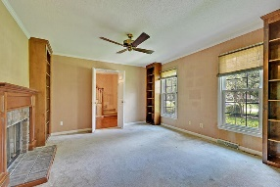
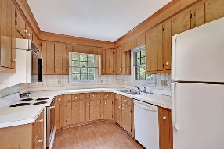
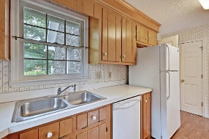
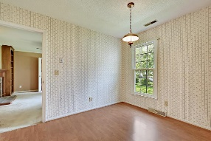
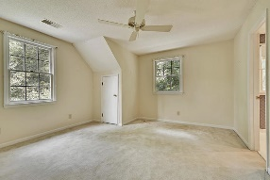
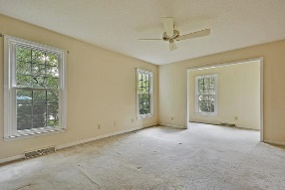
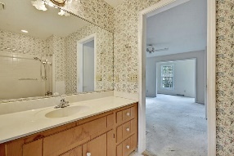
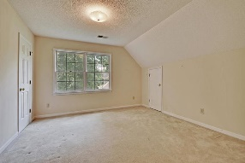
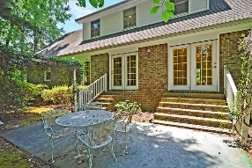
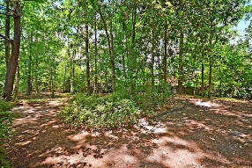
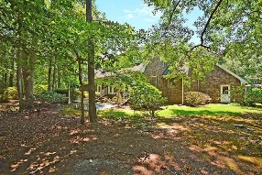


Great Home in Established Summerville Neighborhood
111 Delaney Circle
Ashborough East
Summerville, SC 29485
MLS# 19018490
$299,000
4 Bedrooms | 2½ Baths | 2,434 sf
Welcome home to this lovely, brick home located in the established neighborhood of Ashborough East. This home is ready for you to make your own! Great floor plan, curb appeal galore and large lot, makes this a house to see! Upon entering, you'll step in to the welcoming foyer. To your left, is a formal living room/office space with a fireplace and brand new carpeting. Straight ahead, is a very large family room, with beautiful wood floors and a fireplace. Step through to the dining room, which is a great size for entertaining. The kitchen has an eat in area as well as access to the garage and laundry room. On the other side of the home, is the huge master suite. This room has a large sitting area that can be used as a home office, nursery, you name it! The master also offers a walk-in closet and full bathroom. Upstairs, you'll find three more bedrooms, a full bath and walk in attic space. The backyard of this home is a nature lover's paradise! Very private with a large patio with arbors surrounding it. Ashborough East offers tennis courts, playground, clubhouse and pool! Centrally located off of Dorchester Rd, this house is close to Boeing, Bosch, Volvo and Palmetto Commerce Park. This is the home you've been waiting for, under $300k in Dorchester District 2 school system! Come see this home today!!
Larry & Kathy Mazalatis
Larry Cell 843-693-0529
Kathy Cell 843-693-0159
Office 843-871-9133
AGENTOWNED PREMIERE GROUP | 1800 TROLLEY RD | SUMMERVILLE, SC 29485

