Slide 1
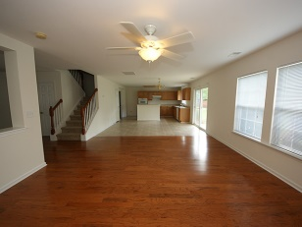
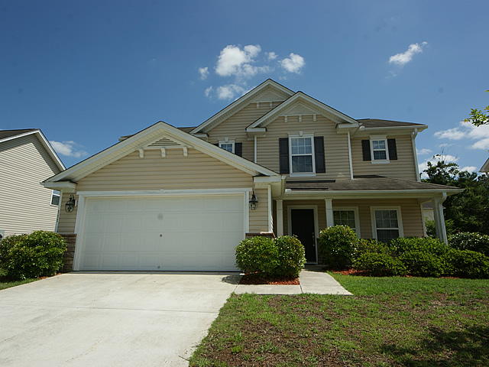
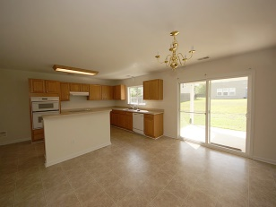
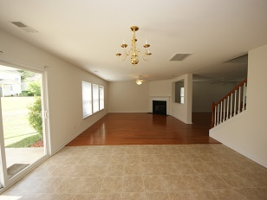
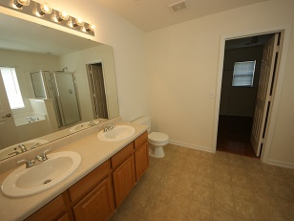
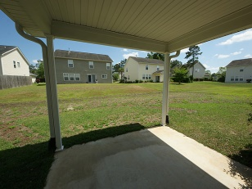
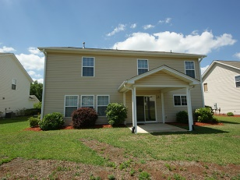

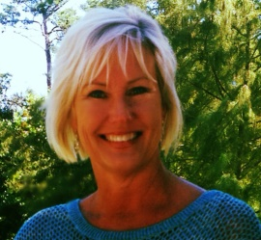
Reduced and move-in ready
2 Bedrooms | 1½ Baths | 1,000 Sq Ft
111 Graduate Ln
Eagle Run ~ Ladson ~ MLS# 1411248 ~ $199,900
Enjoy this 4 BR, 2.5 BATH, that has gleaming wood floors, upstairs and downstairs. All neutral colors, with high smooth ceilings. Formal living room and family room with gas fireplace. Laundry room is between kitchen and garage and is spacious. Entertain your guests in your large kitchen that has abundant counter space and a walk-in pantry. There is a covered patio leading from the kitchen to outside. Upstairs there are 4 true bedrooms, all with ceiling fans. A roomy master bedroom features a huge walk-in closet. The master bath has dual vanities, separate shower, and a jetted tub. Located just minutes from Dorchester II elementary and middle schools, Boeing, Bosch, hospitals, and Tanger Outlet Mall. Vacant and easy to close quickly.
B C D Properties LLC
123 Piccadilly Loop
Summerville, SC 29483
Nancy Stewart
843-408-6251 M
knstewart81@gmail.com

