Slide 1
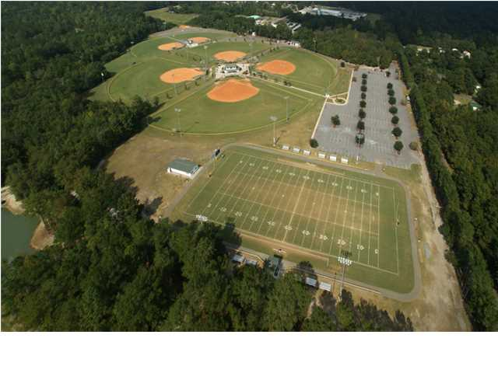
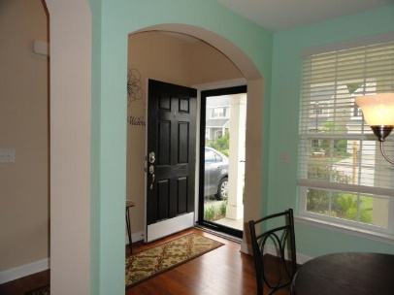
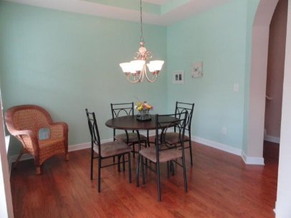
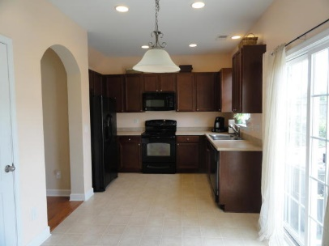
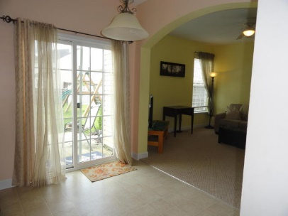
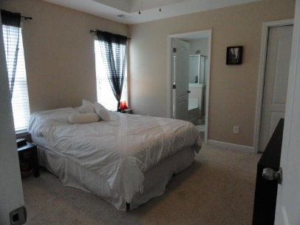
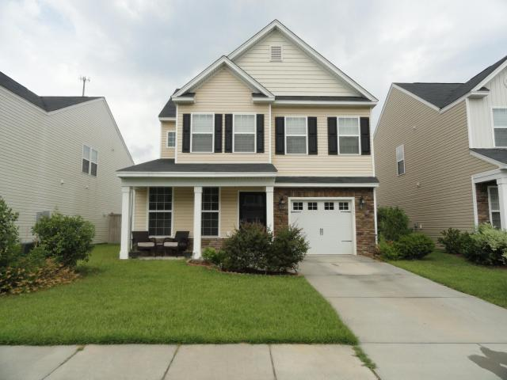
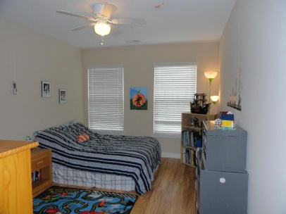
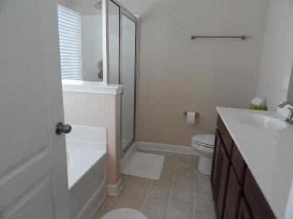


111 Longford Drive
Wentworth Hall | Summerville, SC 29483 | MLS# 16017473 | $179,000
JUST LISTED
Priced to Sell!
Great 3BR/2.5BA home under $180,000 with so much to offer! Foyer has a drop zone for bags, coats, keys, etc plus hardwoods throughout Dining Room, Double-Door Hall Closet and front hallway. Half BA down. Step through the arched doorway into the eat-in Kitchen with large pantry, lots of cabinet and counter space, black appliances with refrigerator to convey. Great Room (14x14) off Kitchen has new Berber Carpet. All window treatments to convey. Step outside to the fully fenced backyard overlooking a pond. Enjoy 2 Patio spaces(one added 6/15),a garden and hot tub. Play set can also convey. Upstairs you will find the Master Suite with Trey Ceiling, separate Garden Tub and Shower, Dual Vanity and Walk-in Closet. 2nd BR has laminate flooring and Double-Door Closet. Laundry Room is up, Linen Closet and Full Bathroom with Single Vanity and Tub/Shower. Smooth Ceilings throughout, Ceiling Fans in all rooms, Termite Bond and Home Warranty thru AHS.
Beth Mandell
M 843-900-1296 | O 843-871-2121
bmandell@century21properties.com
www.bestcarolinahomedeals.com
Century 21 Properties Plus of Summerville | 118 W Richardson Ave | Summerville, SC 29483

