Slide 1
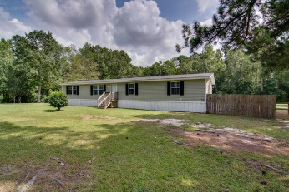
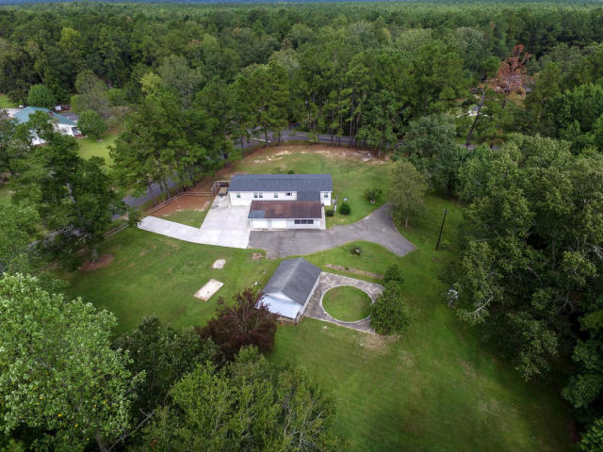
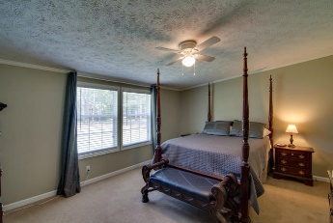
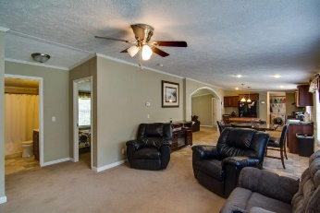
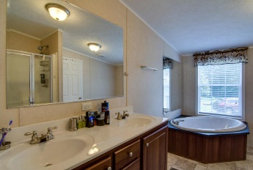
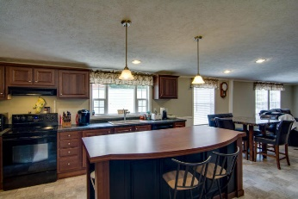
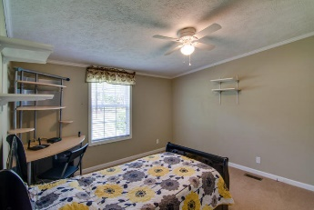
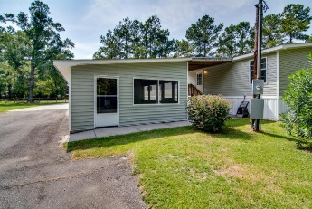
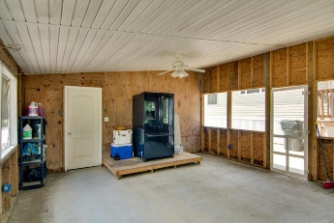
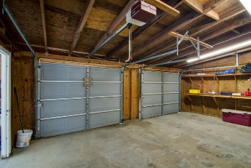
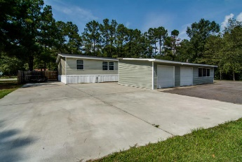
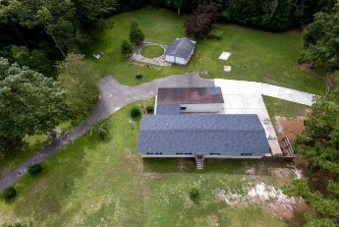


Highly Motivated Seller
Bring Offers!
Available
Nov 1st!
111 New Hope Drive
New Hope Estates ~ Summerville, SC 29483
MLS# 16024751 ~ $220,000
This is truly a must see property. The paved driveway leads you into almost two acres of cleared land and totally functional. The 2100 sq. ft. open concept mobile is only 4 years old and beautiful inside. The well appointed eat-in kitchen has an island for added seating and is open to the living room and family room. The master is large and its bath has 2 sinks and a separate tub and shower and, of course, a large walk-in closet. The other 3 bedrooms are large as well. Also, a large laundry area is off of the kitchen. Now outside is so beautiful with a huge screened-in porch steps away from the home. Next to the screened-porch is a huge 2 car garage. Beside the garage and home is a huge cement area where you can park any large vehicle that you may have. That's not all for there is another out building that can be used as either another garage or workshop, When you arrive to see this beautiful place, I bet you will wander around as I did and wonder what it must be like to live on such a wonderful piece of property.
Liz & Bob Simonds
843-437-9696
lizandbob@agentowned.com
AGENTOWNED REALTY CO. PREMIER GROUP, INC.
141-A N. MAIN STREET
SUMMERVILLE, SC 29483

