Slide 1
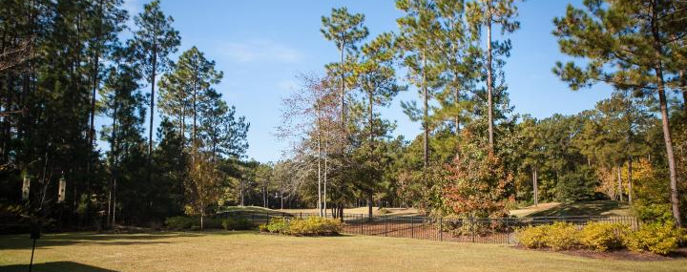
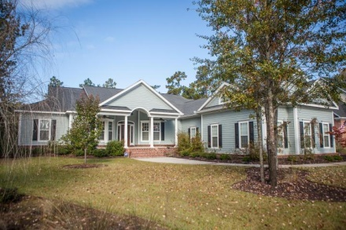
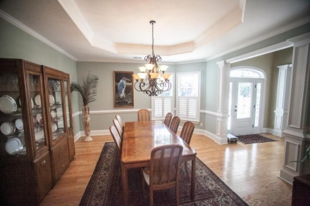
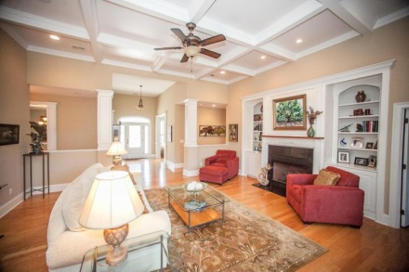
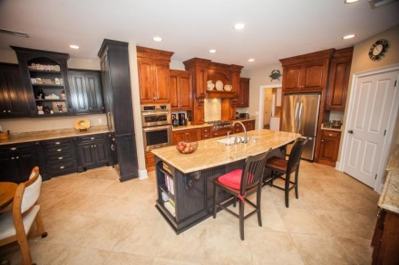
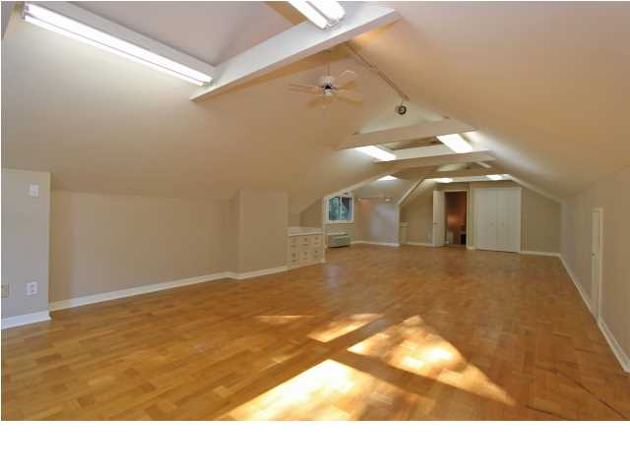
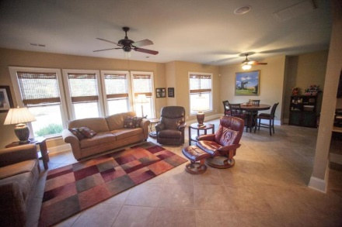
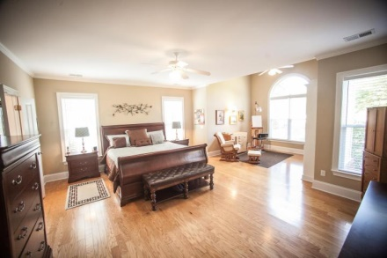
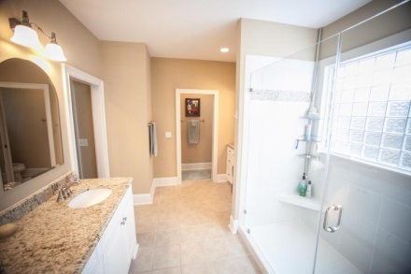
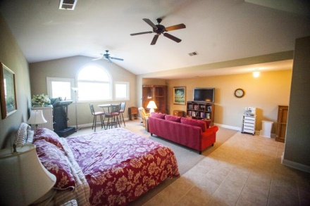
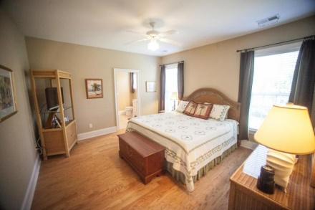
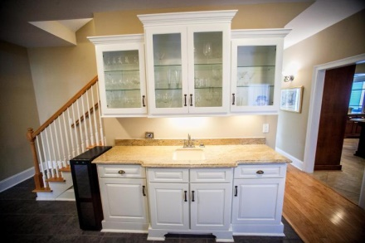
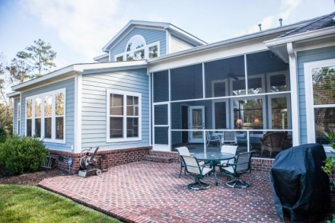
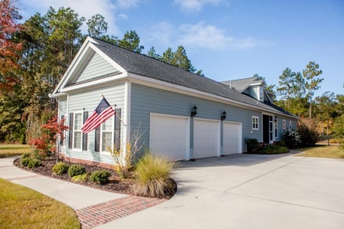


111 Pine Valley Drive Summerville ~ MLS# 14028776 ~ $660,000
Incredible Value on the Pine Forest Golf Course!
Custom Built Executive Home on the 4th Fairway! This home belonged to one of the areas most respected builders! Custom designed from the ground up. All through out this home you will find attention to detail and cement siding! Extra wide hallways, coffered ceilings, huge sunroom, gourmet kitchen, custom built cabinets! Brick Patio, 2 tankless gas hot water systems.
Built in lighted vanity in master bath. Open floor plan, FROG, In law suite, large golf course lot with fenced yard. 3 car garage, Wonderful golf course views. Oversized laundry room, Eat in kitchen with island. Community club house, swimming pool and tennis courts, great room, Natural gas heat and cook top. Wet bar, Gorgeous wood floors. Study/Office. Fireplace in the family room. Ceramic tile floors, walk in closets and more...
Christopher McCormick
Office - 843-974-6200
Cell - 843-224-3204
cjmccormick@carolinaone.com
Carolina One Real Estate
900 N Main St
Summerville, SC 29483

