Slide 1
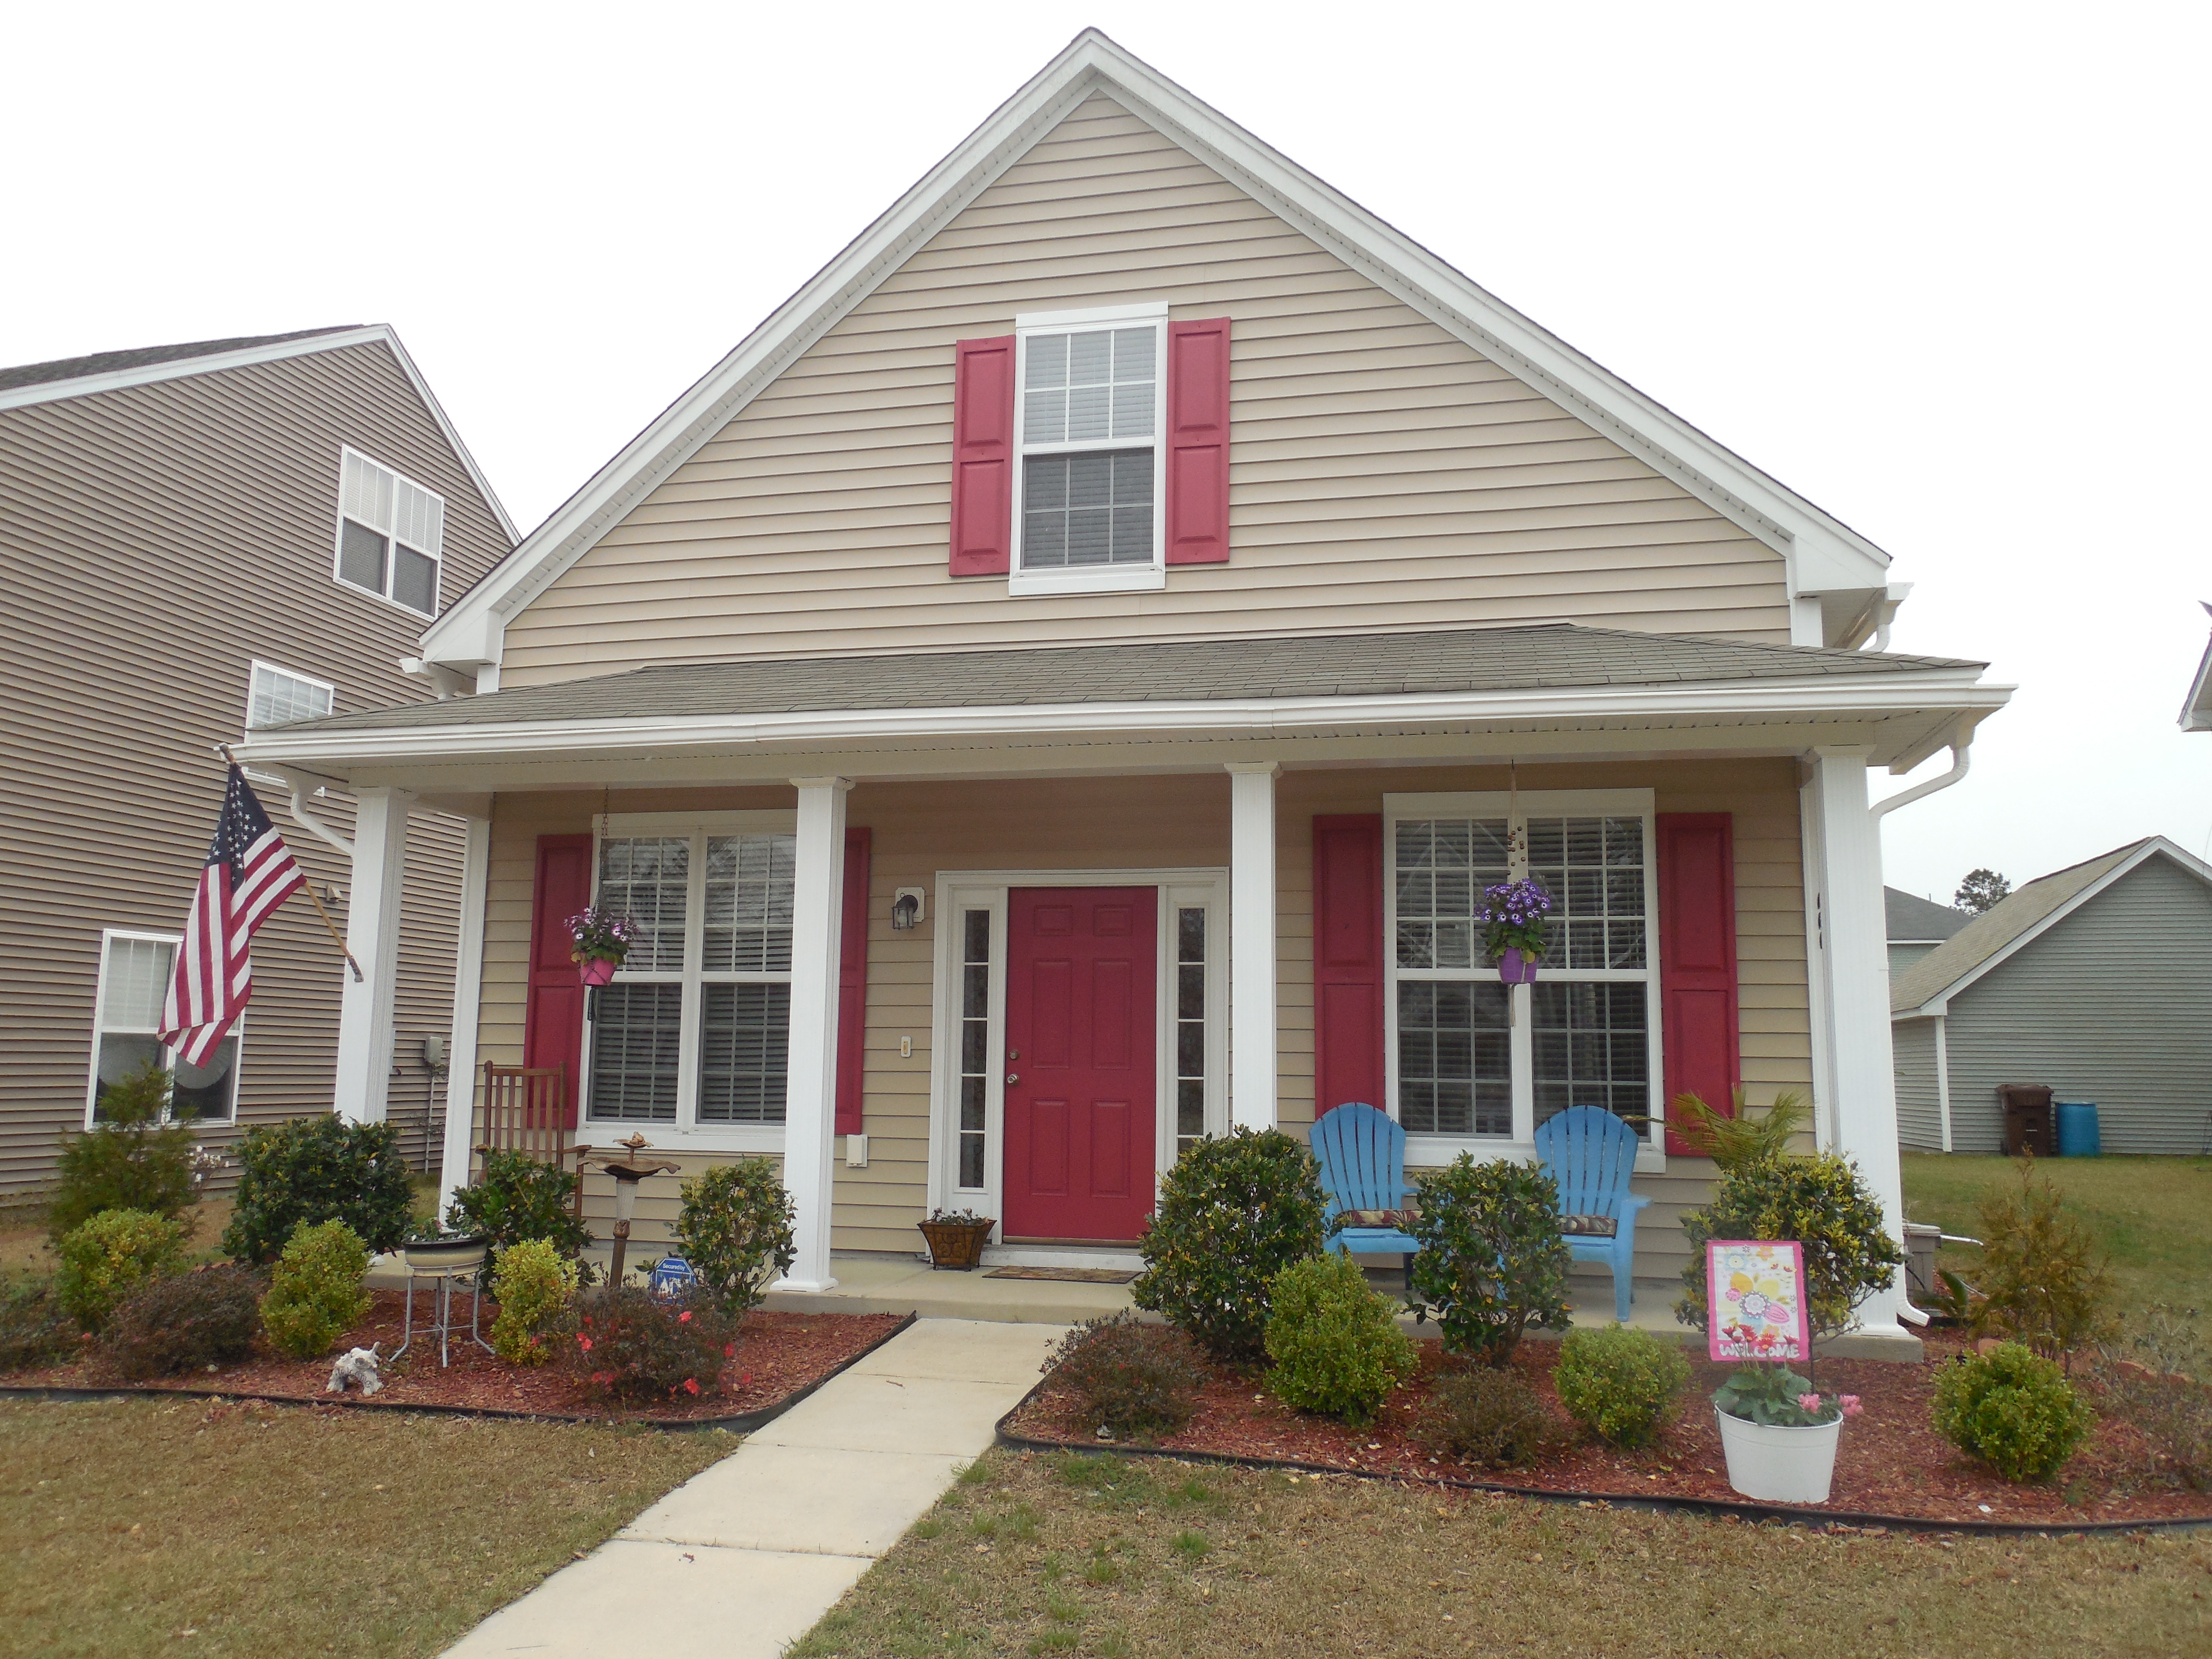
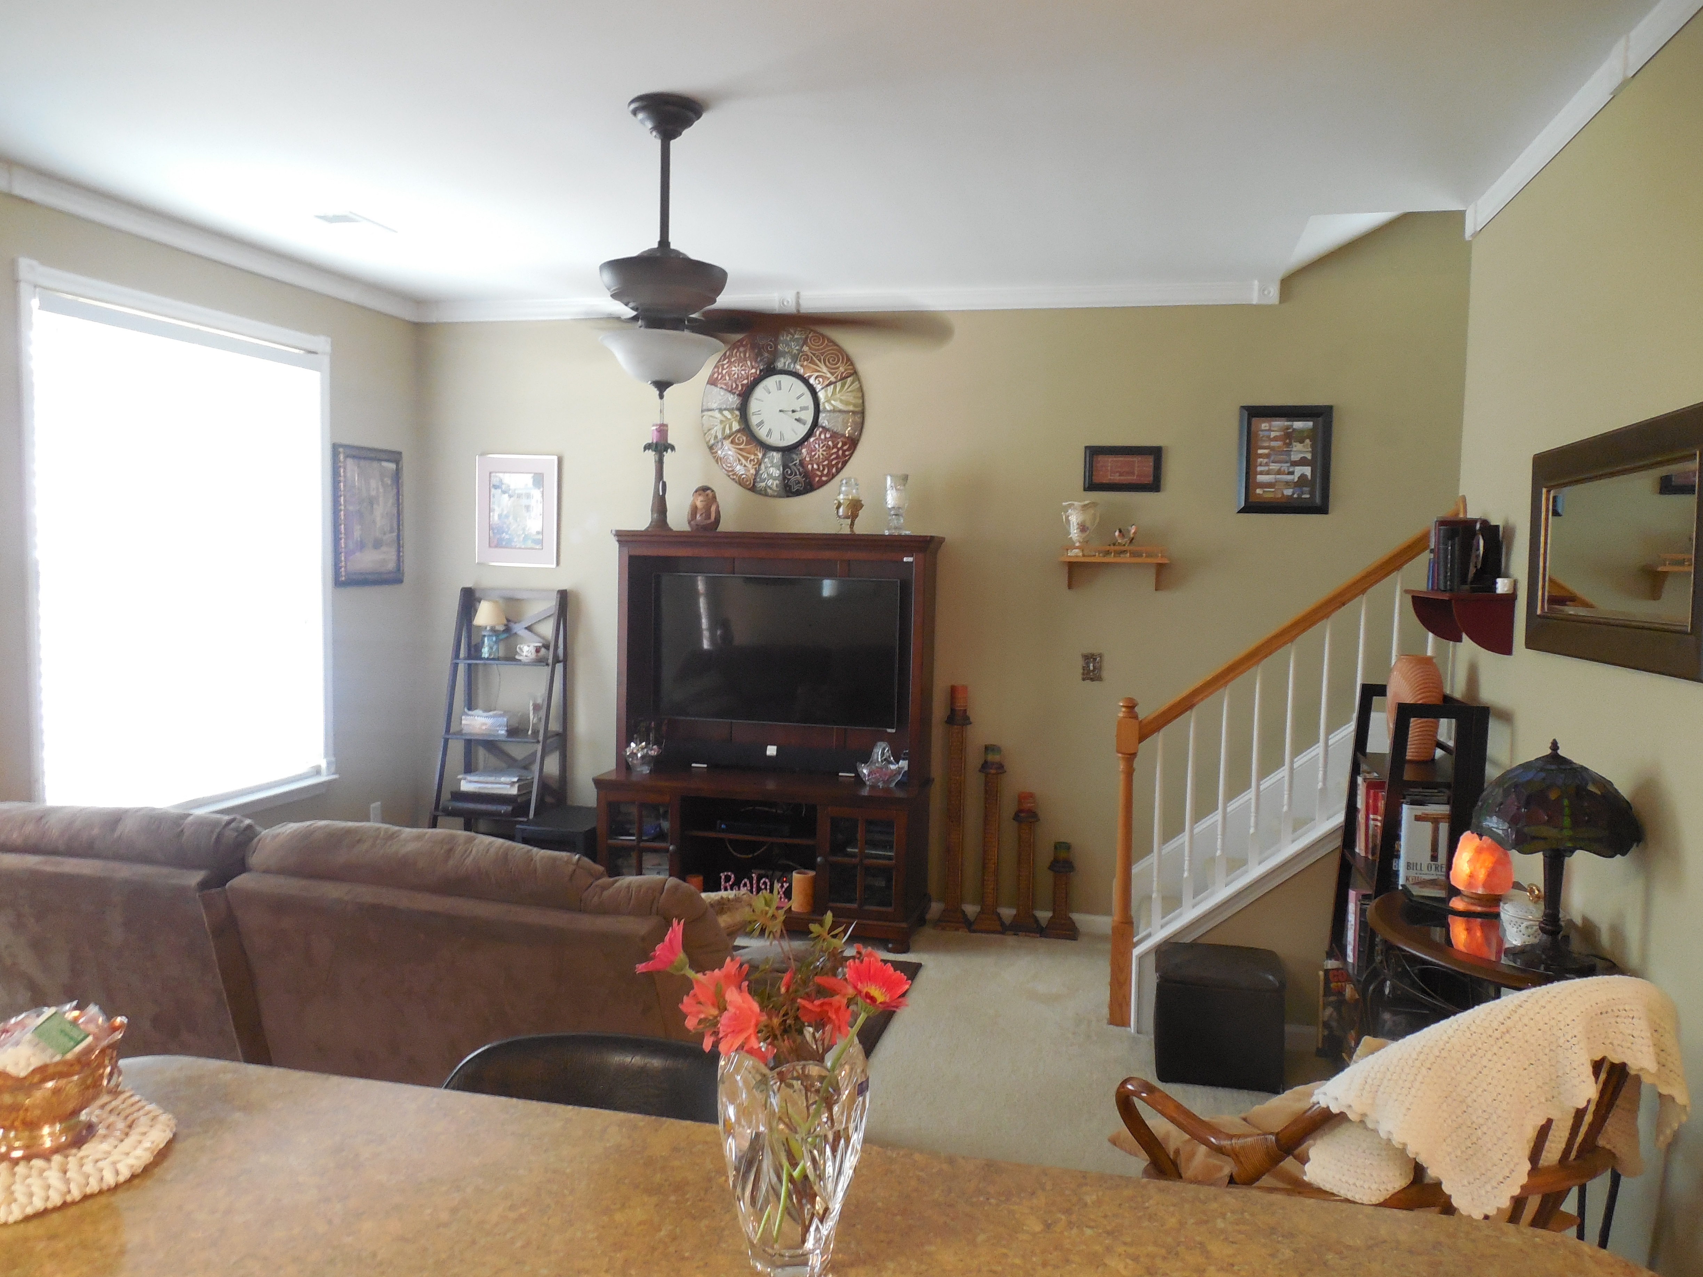
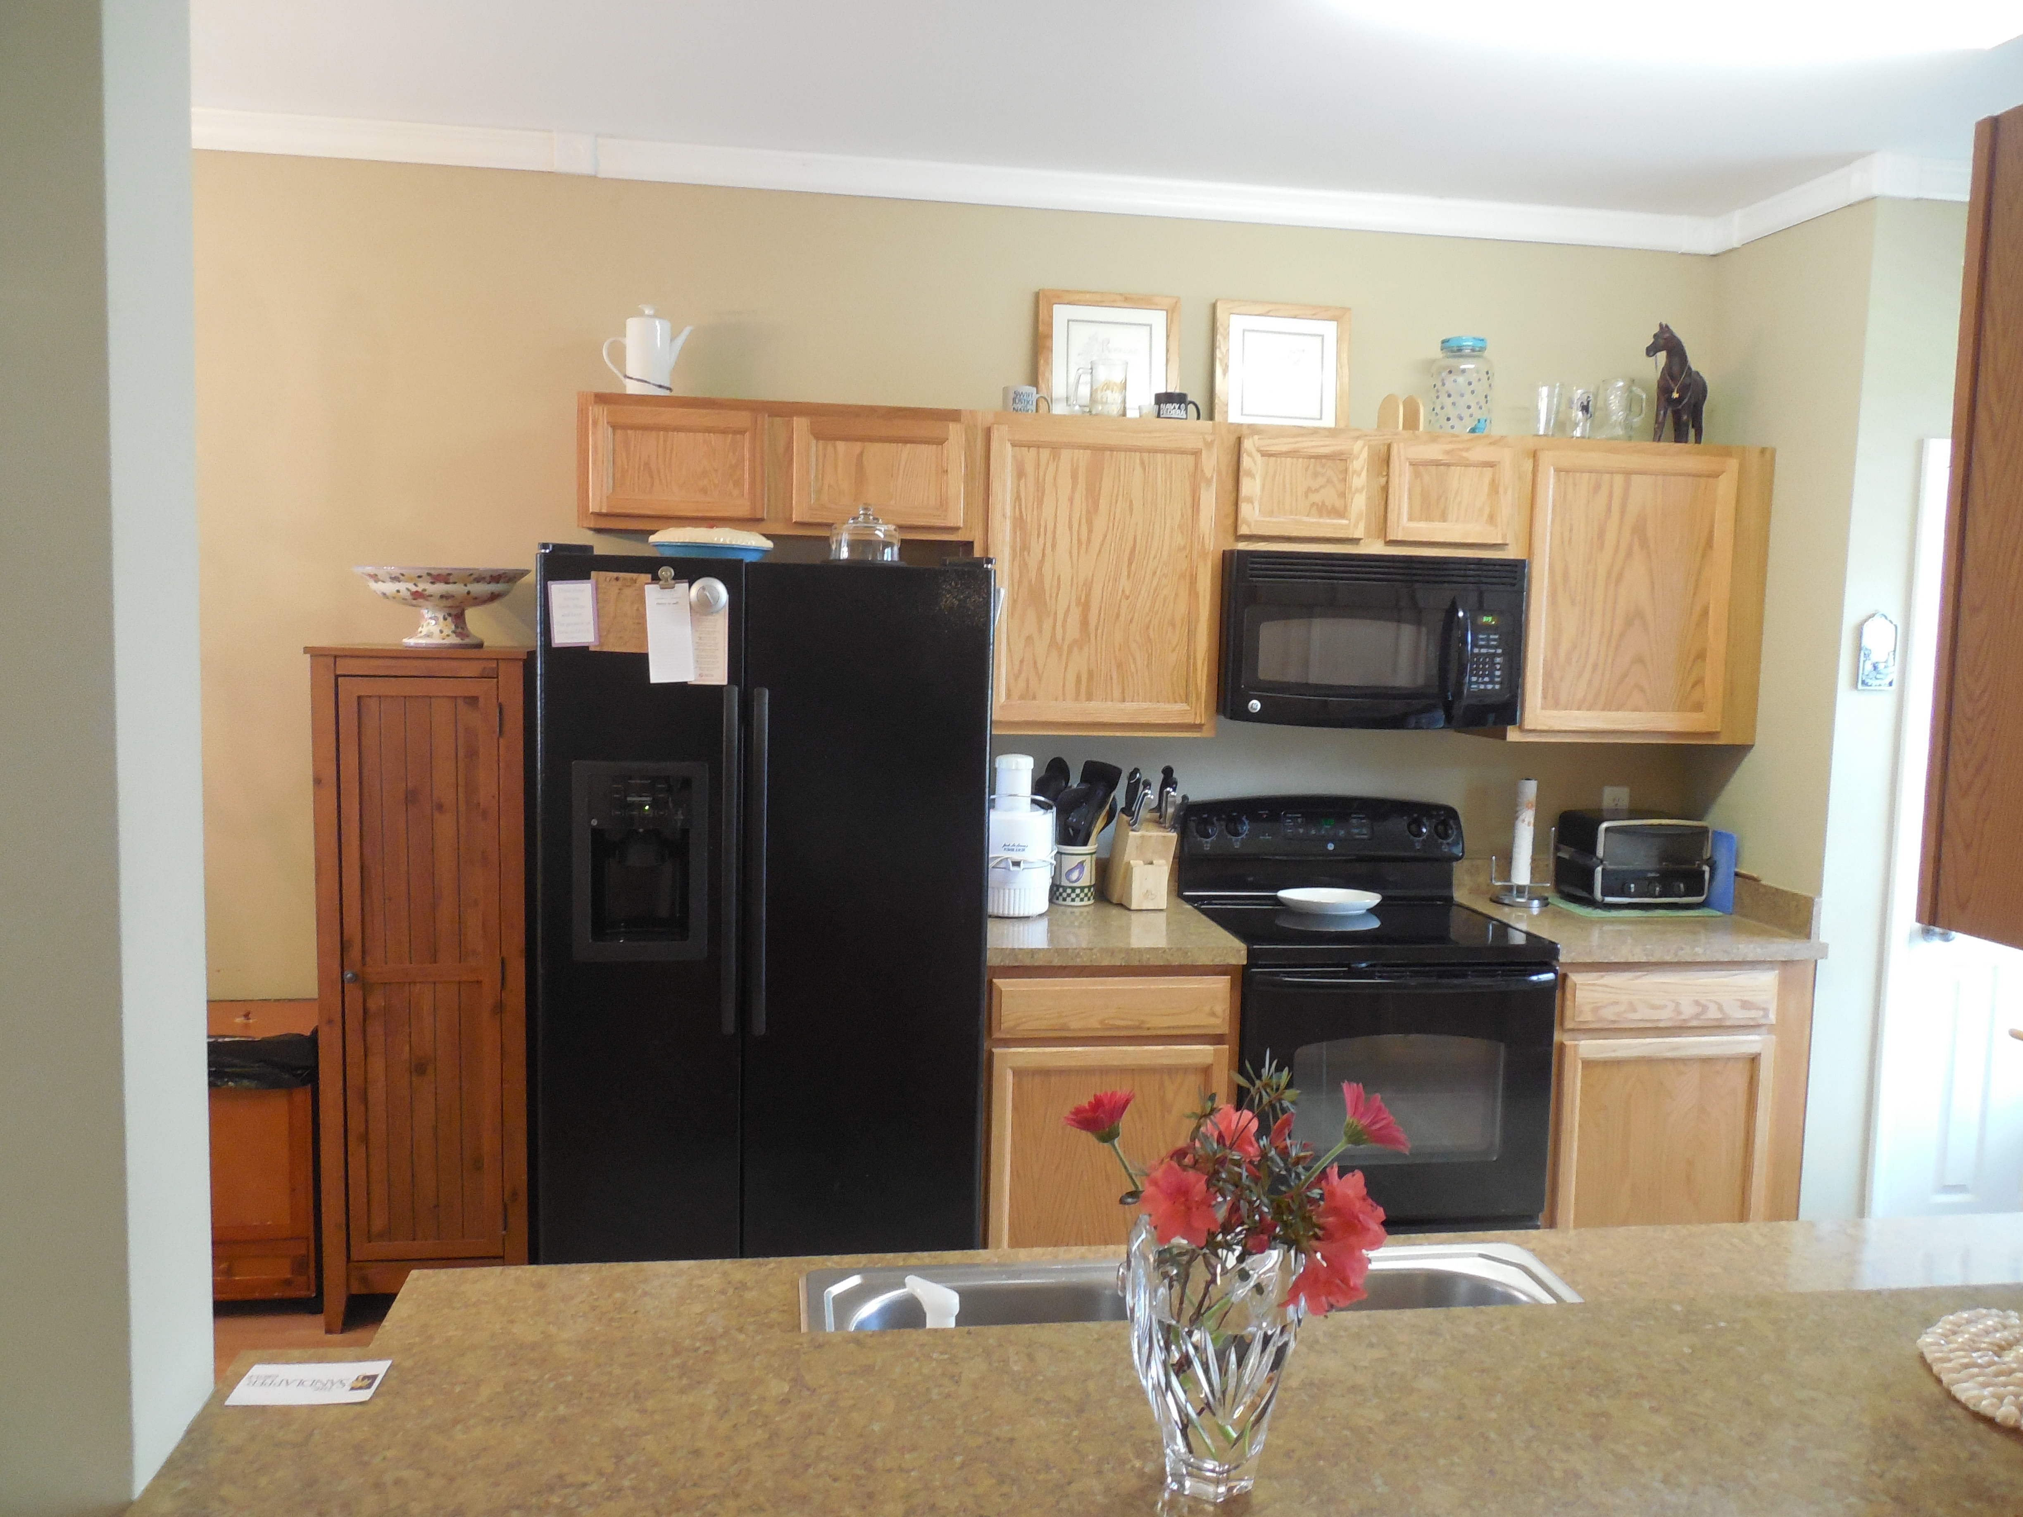
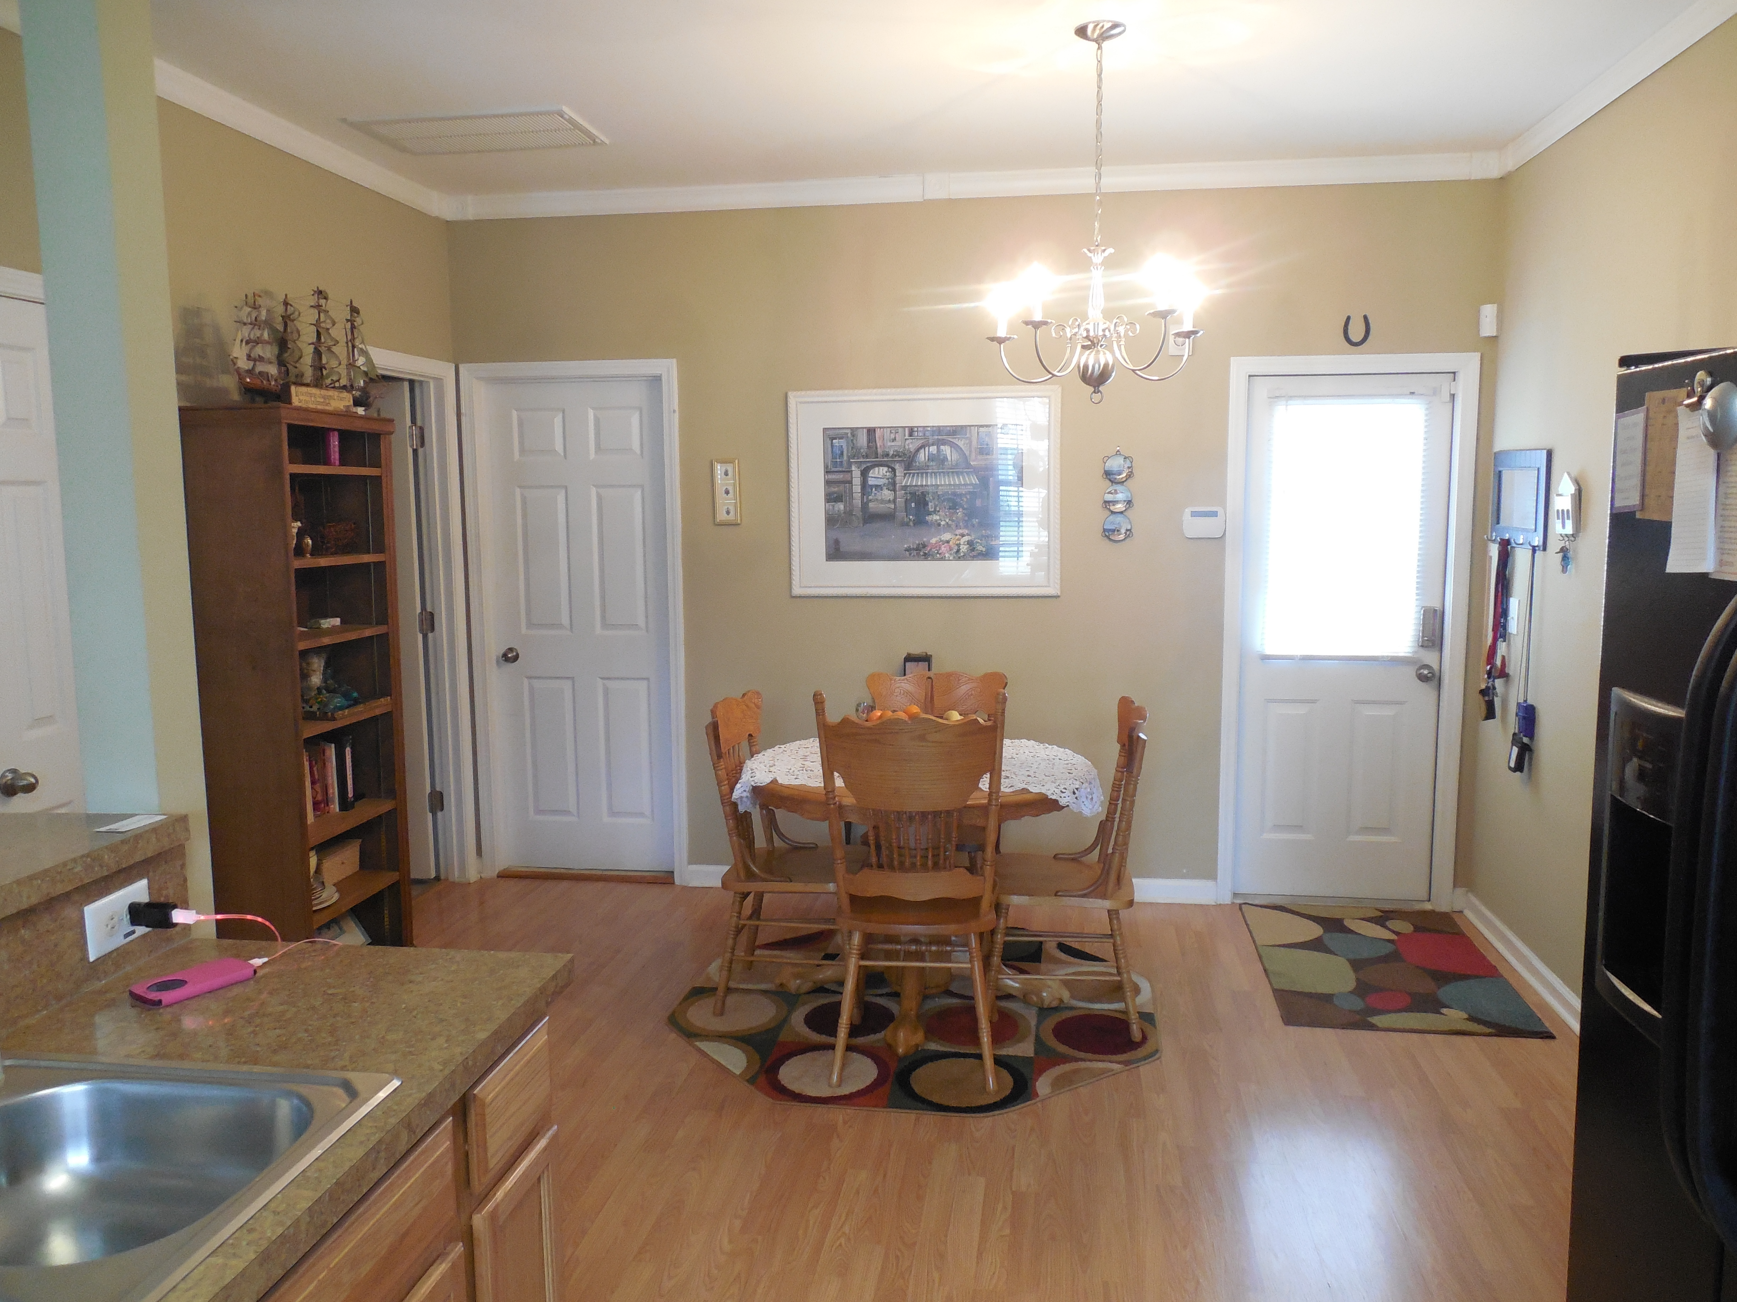
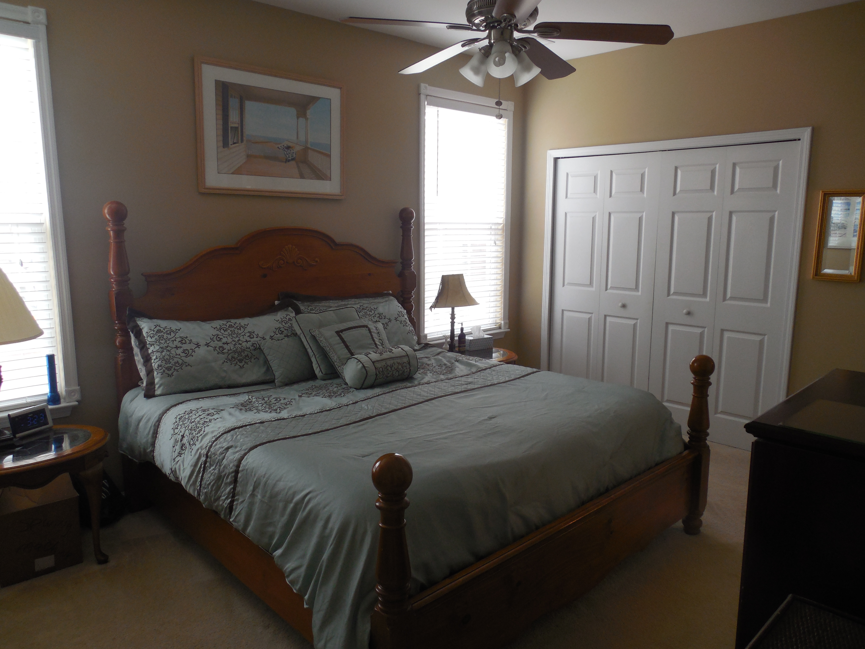
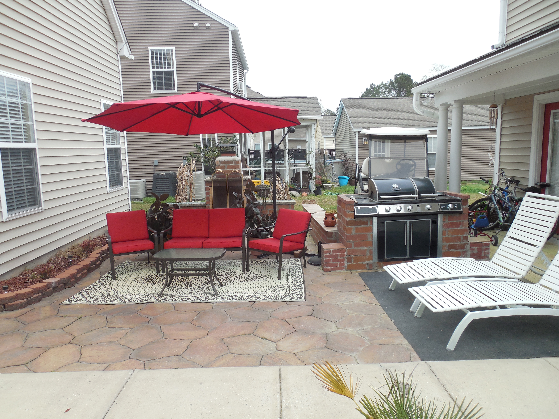
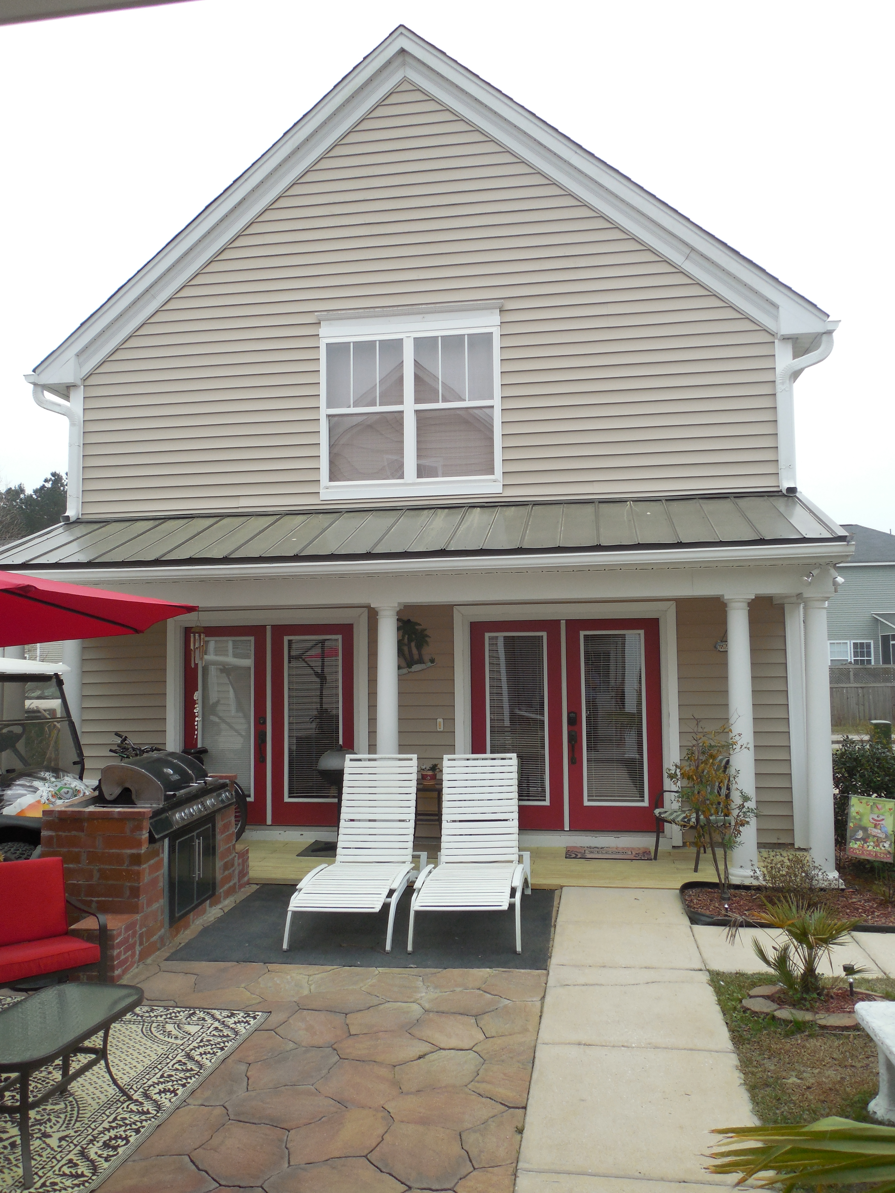


Must See!
Open House
Saturday, May 7th 11-2
111 Red Leaf Boulevard
Foxbank Plantation · Moncks Corner · MLS# 16007513 · $209,000
Rodney Hancock
(843) 437-1347
rodneyhancock08@gmail.com mortgageprofessionalsonline.com
Must see! Adorable 3 bedroom 2.5 bath two story home In Foxbank Plantation. Down stairs master bedroom and two generous bedrooms, bath and laundry upstairs. Main house is 1404 sq. ft. This property includes a 830 sq. ft. Carriage house, which was the Original Sales office for Foxbank Plantation. Trees inside were the first trees they cut down in the neighborhood. Owner uses for her at home Ebay Business. Ideal for that as you will see, perfect for guest or mother in law suite. Equipped with a bedroom downstairs and a full bath. Upstairs has an office and owner added 90sqft upstairs by having the floor finished across the room upstairs. This is a must see, nothing like it around. This house can be eligible for 0.5% of the loan amount cash back toward closing costs. Ask me how!
AgentOwned Charleston Group
902 Savannah Hwy
Charleston, SC 29407
Real Estate ● Mortgage Insurance ● Business Brokerage

