Slide 1
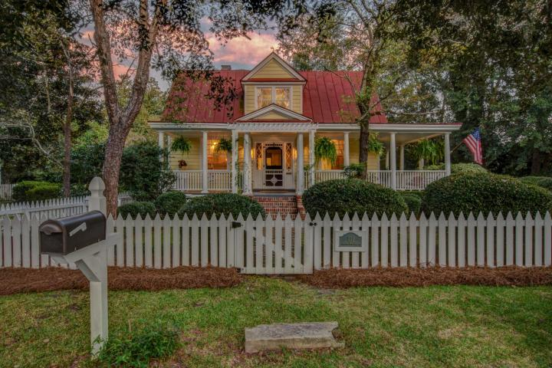
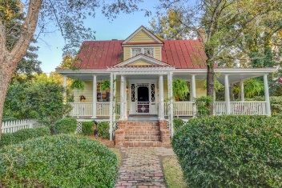
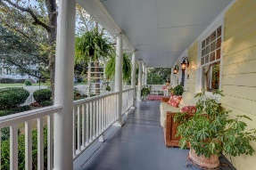
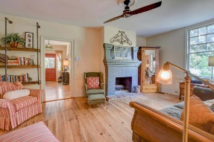
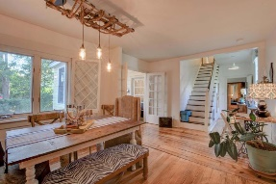
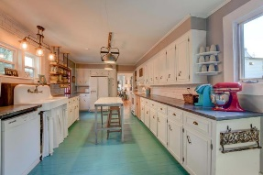

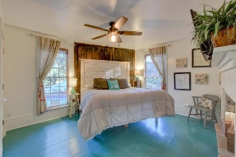
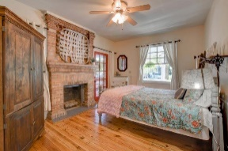
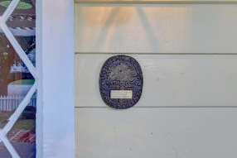
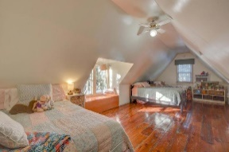
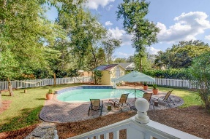


Spectacular Historic Home With Quintessential Southern Charm!
111 S Magnolia Street
Historic District
Summerville, SC 29483
MLS# 17025499
$479,900
5 Bedrooms | 3½ Baths | 3,200 sf
From the white picket fence to the wraparound porch & red metal roof, this home EXUDES Character from the moment you lay eyes on it. The porch, yard & pool are the reason sweet tea was invented...so you can unwind, relax & abide in the dream of true Southern living. Built circa 1880 & known as ''The Kennedy House'', this home is on the National Register of Historic Places. Inside, be WOWED by refinished heart pine flooring, remodeled kitchen, remodeled master suite, new HVAC & ductwork & new PEX plumbing. This is a rare find that simply cannot be outdone by modern homes. Not only that, but you also can't beat the LOCATION! All of Summerville's soul is a quick stroll away - from Town Square to Azalea Park to the Farmer's Market.
This is the first home ever purchased and completely restored by the Summerville Preservation Society (in 1979). It has also been LOVINGLY updated and cared for by the current owners. Besides the refinished floors, remodeled kitchen & master suite, new PEX plumbing and the fresh interior paint, the exterior has also been recently repainted, an all new HVAC unit and ductwork has been installed and the yard was completely re-sodded. Surrounded by hardwood trees like magnolias, river birches, oaks and dogwoods and flowering plants like azaleas and camellias - there is plenty of nature to admire & enjoy.
There are too many other details to mention here!
Larry Mazalatis
843-693-0529
mazteamrealty@gmail.com
Jim Brantley
(843) 412-7647
brantleyjim@gmail.com
AGENTOWNED PREMIERE GROUP | 1800 TROLLEY RD | SUMMERVILLE, SC 29485

