Slide 1
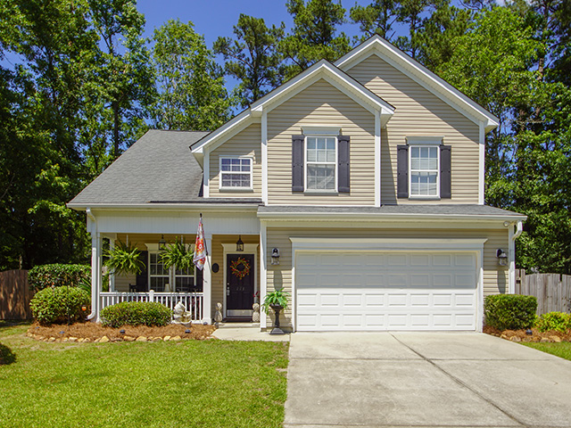
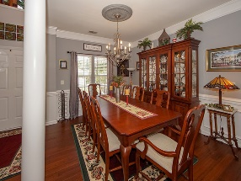
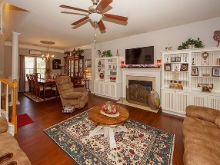
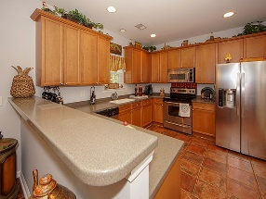
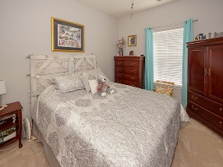
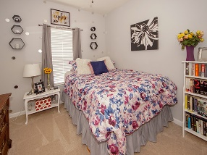
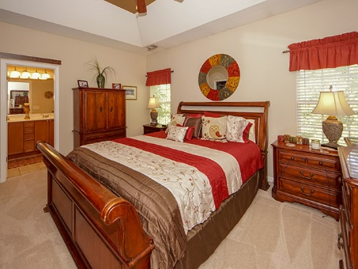
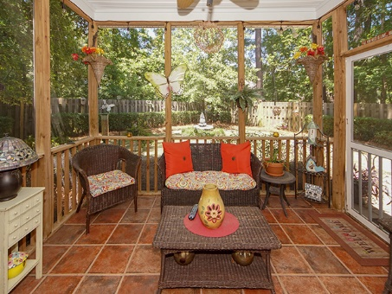
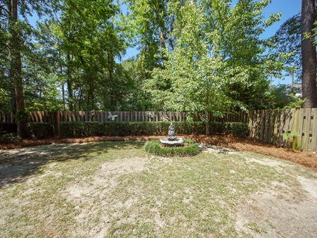


111 Salinas Court
Plum Creek
Summerville, SC 29483
MLS# 19014281 | $244,900
1,870 Sq Ft - 4 Bedroom – 2½ Bath
LOCATION, CONVENIENCE, LIFESTYLE!
Paradise awaits you at this Plum Creek cul-de-sac home! Beautiful and spacious both inside and out, this house consists of style and function. The downstairs has newly installed bamboo flooring with an open floor plan that includes a generous great room and dinning area with crown molding and wainscoting .You will enjoy the gourmet kitchen with stainless appliances which is ideal for family gatherings. The eat-in-kitchen, laundry room, kitchen area, and back patio all have a stylish Spanish tile flooring, which is perfect for entertaining and easy clean up. The great room has a gorgeous fireplace, ceiling fan, and lots of windows to allow for natural light. This house is move in ready and has recently been painted throughout including garage.
The kitchen is equipped with corian countertops, a built-in desk, and a half bath that is located to the right, as you enter the kitchen. The upstairs has brand new carpet throughout. The master bedroom has a ceiling fan and large walk-in closet. The master bath has dual sinks, a garden tub and shower with plenty of storage space. The other three bedrooms have ceiling fans and spacious closets. The upstairs guest bath has a vanity with a shower/tub combo. The tranquil backyard is enclosed with a wooden privacy fence, with beautiful landscaping, an outdoor utility shed, and a relaxing fire-pit area . This house has been well-maintained, now all it needs is YOU! Note: The neighborhood is in the desirable Dorchester District Two schools as well as one of the best private schools in the area. It is close to shops and offers fast and easy access to major roads such as Old Orangeburg Road, and Highway I26.
Brand Name Real Estate
4 Carriage Lane Suite 106
Charleston, SC 29407
Barbara Limehouse
843-870-8291
bllimehouse@gmail.com

