Slide 1
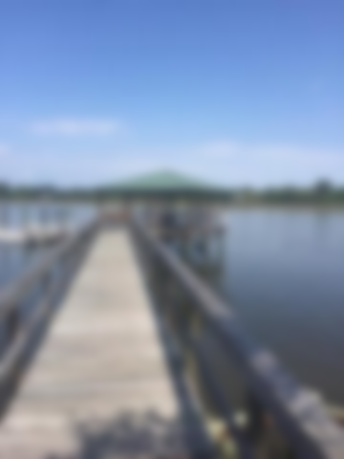

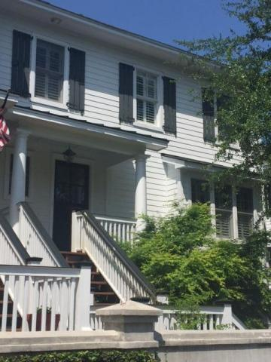
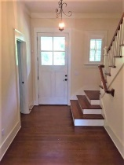
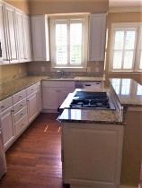
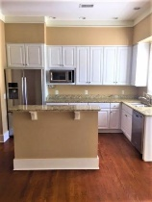
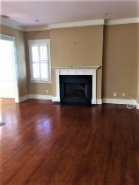
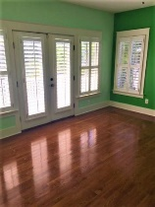
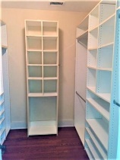
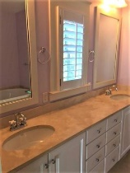
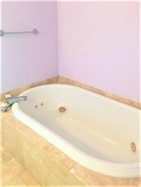
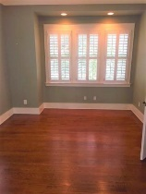
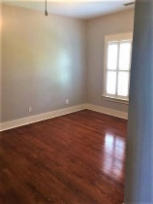
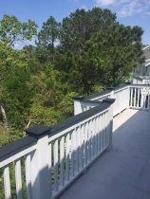
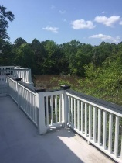
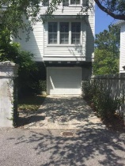
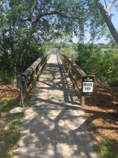
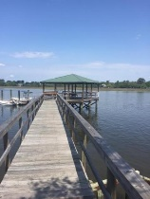
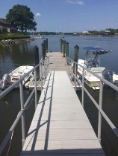



Rare Find In A Spectacular Setting!
Agent Open House
Saturday July 22nd 12pm-2pm
111 Wappoo Landing Circle
Wappoo Landing
Charleston, SC 29412
MLS# 17012789 | $490,000
3 Bedrooms :: 3 Bath :: 1,963 sf
Wappoo Landing is a quaint waterfront community that sits directly on the Wappoo Cut/Intracoastal Waterway and is just minutes to downtown and beaches. The community offers fantastic views of the beautiful marsh and from the private dock, views of Wappoo Cut. The deep-water dock has running water and electricity and is perfect for your boating entertainment. This bright end unit has an open floor plan with oversized windows with custom plantation shutters throughout, gas fireplace, attractive woodwork, a built-in desk, smooth 9'ceilings and hardwood floors throughout. The first level has beautiful site finished oak floors, a generous open floor plan and is filled with lots of sunlight. The kitchen is complete with granite countertops and stainless steel appliances. There is a great bonus room on this floor due to the multi purpose room which could be a 3rd bedroom, office, library or media room. Current owner is using it as a guest bedroom with its own full bath. Upstairs you'll find the master suite, guest suite, and laundry room. The master suite has French doors leading onto the private deck, his and her vanities, soaking tub, and separate shower. Natural marble countertops and travertine shower and floors. HOA will be painting the exterior of this home beginning on June of 2017.
Matt Quinn
(843) 442-3512
mkquinn15@gmail.com
Charleston Real Estate Group 792 Folly Rd. C1 Charleston, SC 29412
www.charlestonrealestategroup.com
Jon Moore
(843) 732-3365
jonathanwyattmoore@gmail.com

