Slide 1
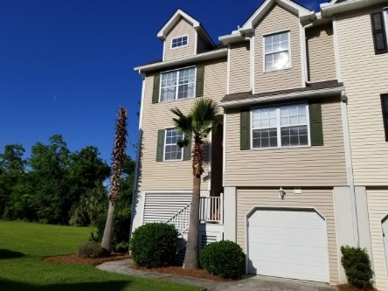
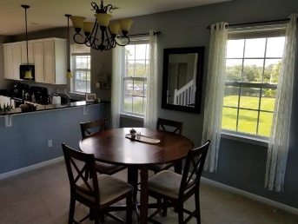
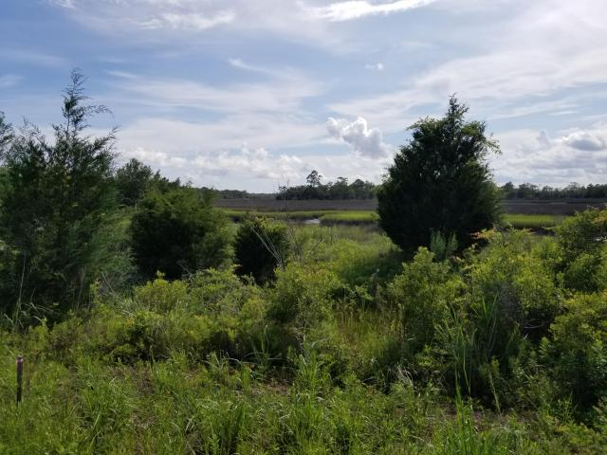
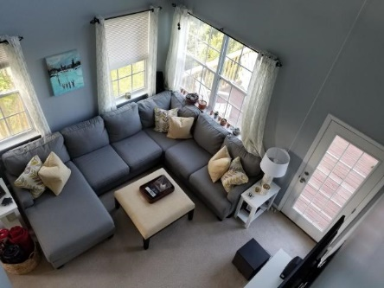
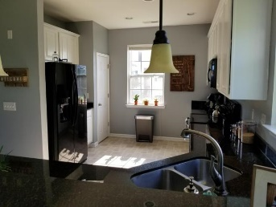
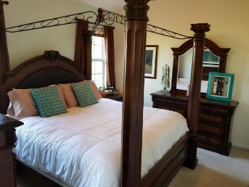
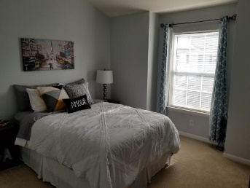
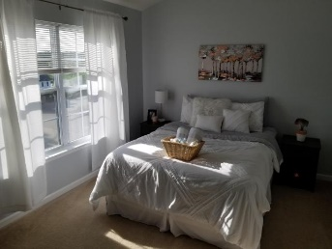
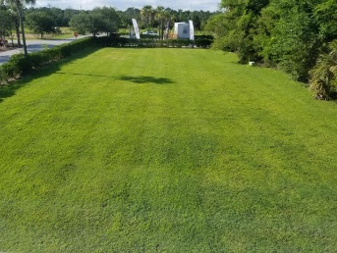
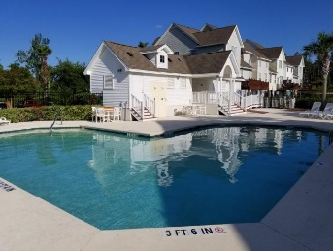


$1,500 Agent Bonus for Ratified Contract by 9/25 This Flawless End-Unit Townhome is Priced to Sell
111 Winding River Drive Marshview Commons ~ Johns Island, SC 29455 ~ MLS# 18018781 ~ $259,900
Flawless END unit townhome in the wonderful subdivision of Marshview Commons! Steps away from West Ashley Place, minutes to Citadel Mall, less than a half mile from Hwy 17, quick access to I-526, and located right across from the neighborhood pool! This deluxe 3 Bedroom plus office (which can EASILY be converted to a 4th Bedroom w/ closet), 2.5 Bath, unit is in flawless condition and comes with a 10 year warranty on the newly replaced HVAC unit (as of last year)! If you are interested in a turn-key purchase, then this end unit is especially enchanting. This townhome boasts with natural light which is easily noticed when walking into the living room with 18 ft. ceilings and tons of windows! Off the living room, you walk onto the back deck which is perfect for lounging and enjoying a drink.
The kitchen has plenty of cabinets and beautiful granite countertops with plenty of space for hosting any event. The master bedroom is conveniently located on the first floor and can easily fit a king-sized bed. The master bathroom has double vanity countertops, a stand-up shower, and separate garden tub. The office is also conveniently located downstairs and can easily be converted into a 4th Bedroom. As you step upstairs, you walk into the large, sunlit loft that overlooks the living room. The additional 2 bedrooms are located off the hall from the loft and have plenty of room for a play room, kid's bedroom, guest room, etc. The HOA covers everything from the studs of the house, out! Need a new roof? HOA takes care of that. HOA also covers flood insurance, lawn maintenance, and more! Back deck being replaced, the work order is currently filed with the HOA to fix. All furniture is negotiable!
Come by and see this gorgeous end unit today!
Nick Mazzilli (843) 640-5575
nick@nickmcharleston.com www.nickmcharleston.com
Reside Real Estate LLC
155 Wingo Way Unit 421 Mt. Pleasant, SC 29464

