Slide 1
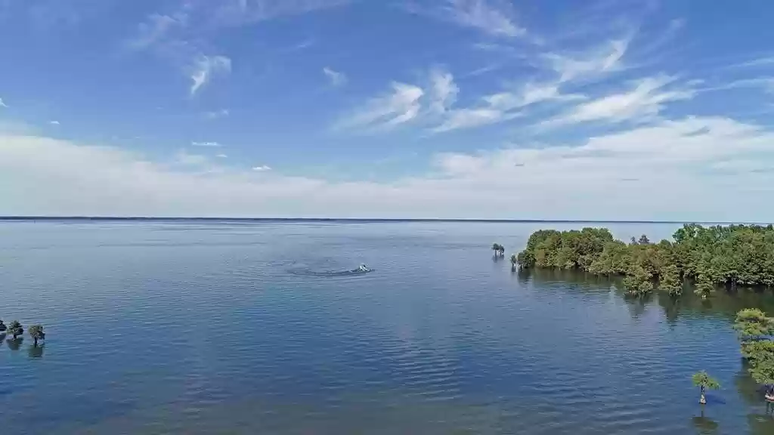
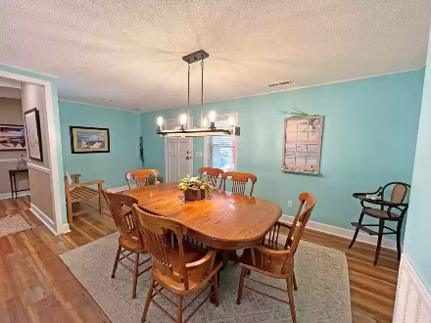
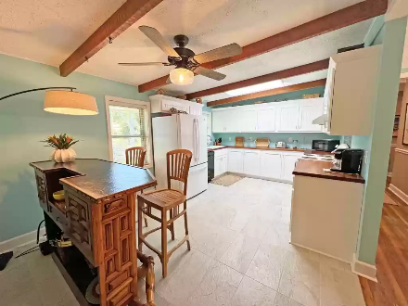
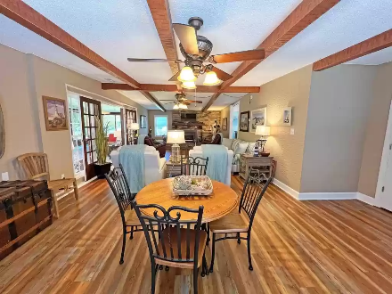
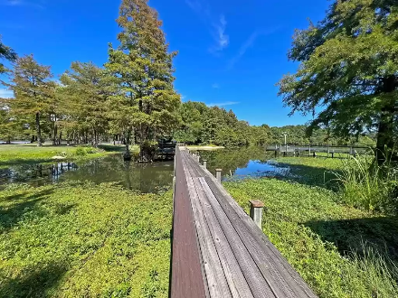

Waterfront Living
111 Belvedere Dr
Eutawville, SC 29048 ~ MLS# 152602 ~ $627,000
Fully Updated Ranch style House Waterfront on Lake Marion. Custom Kitchen with all new counter tops, Fully new custom tiled showers in guest and master baths, all new paint, HVAC and Duct work, New luxury plank flooring, all new flooring tile, new well and new floating dock. This home is ready to move in. Sitting just 1 hour or less from the Summerville/Charleston area and 1 hour from Columbia you can live and play at the lake full time. Ranch style means NO STAIRS to climb - you can retire here. No HOA to deal with - it is just you and the lake! See this one today before it is gone like the wind!
Lake Homes Realty, LLC
Elloree, SC 29047
www.SCLakeLife.com
Kristie Anderson
(803) 387-9459
kristie@sclakelife.com

