Slide 1
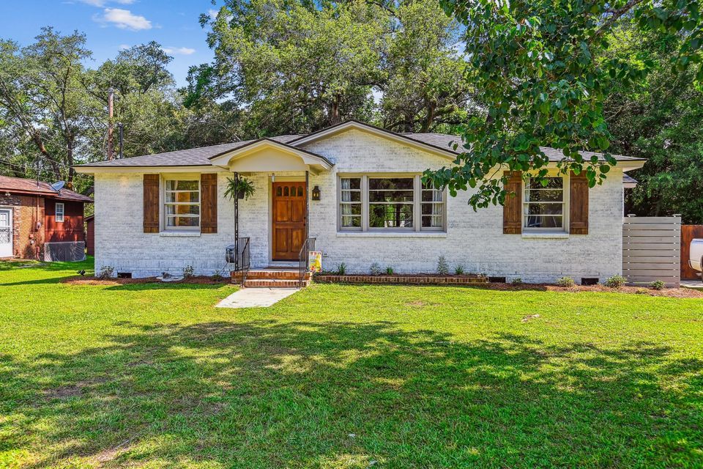
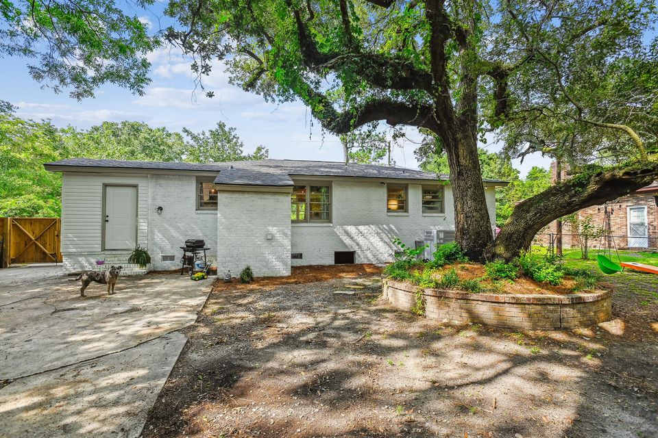
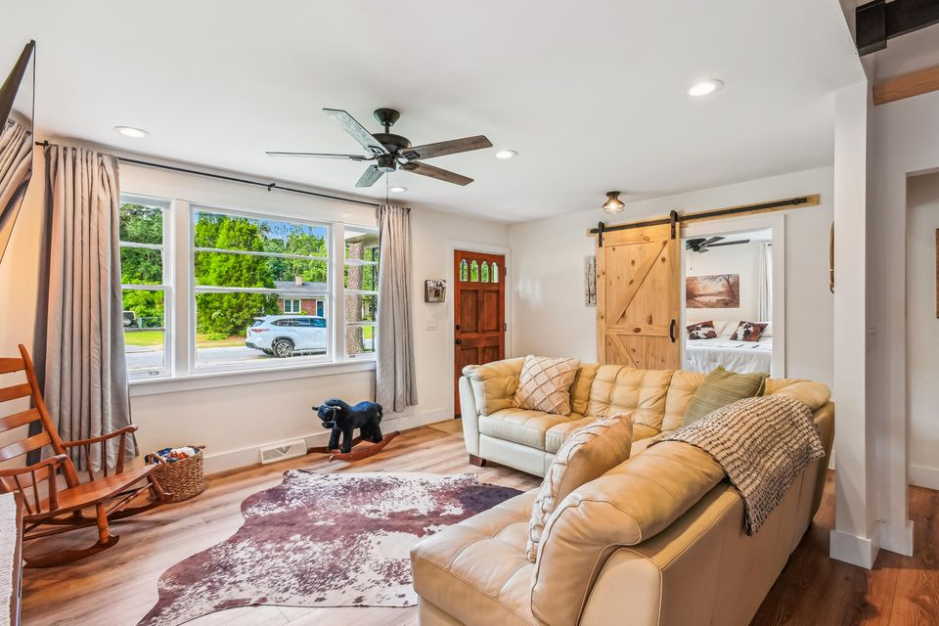
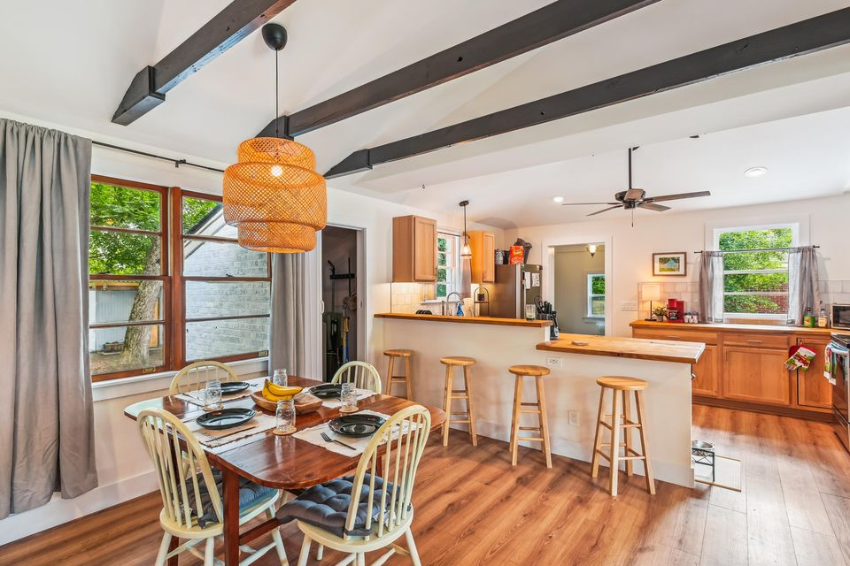
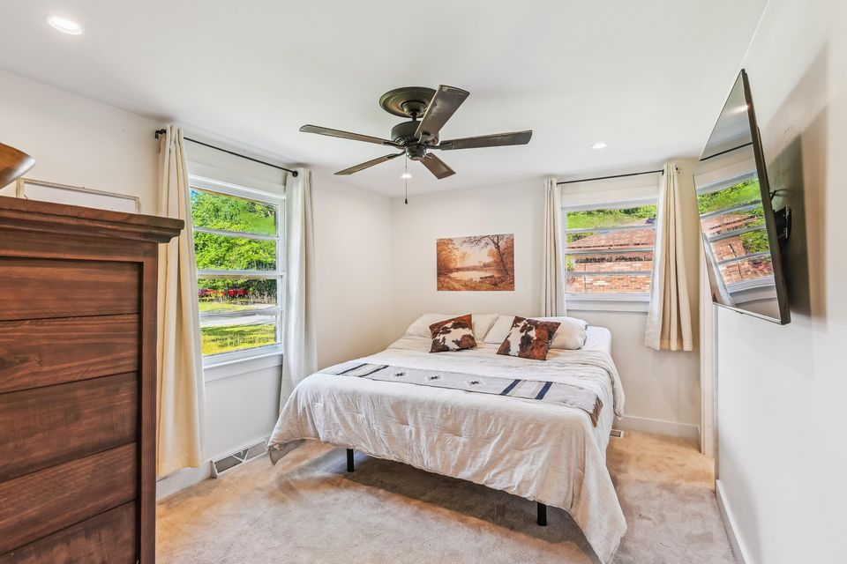
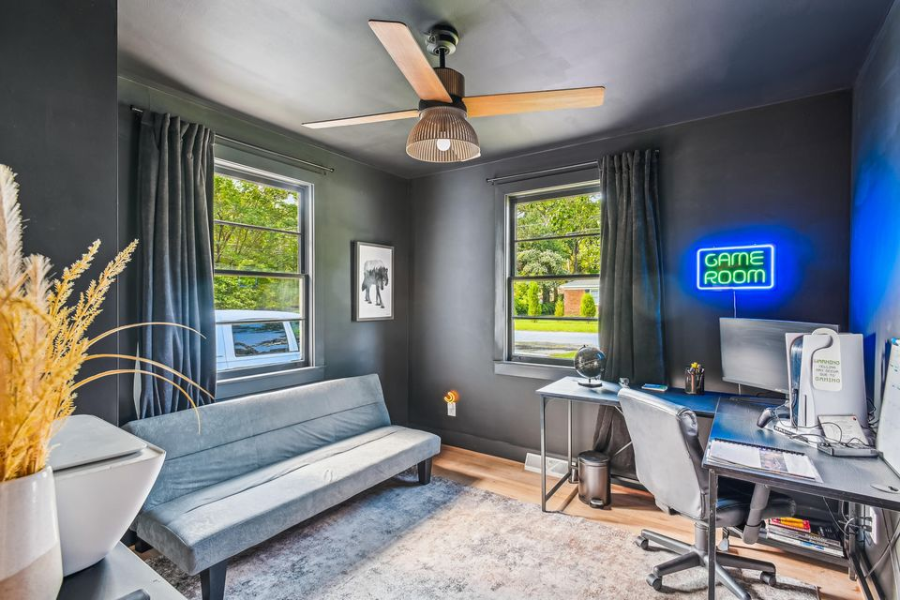


MOVE-IN READY HOME WITH NO HOA
SELLER WILL CONSIDER A RATE BUYDOWN WITH ACCEPTABLE OFFER
111 CIRCLE DRIVE
Dorchester Estates | Summerville, SC 29485 | MLS# 25016527 | $347,000
Meticulously Remodeled Home with Modern Upgrades & NO HOA! Step into this beautifully remodeled home, where every detail has been thoughtfully upgraded by the owner. The open-concept design showcases a spacious kitchen with stunning vaulted ceilings, perfect for both everyday living and entertaining. Enjoy high-end finishes throughout, including luxury vinyl plank (LVP) flooring, elegant butcher block countertops, and a stylish tile backsplash. This home has been completely updated with new wiring, a smart electrical panel, new ductwork, and fresh insulation for energy efficiency. Major recent upgrades include a new roof, HVAC (2023), and water heater (2023), ensuring peace of mind for years to come. Best of all, NO HOA means more freedom to make this home truly your own!
The property also features a beautifully landscaped yard adorned with three mature oak trees, two productive pecan trees, a charming mimosa tree, and a fruitful mulberry tree - providing both natural beauty and seasonal shade. These established trees add character to the outdoor space, creating a serene environment perfect for relaxing or entertaining. Don't miss the chance to own this move-in-ready gem!
David Hotchkiss
843-695-7015
davidhotchkissrealtor@gmail.com
davidhotchkiss.erawilderrealty.com
ERA Wilder Realty | 1282 State Rd | Summerville, SC 29486

