Slide 1
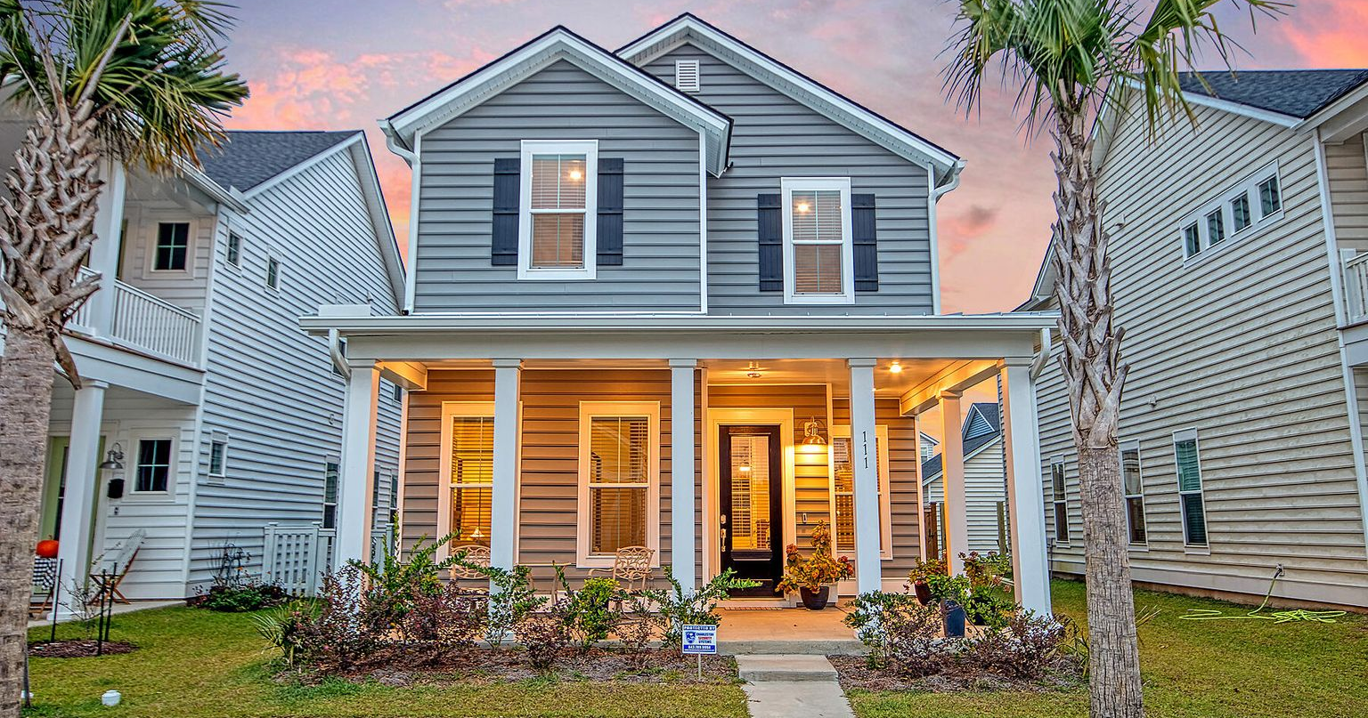

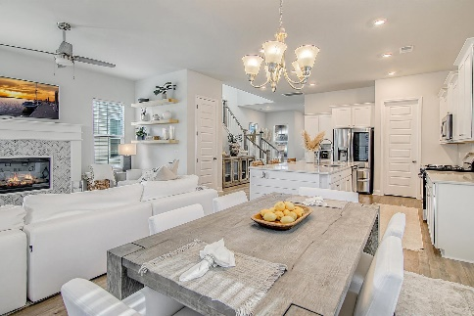
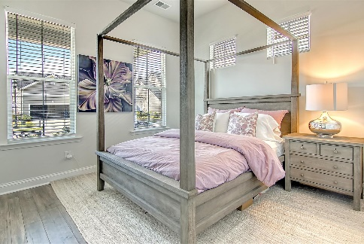
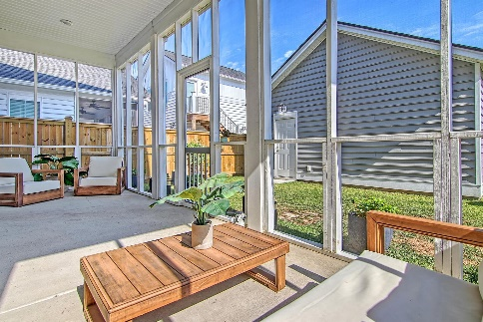
Shows Like A Model
Price Reduced
For Quick Sale
Open House Saturday 12-3
111 Country Gate Lane
Summers Corner ~ Summerville, SC 29485 ~ MLS# 22000061 ~ $450,000
Situated in the new Azalea Ridge section of Summer's Corner, this practically brand new construction home in pristine condition shows like a model! The two story residence welcomes you with a spacious, covered front porch. The inviting and open living space offers light laminate floors, a custom-built electric fireplace with herringbone surround in the living room, a dining area, and a chef's kitchen with breakfast bar seating at the center island, subway tile backsplash, stainless steel appliances, quartz countertops, white cabinets, and a walk-in pantry. The first level has a bedroom and a full bath as well. On the second level, you'll find a spacious loft area...perfect for a media room, a second living room, or whatever suits your needs. The owner's retreat features a huge walk-in closet and an en-suite bath with a dual vanity and a huge frameless step-in shower with a rain shower shower head. There are two additional bedrooms, a full bath, and a laundry room on the second level as well. A full, covered screened-in porch looks over the fenced-in backyard and to the detached two car garage. Summer's Corner has a pool, a dog park, multiple green spaces, parks with fire pits, ponds with lit fountains, walking trails, a children's library, farmers markets multiple times a year, food trucks on Wednesdays, a gardening club, and schools. This lovely community is also home to Buffalo Lake, a 95 acre freshwater lake where you can kayak and canoe, fish for largemouth bass, crappie, catfish, and bluegill, spot beautiful waterbirds like ospreys and ibises, take in views from the dock, or enjoy activities at the open air pavilion. Don't miss your opportunity to live in this stunning home and fantastic community!
Additional features include:
Upgraded all toilets - American Champion and Gerber Avalanche
Six foot Privacy Fence
Whole house air purifier
Whole house generator (Generac)
Screened in porch with storm door
Custom fireplace
Custom king stair treads
Upgraded the railing for extra security
Air purifier built in upstairs in attic
Gutters front and back
Open concept plan
Buffalo lake with open air pavilion
High end amenity center slated to be built as well as Publix Supermarket
Book your showing today!
Katie Wishneff kwishneff@mattoneillteam.com 843-870-8784

