Slide 1
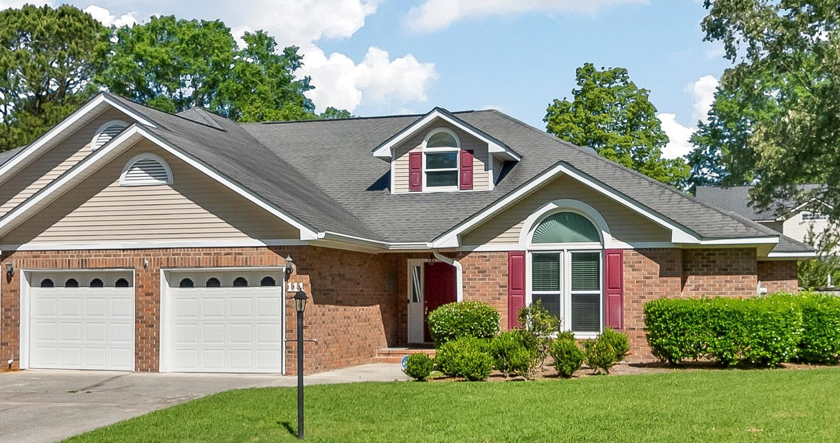
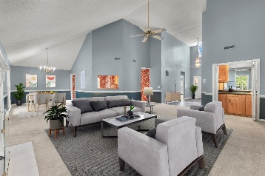
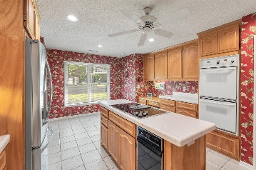
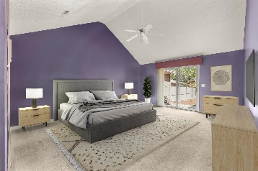
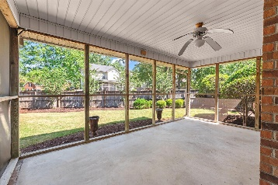
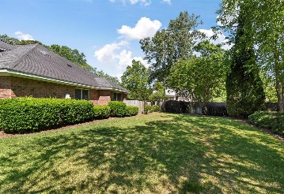


Crowfield for $400k, Screened Porch, 2 Car Garage, Fenced Yard
111 Dresden Drive
Crowfield Plantation | Goose Creek, SC 29445 | MLS# 24010204 | $400,000
Stratford Gardens is a very small subsection of Crowfield, consisting of about 28 Garden Style Patio 'twinhomes'. They look and feel like single family detached and are Fee Simple. These are kind of a hidden gem unless you've specifically driven through this no outlet cul-de-sac neighborhood. 2,157 SqFt 3 Bdrms 2 Baths, Screened Porch, Oversizied 2 Car Garage, Abundant Storage, and fully fenced in backyard with room for pets. This checks a lot of boxes for the right person seeking lower maintenance options or a Lock It And Leave It lifestyle. Cathedral ceilings add a great architectural feature to this single story living and make it feel open, bright, and welcoming. Full access to all Crowfield Plantation Amenities and all the area offers. Front Exterior Landscaping Included in the low $165 Qtrly Regime. The kitchen overlooks the dinning area as well as the living room, and access to the screened porch is conveniently located off the living room for easy access and backyard views. A gas fireplace and wet bar are also located in the living room. All bedrooms are spread out with the main bedroom towards the rear of the house featuring a high vaulted ceiling, dual sinks, standup shower, separate garden tub, multiple closets, and private access to the backyard via a sliding glass door that is perfect for a hot tub area. A generous sized backyard is fully fenced in for privacy and pets. In addition to the screened porch and patio area, there is also a side yard outside the fence to the right side of the home adding to the privacy. Oversized 2-car garage with a handy utility sink and extra usable attic space above. Recent improvements include new plumbing pipes replaced throughout the whole house in conjunction with new paint in Summer of 2023 (approx. cost of $20,000), new gutters in 2023, and new dishwasher March 2024. The current owner paid for these upgrades, the new owner can choose any cosmetic updates they wish to have at their own taste, but the major expensive plumbing project is completed here. This is a fee simple "twinhome" with one attached dwelling to the left offering an incredible design that looks and feels like a single home, including the private fenced in yard. Stratford Gardens has a quarterly regime of $165 that includes lawn maintenance outside the fenced area (that fee is $215 if you want irrigation water included). Full Crowfield Amenity access for Approximately $535 Annually (verify all HOA/Regime info if important) includes Pool, Tennis Courts, Walking Trails, Hiker/Biker Trails, Clubhouse, Recreational Storage Lot, Ponds, Trash Pickup, and access to Golf is extra if wanted...but convenient! (Search up Crowfield Plantation HOA for more info) Wall oven/microwave has never been used by this owner and sold as-is. Buyer to pay a one time Crowfield Fee of $750 at closing. Embrace the "lock it and leave it" lifestyle with this charming home that checks a lot of boxes! Conveniently located and close to shopping, restaurants and I-26 and just a short drive to Down-town Charleston, Summerville or beaches!
Jerod Coulter, ABR, REALTOR
843-513-3741
jerodcoulter@gmail.com
The Boulevard Company, LLC | 35 Broad Street | Charleston, SC 29401

