Slide 1
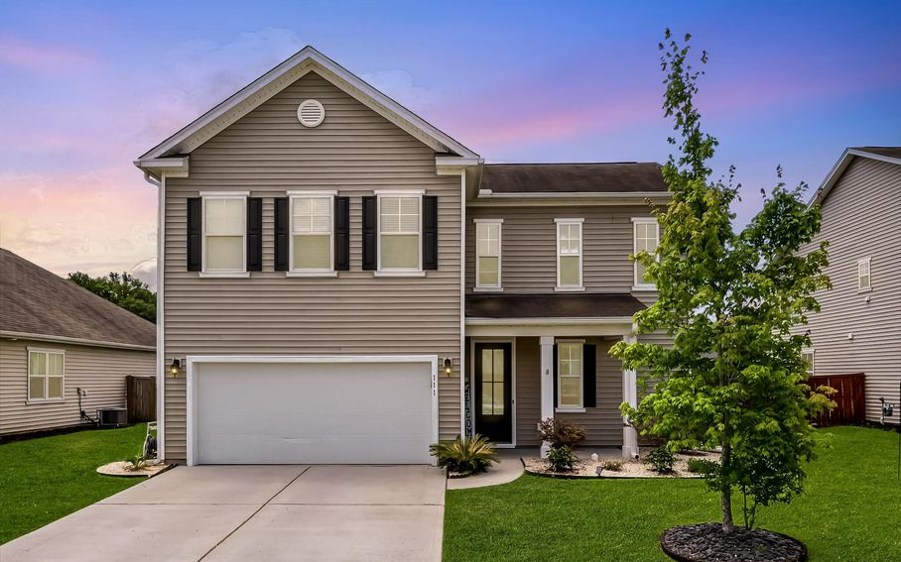
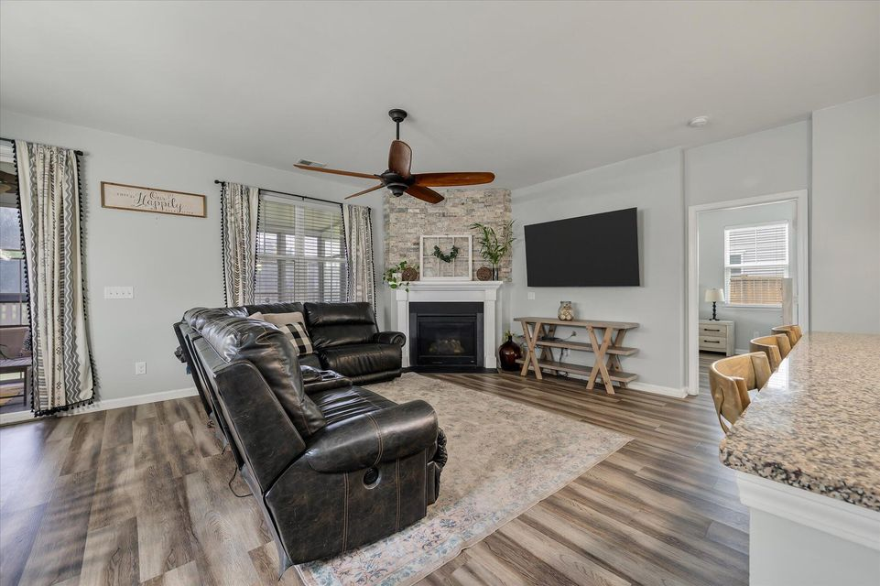
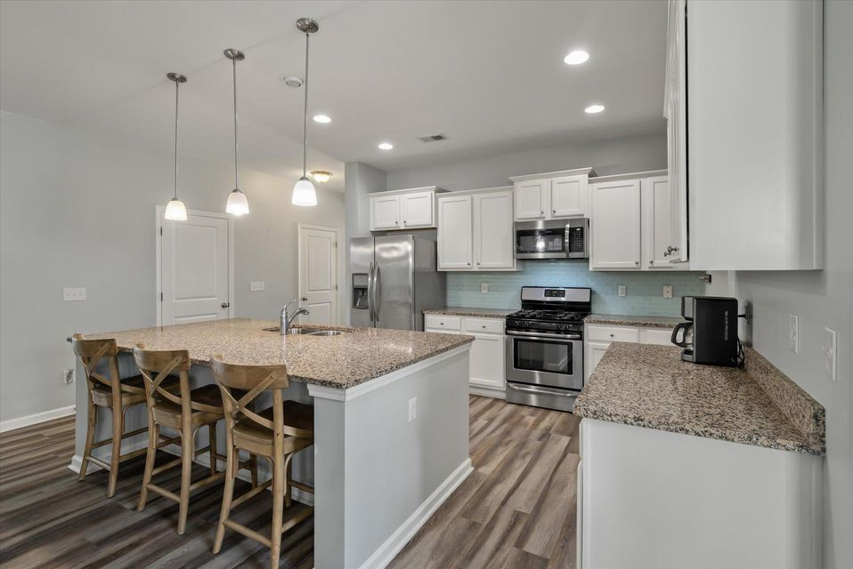
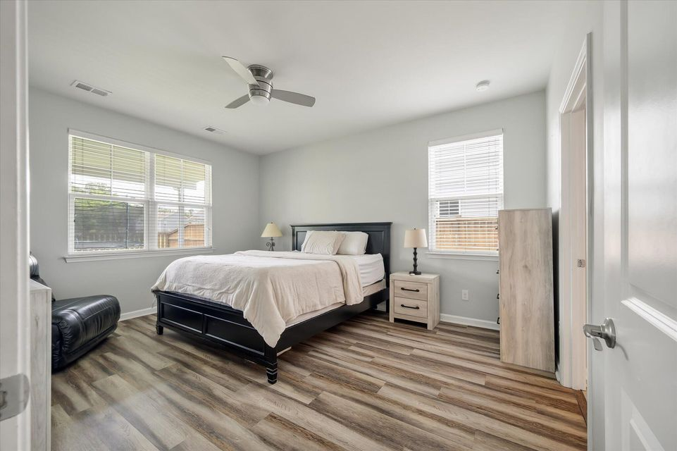
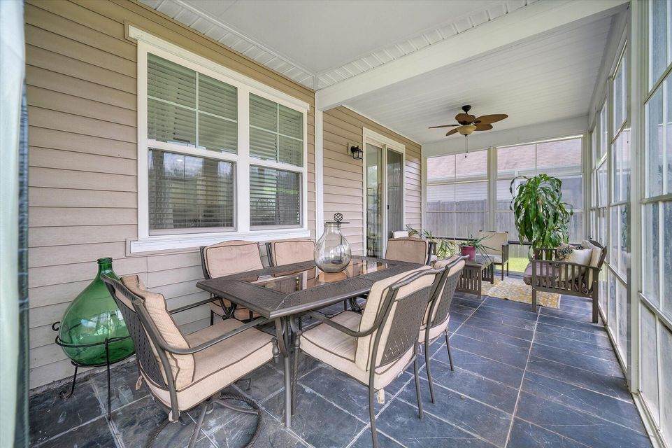
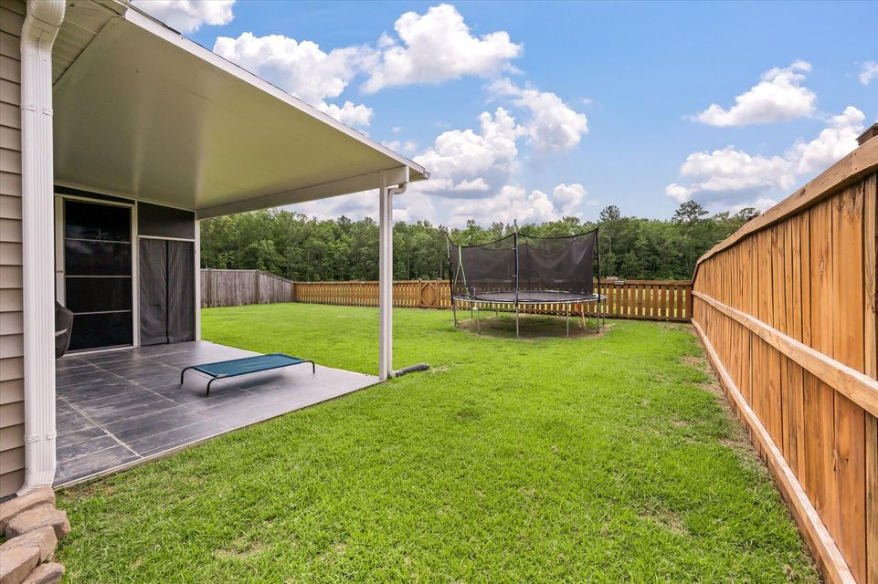


Price Reduced to $394,000
111 Nolin Road
Spring Grove Plantation · Moncks Corner, SC 29461 · MLS# 25015168 · $394,000
Buyers Agent Compensation
Premium pond lot with no rear neighbors perfect for buyers seeking privacy and outdoor space! The 20x10 sunroom can be used year-round (screened in or enclosed), and the 17x10 covered patio is ideal for entertaining. Fully fenced backyard, upgraded interior, and located in an established neighborhood. Easy to show bring your buyers!
Casey Rentz- Gallup
843-345-5617
caseylowcountryrealtor@gmail.com
casey.nexthomelowcountrysc.com
Nexthome Lowcountry · 1941 Savage Rd Ste 200 E · Charleston, SC 29407

