Slide 1
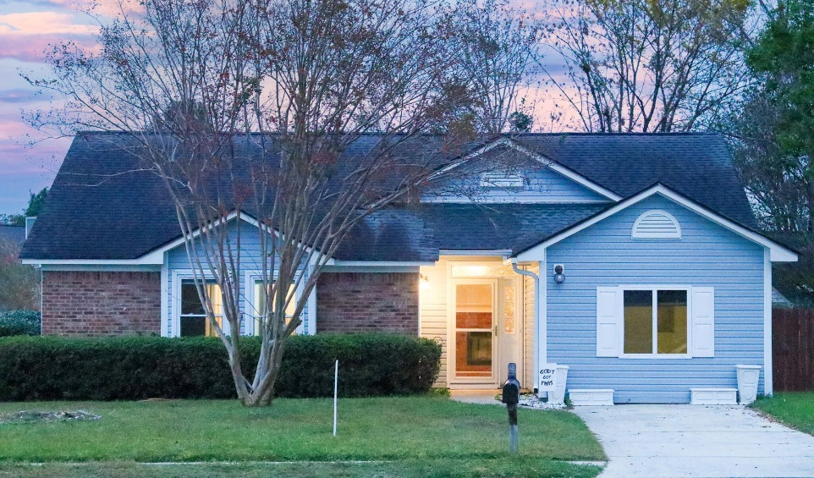
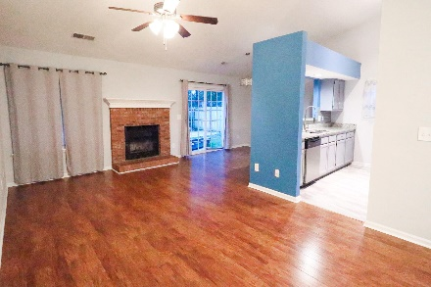
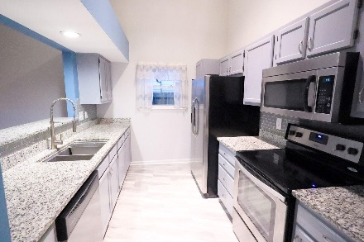
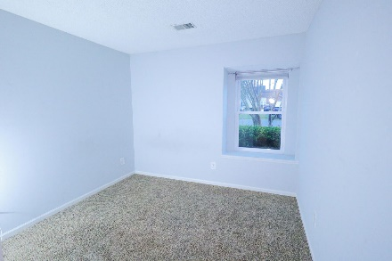
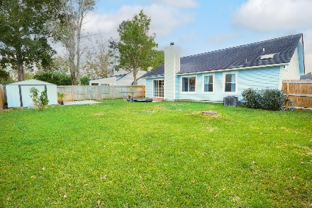



Jackpot! Renovated Kitchen 3 Beds, 2 Baths!
111 Persimmon Circle
Oak Creek
Goose Creek, SC 29445
MLS# 22027554
$325,000
SELLER OFFERING $7,500 CREDIT TOWARD A LOAN BUYDOWN* (reach out for more details)! Welcome home to this fabulous 1 story home in the quiet neighborhood of Oak Grove, surrounded by a huge growing area! When walking into this gorgeous home on a CORNER LOT, you'll notice the pristine laminate flooring and the huge vaulted ceilings. The living area offers a brick mantle, wood-burning fireplace, perfect for staying warm these upcoming colder months! The UPDATED galley kitchen offers granite countertops, waterproof vinyl flooring, undermount sink with stainless steel faucet, gray subway tile backsplash and like-new STAINLESS STEEL APPLIANCES that convey WITH the sale! REFRIGERATOR and BUILT-IN MICROWAVE INCLUDED!
The new owner will appreciate the updated bathrooms featuring tile flooring and updated vanities! What makes this house SO UNIQUE is the CONVERTED Garage (heated and cooled!), perfect for a second living space, a "man" or "girl" cave, potential 4th BEDROOM, hangout area - the list goes on. Outside is the large FENCED BACKYARD with shed and 2 patio areas, making it great to enjoy the warmer weather or for those who enjoy entertaining guests and more! HOA fee is ONLY $100 A YEAR, YUP, A YEAR! The elementary, middle, and high school are all LESS THAN 4 miles from the property, making dropping kids off before work or making trips to school a BREEZE. Nearby you'll find plenty of stores, restaurants etc, including; Walmart Supercenter, Charleston Sports Pub, Lowe's, Navy Federal Credit Union, Pinnacle Bank, sweetFrog Frozen Yogurt, Mattress Firm, Dollar Tree, Blue Tequila Tacos & Grill, McDonald's, Chick-fil-A, Biggby Coffee, Wendy's, Walgreens, Little Caesars Pizza, Haircut spots, a dentist office AND MORE!
Come take a look today!
Nick Mazzilli (843) 640-5575
nick@nickmcharleston.com www.mavenrealtysc.com
Maven Realty
2180 McMillan Ave
#71672
Charleston, SC 29405

