Slide 1
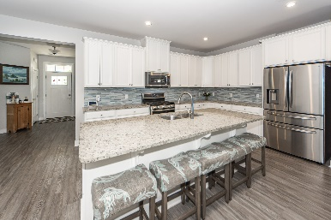
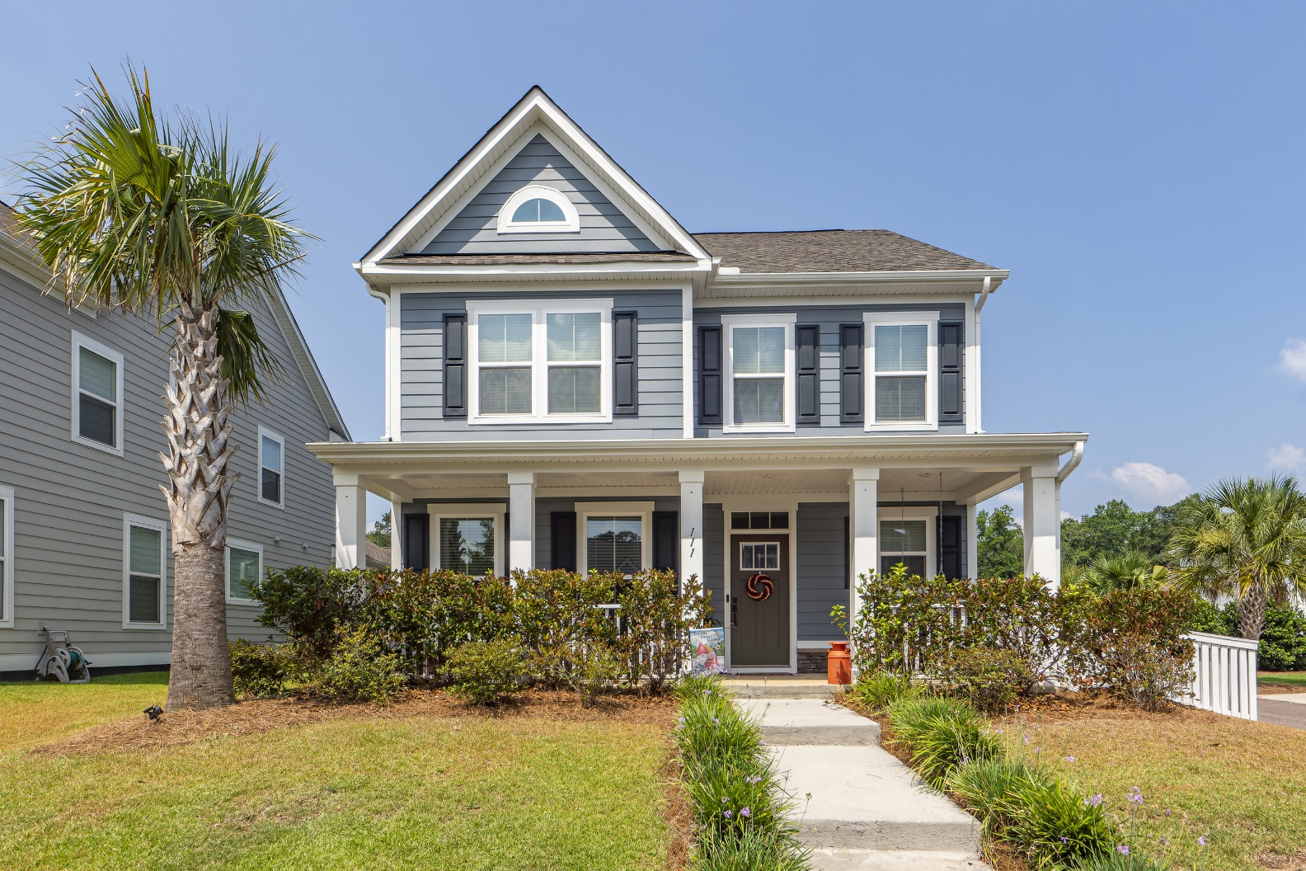
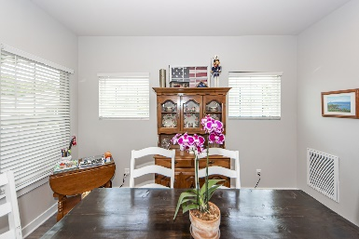
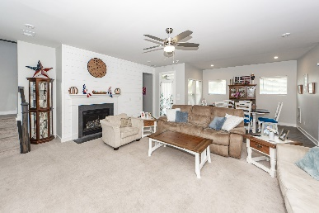
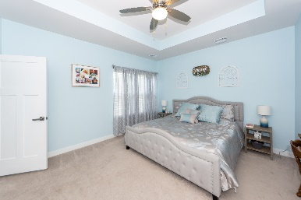
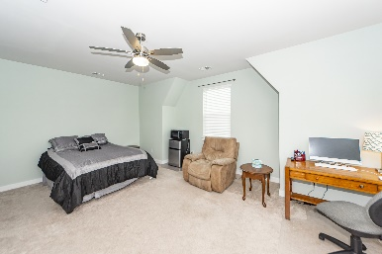
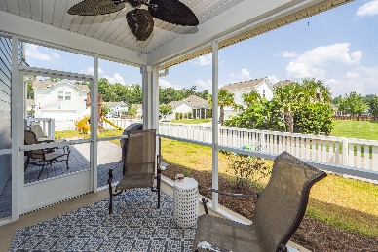
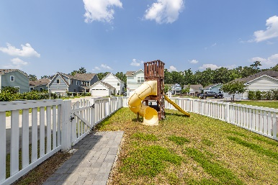
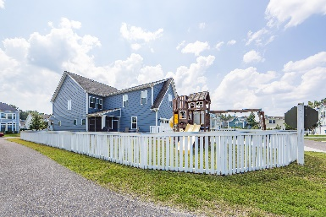
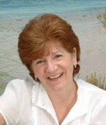

111 Starling Street
The Ponds | Summerville| MLS# 23016210 | $535,000
OPEN HOUSE SATURDAY 11AM-1PM
$1,000 Buyer's Agent Bonus
For Ratified Contract That Can Close By 9/27/2019
Welcome Home to The Ponds. If you've been searching for the perfect home in Summerville with everything on your wish list, in a convenient location, then your search is over. The Ponds offers amenities and a community that will enhance your family's lifestyle. With Lowcountry living offerings at its finest, this neighborhood features a beautiful Amenities Center, a community garden, a dog park, playgrounds, an amphitheater, a boat/kayak launch, miles of walking trails, and a YMCA. This 3000 sq foot home offers 5BRs and 3.5BAs. Situated on a corner lot and with parking in the rear, there is plenty of space in the front for socializing with neighbors, or watching the seasonal golf-cart parades. The fenced in backyard provides a space for the kids to enjoy playing with all their new friends.
This home is light, bright, and airy, boasting tons of natural light from all the windows. The open floor plan is perfect for entertaining guests and family gatherings. The downstairs office is currently being used as a bedroom but is a wonderful flex space for the crafter or for someone who works from home. There is also a FROG space (the 5th bedroom) with a full bathroom, perfect for older teens or could be used as an in-law suite, has its own set of stairs & is private/separate from the rest of the bedrooms in the home. This beautiful & large home has tons of upgrades and is move in ready. The kitchen features granite countertops, a large island, stainless steel appliances, a gas stove, and beams with white cabinetry. The homeowner's suite boasts 2 walk-in closets, a tray ceiling, and an en-suite with a full tile shower and dual showerheads. The 3 secondary bedrooms have double door closets. The screened in porch offers a private and comfortable outdoor space for cooler evenings and shade in the summer. The seller has kept this home in immaculate condition. Pride of homeownership will be evident as you walk through and discover just how darling this house is. Bonus? This home & community are located in the award-winning, highly sought after Dorchester District Two School District. Don't miss out! Schedule your showing today!
Take a Virtual Tour
Tammy Thompson
843-412-1856
tammylthompson@live.com
Coldwell Banker Realty, Downtown
55 Broad Street
Charleston, SC 29401

