Slide 1
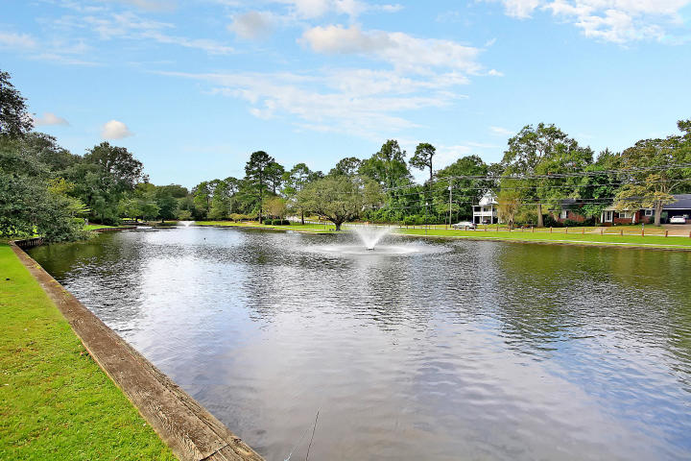

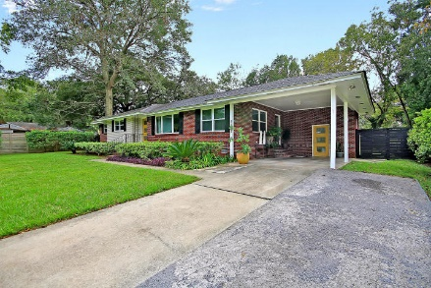
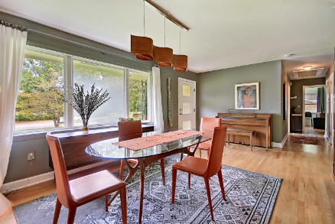
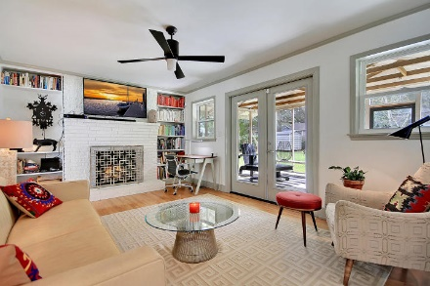
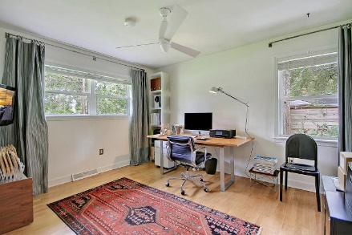
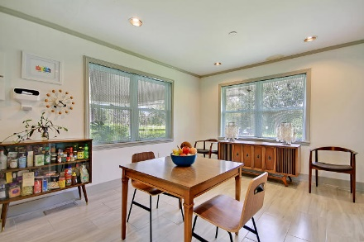
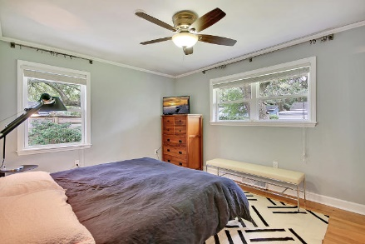
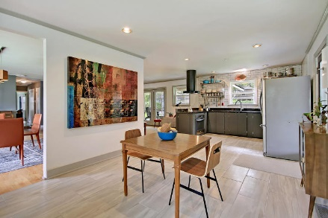
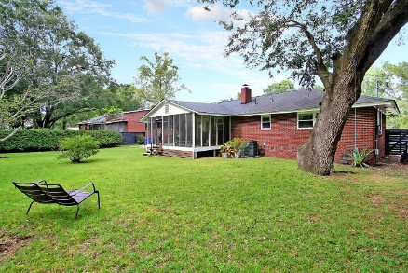
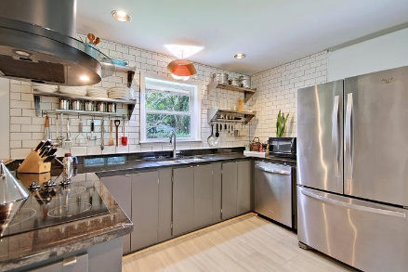
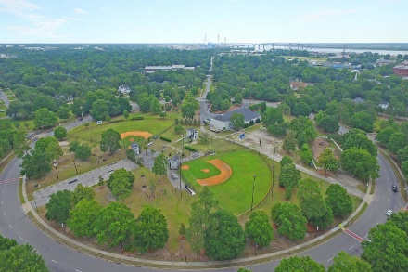
Price Reduced!
Fantastic Park Circle Location
$25.00 gas card giveaway. Chicken Salad Chick lunch provided by Warren Armstrong of Fairway Mortgage
1121 South Boulevard Park Circle ~ North Charleston, SC 29405 ~ MLS# 19026659 ~ $449,000
Directly across the street from Quarterman Park in desirable Park Circle, this gorgeous home sits on a spacious, premium lot. This location is within walking distance of popular restaurants and stores. The sun filled living room overlooks the park with hardwoods throughout. The renovated kitchen has a beautiful subway tile backsplash, granite counters, stainless steel appliances, & a vent hood. The open living room boasts a fireplace with built-ins on either side & access to the roomy screened-in porch. The large fenced-in backyard includes mature trees, azaleas, & a storage shed. Hall bathroom has been completely renovated. Walking distance to EVO Pizza, Sesame Burger, Cod Father, Junction Kitchen, and soon opening Jack Rabbit Philly and Barrelli Barber Shop.
Additional features include:
Great home for entertaining
New windows
New exterior doors
New Rinnai tankless water heater
New HVAC, ducts, and handler
Ample parking at Quarterman Park
The pond at Quarterman Park is part of the Noisette tidal creek
Lots of restaurants and bars nearby
Book your showing today!
True Edwards true@trueedwards.com 843-442-6253

