Slide 1

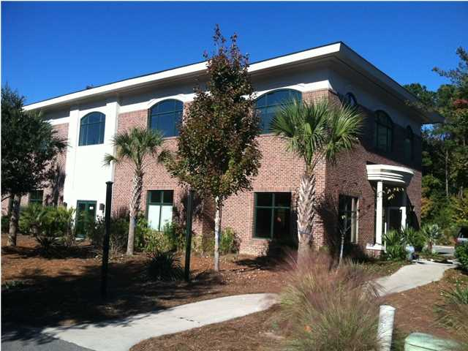
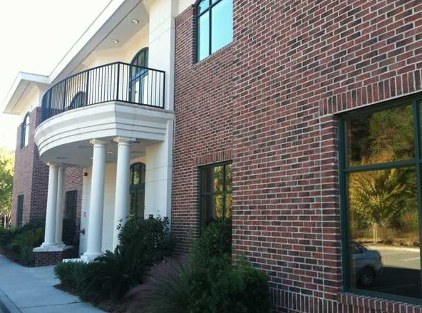
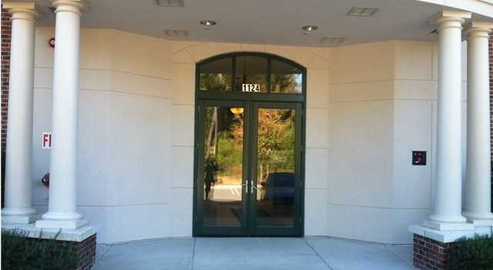
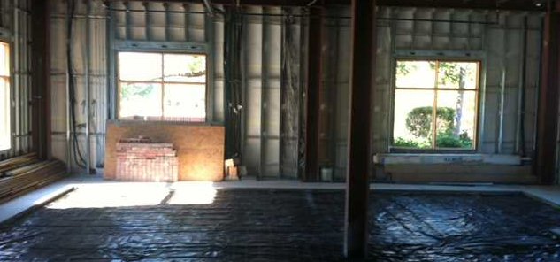
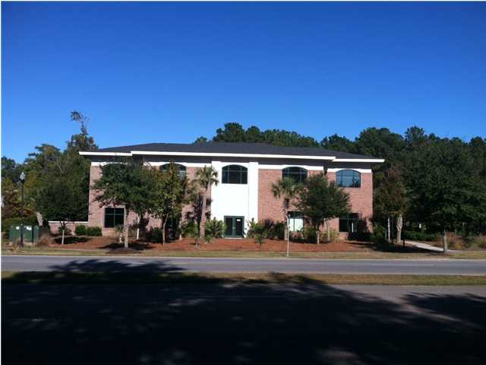
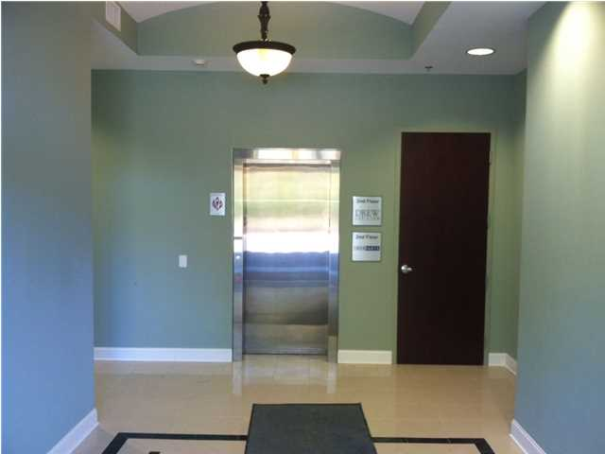


CLASS A OFFICE SPACE IN PARK WEST
Under New Ownership. Class A office space with Park West Blvd. signage and access. An elevator is in the building with a well appointed entrance and foyer. The second floor is move in ready up to 2,816 square feet and the two first floor suites of 1,351 and 1,462 square feet are under construction and will be finished to office standard. The Landlord is willing to modify the building to accommodate the right tenant/use. Parking is directly out the main entrance with the ability for tenants to walk to breakfast, lunch and dinner as well as the grocery store and various professional and medical services. This is one of the nicest office buildings in northern Mount Pleasant. The NNN Expenses are estimated at $5.27 per square foot.
Address: 1124 PARK WEST BLVD
Area: CHS-Mt.Pleasant North of IOP Connector
Building Square Feet: 6492
Category: details
City: MOUNT PLEASANT
County: Charleston
Listing ID: 1328861
Listing Price: $22
Max Contiguous SqFt: 3561
Minimum Div. SqFt: 895
Office Class: A

