Slide 1
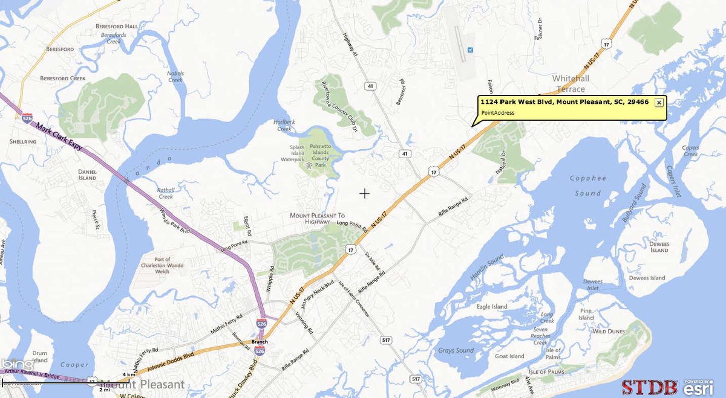
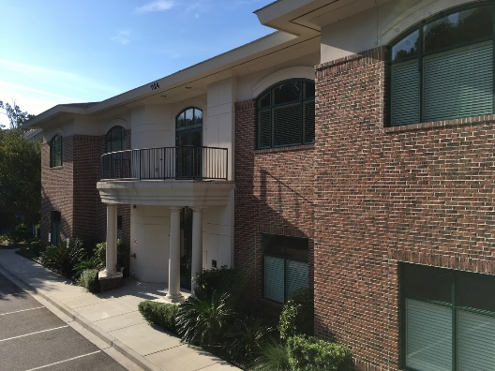
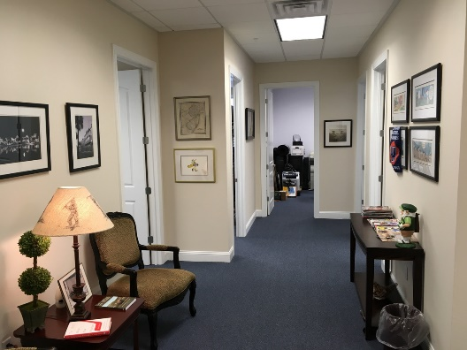
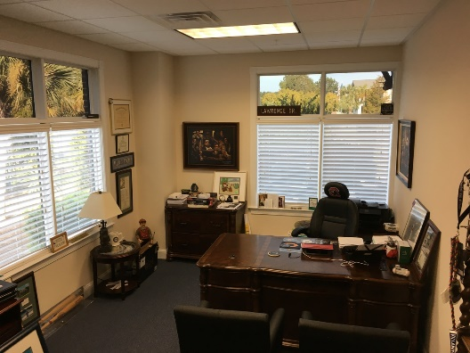
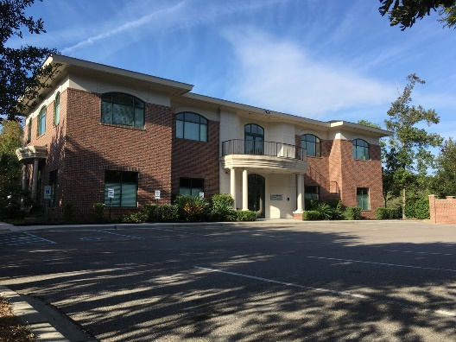

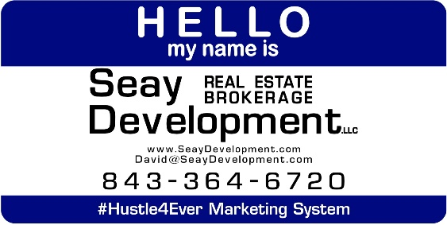
1124 PARK WEST BOULEVARD, STE 100
1124 PARK WEST BLVD
Mt Pleasant, SC 29466
OFFICE FOR LEASE
Park, Work, Shop, Eat! Not a bad day at the retail location or office out in Park West. Class A office space with Park West Blvd. signage and access. First floor suite with main corridor entrance and dedicated entrance into space. An elevator is in the building with a well appointed entrance and foyer. Space consists of 5 offices and a kitchenette area. Medical, Dental, Office, Retail. A video tour exists. This area is booming. Construction underway across the parking lot for a pediatric practice and other uses.
Catylist ID: | #30010557
Contiguous Space: | 2,032 SF
Lease Rate: | $22 PSF (Annual)
Lease Type: | NNN
Lease Term: | 36 Months
Offices: | 4
Property Visibility: | Excellent
County: | Charleston
Tax ID/APN: | 540-00-00-150
David H Seay
CCIM, BIC, CCIM, REALTOR
(843) 364-6720
david@seaydevelopment.com
Seay Development, LLC
3404-202A Salterbeck Street
Mt. Pleasant, SC 29466
www.seaydevelopment.com

