Slide 1
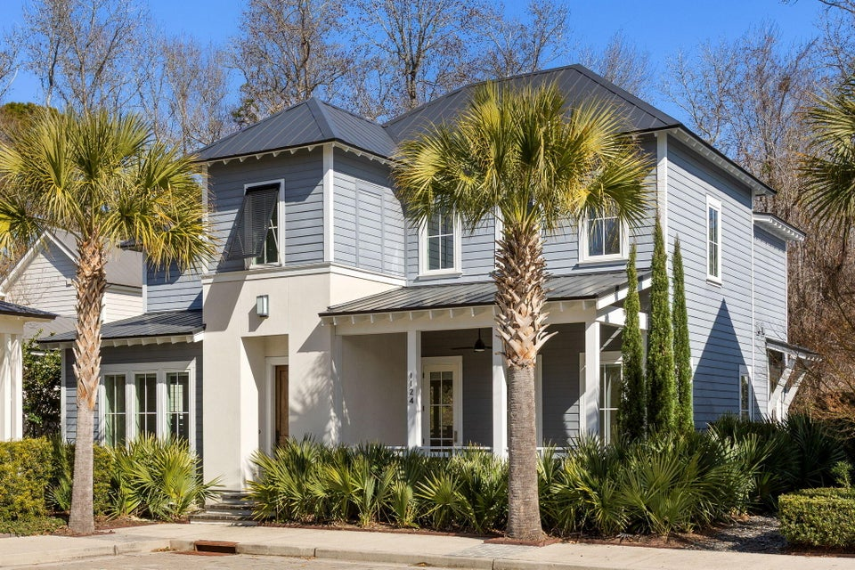
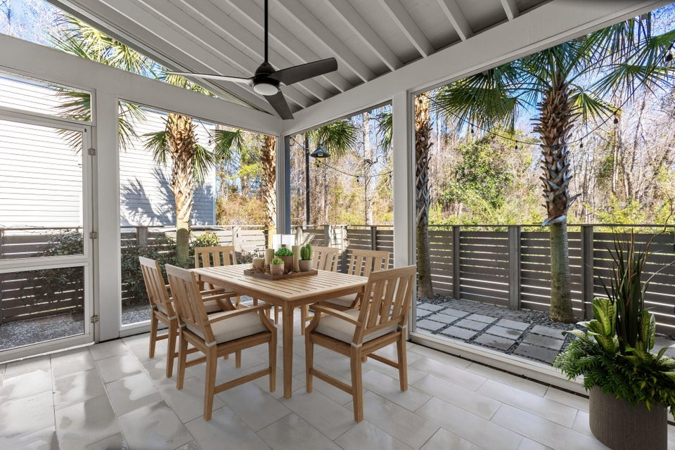
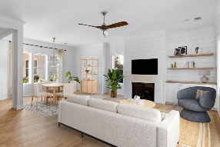
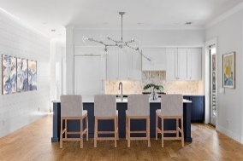
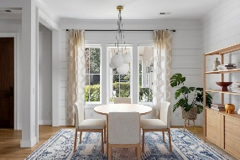
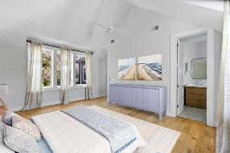
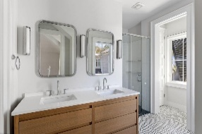
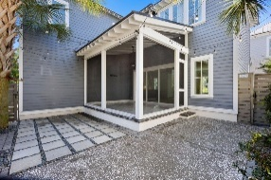
1124 Fulton Hall Lane Fulton | Mount Pleasant, SC 29466 | MLS# 26004817 | $1,298,000
A Mix Of Sleek Contemporary And Coastal Cottage Style
This 3-bedroom, 2.5-bath home is expertly finished with a mix of sleek contemporary and coastal cottage style. Just three small steps take you up to the Mahogany front door, then into the foyer and great room. The great room features wide-plank wood flooring, shiplap walls, a gas fireplace, and a panorama of large windows and glass doors, offering abundant natural light and outdoor views. The kitchen includes high-end custom cabinetry with solid wood construction; quartz countertops with tile backsplash; island with breakfast bar; and high end appliance package including paneled dishwasher, paneled refrigerator/freezer, wall oven, and gas cooktop.
Behind the kitchen are an office; the guest powder room; and a scullery with additional cabinetry and counter space, microwave, and beverage refrigerator. Double sliding glass doors in the living area access the back porch, which has a vaulted ceiling, tile flooring, and wall mount/wiring for TV. The porch overlooks the small privacy-fenced back yard. Three bedrooms, two full baths, and the laundry closet are upstairs. The primary bedroom features a vaulted ceiling, wood floors, and en suite bathroom with custom double-sink vanity, curbless shower with tile and glass surround, and walk-in closet with custom organization. The other two bedrooms also have wood floors and custom-designed closets. The home was expertly designed and built for both space and energy efficiency. See features sheet (in documents section of listing) for more information. Fulton Neighborhood is tucked back off of Hwy 17 across from Boone Hall Farms and convenient to all of north Mt Pleasant's shopping, dining, and medical facilities. Amenities include a pool with large covered patio and a play park.
VIEW LISTING
VIRTUALLY STAGED
VIRTUALLY STAGED
VIRTUALLY STAGED
VIRTUALLY STAGED
VIRTUALLY STAGED
VIRTUALLY STAGED
Andrea Rogers
843-532-3010 | andrearogers1@gmail.com | www.andrearogersrealtor.com
AgentOwned Preferred Group | 1400-G Palm Blvd | Isle Of Palms, SC 29451

