Slide 1
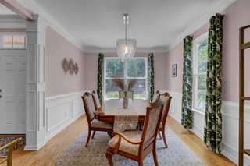
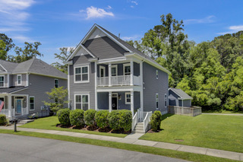

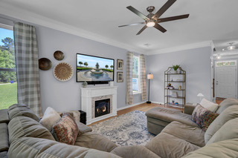
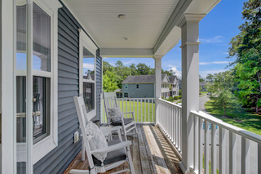
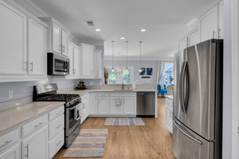
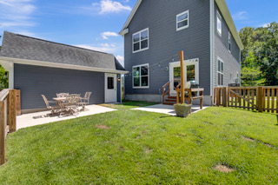
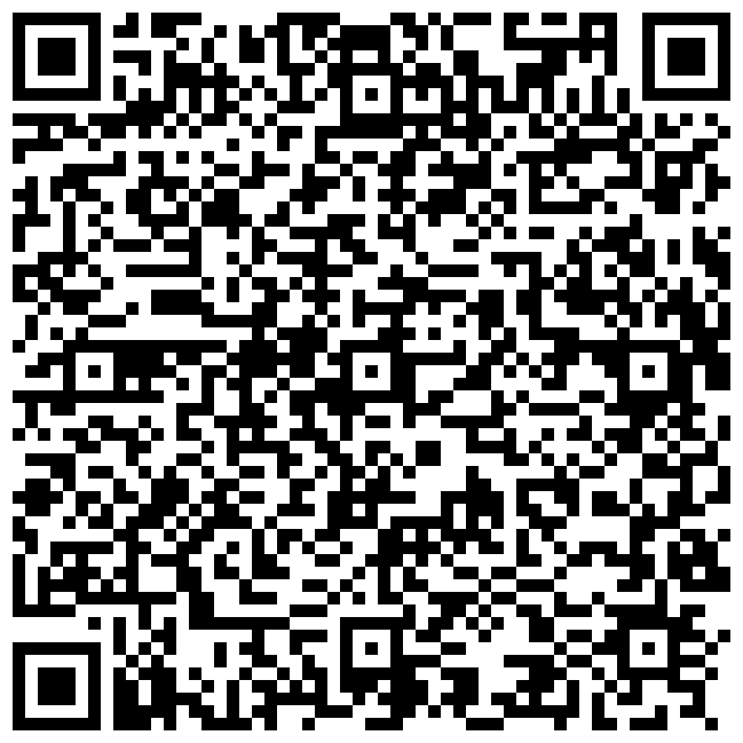


Hot New Listing and Open House Sunday 5/26 11AM-2PM
1124 Twitchell Street
Swygerts Landing
Johns Island, SC 29455
MLS# 24013044 | $529,900
Video Tour
Aggressively priced new listing in Swygert’s Landing is H-O-T like the summer weather coming our way! This is one heck of a charmer with double porches, and the finishes and floorplan make this a WINNER! Wood floors throughout the main level, trendy finishes and fixtures and a great open floor plan are sure to please. Set on a prime lot, there is only one neighbor, a huge open green space beside the home, and views of a park like setting from the front porches. Awesome kitchen- super spacious with quarts, bright white cabinets galore, and stainless appliances. The owners will love their huge suite with two additional bedrooms and laundry room all upstairs. The front bedroom has access to the upper level porch. Fully fenced yard and an easy walk to the neighborhood amenities (pool, playground, and huge pond) This is a stunning home in a very popular community. When the new CCSD elementary school is finished, residents are a mere golf cart away with a connection straight from the neighborhood.
Busy this holiday weekend? Send your buyers to the Open House Sunday!!!!
Call Ellen with any questions (843)300-8530
Virtual Tour
Ellen O'Neil
Broker/Owner, ABR, e-PRO, CNE
Charleston Realtor of Distinction
(843) 300-8530
www.EllenONeilProperties.com

