Slide 1
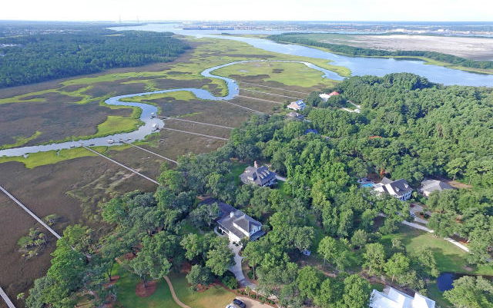
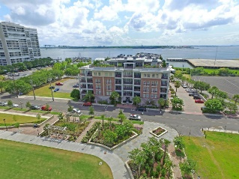
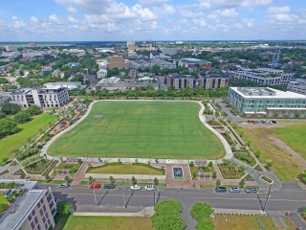
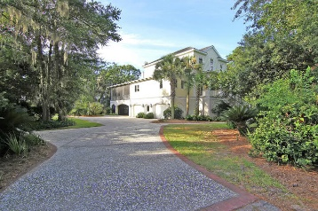

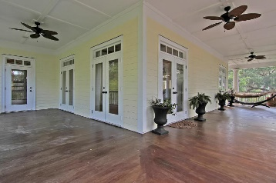
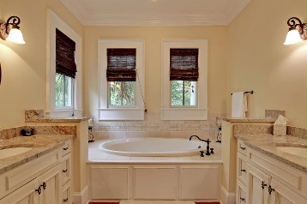
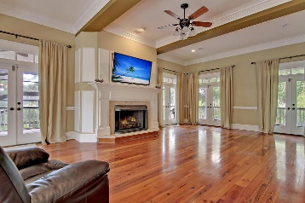
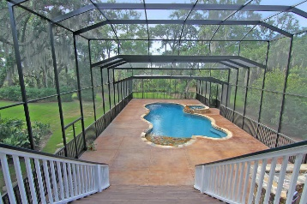
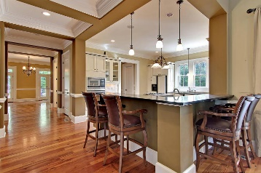
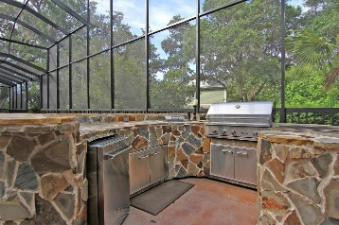
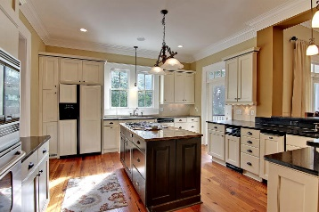
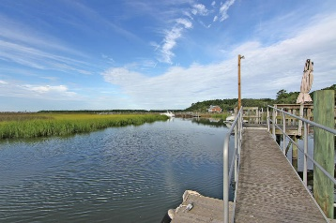
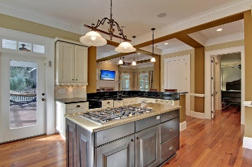
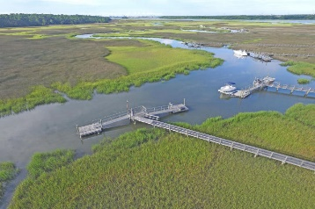

Deep Water ~ Daniel Island
$250K Price Reduction
Price Reduced!
1125 Pinefield Drive
Pinefield Plantation ~ Charleston ~ MLS# 16020913 ~ $1,249,000
Deep-Water Custom-Home with Daniel Island Schools has largest residential pool and outdoor oasis in Charleston! Private dock, large yard, and exceptional views. The outdoor oasis is like having a luxurious resort in your backyard. The atrium prevents leaves from falling into the sparkling in-ground pool that has an overflow hot tub. Owners invested $350,000 in renovations over the past 12 months to make this home truly spectacular. The wrap-around back porch, wrap-around covered patio & front porch are additional outdoor living areas where you can enjoy the homes’ privacy. Just a few of the details inside the home include, chair rail/crown/baseboard molding, high ceilings & beautiful hardwood floors. Be sure to come see all this home!
Additional features include:
$350,000 in improvements and upgrades
The kitchen features granite counters, a breakfast bar, a center island, stainless steel appliances, a gas range, a wet bar with a wine rack, a walk-in pantry and a butler's pantry
The living room has a cozy wood burning fireplace
Coffered style ceilings
Antique heart pine floors
Outdoor atrium
The owner's retreat includes two walk-in closets, access to the porch and an ensuite full bath with dual vanity, jacuzzi tub and walk-in shower with dual shower heads
The laundry room has a sink and built-ins
Elevator
Transferable dock permit for dock extension
Great for water activities such as kayaking, crabbing, boating, paddle boarding, and fishing
Book your showing today!
Book your showing today!
Matt O’Neill matt@mattoneillteam.com 843-532-4220

