Slide 1
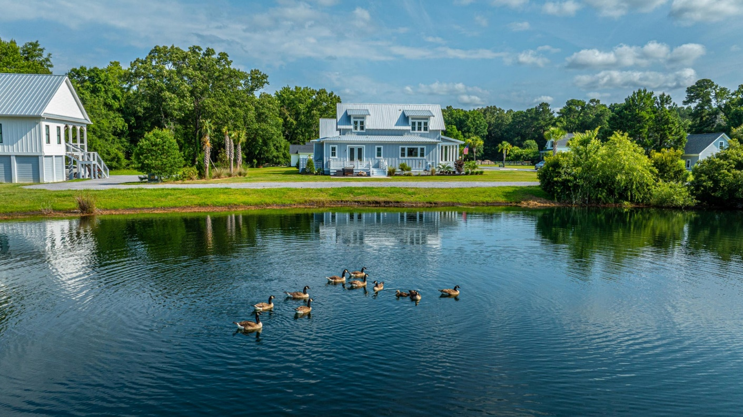
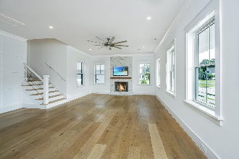
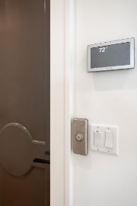
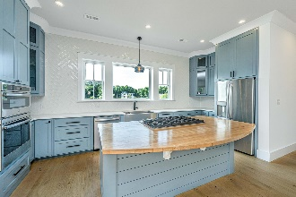
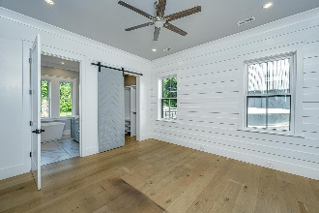

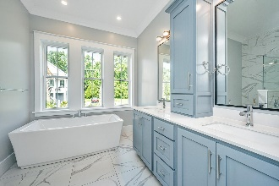
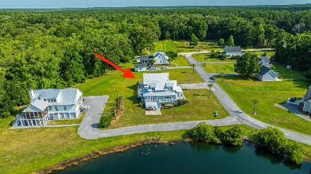
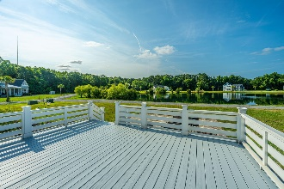


1125 Hitchfield Lane Cedar Plantation | Awendaw, SC 29429 MLS# 24015516 | $909,400
Looking for the perfect escape from the city?
OWNER MOTIVATED
Charm meets convenience in this custom-built home located in quaint ''Cedar Plantation'' in Awendaw. This quiet coastal town is nestled along the Francis Marion forest offering an abundance of outdoor experiences including the Awendaw Green Barn Jams at Seewee Outpost, Charleston Adventure Forest/Zipline, SC Surf Soccer fields, Buck Hall Recreation Area/boat ramp, Garris Landing Public Boat Ramp, Bulls Island Ferry, Twin Ponds Rifle Range, Center for Birds of Prey, and the town's Annual Blue Crab Festival. As a builder's personal home (by TightLines Construction), there are many features that make this property a truly unique home reflecting style and attention to detail.
The exposed rafters tails and metal roof contribute to the architectural character of this amazing Lowcountry abode. Wide-plank European white oak floors, custom high-end trim throughout and freshly painted interior show off a sun-filled open concept living space as you enter. Custom millwork cabinets and appealing backsplash dominate the chef's kitchen with plentiful storage, a gas cooktop surrounded by the butcher block island, stainless steel appliances, and an uninterrupted view of the pond. The focal point of the living room is the functional fireplace complemented by the floor-to-ceiling tile surround. Enjoy the ease of the primary suite on the first floor offering dual closets, dual sinks with a storage tower in between, gorgeous walk-in tiled shower, and large separate tub. Down the short hall is a Murphy door closet under the stairs, powder room, hall closet, laundry room and flex space. Just beyond the sliding glass door is a fabulous deck that steps down to a salt-finished concrete/brick patio large enough for multiple grills and entertaining with the gleaming pond as your backdrop. Catch the delightful breeze with a good book while relaxing on the generous front porch or back deck. Upstairs are two sizable bedrooms as well as a spacious full bathroom off of a small sitting area offering convenience and style for family and guests. The detached garage provides an enormous space, whether it's for your vehicles, workshop, boat, golf cart or your personal gym. If more storage is needed, head up the stairs to 550 square feet of additional unfinished space!
Perfect location for fun year-round with everything the area has to offer - downtown Charleston less than 30 miles away - Isle of Palms beach less than 15 miles away!
Suzi Baldrick Mobile 843-442-3149
suzi.baldrick@carolinaone.com
www.CarolinaCoastalTeam.com
Carolina Coastal Group Carolina One Real Estate
1503 Palm Blvd
Isle of Palms, SC 29451-2280

