Slide 1
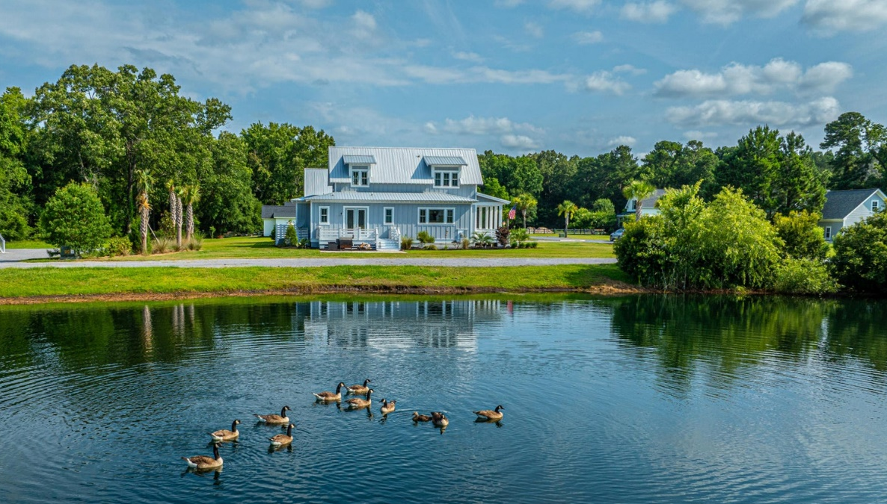
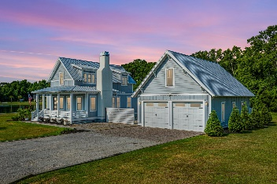
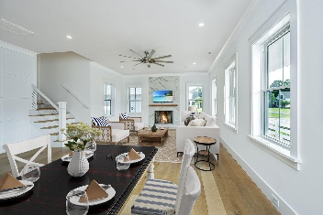
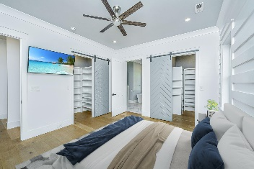
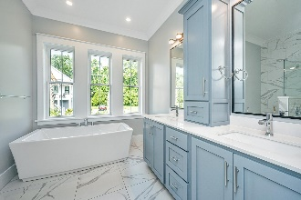
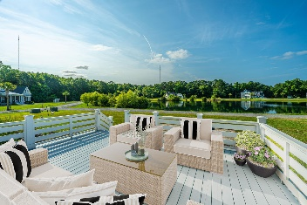


1125 Hitchfield Lane Cedar Plantation | Awendaw, SC 29429 MLS# 24015516 | $875,000
Close to town ~ Away from it all!
PRICE ADJUSTMENT!
Price Recently Reduced!
3 Bedrooms | 2½ Bathrooms | 2,089sf
Architecturally stunning home with metal roof system
Meticulous detailing inside and out
Custom millwork cabinetry
Primary suite on first floor with exquisite bathroom
Butcher block island with gas cooktop, plentiful storage
Wide-plank European white oak flooring
Expansive rear deck steps down to salt-finished concrete patio
Detached garage with an extra 550 sq ft (unfinished) upstairs
Huge lot with uninterrupted views of the pond
Encapsulated crawl space
A true labor of love…builder’s personal home built in 2019 by TightLines Construction
Suzi Baldrick Mobile 843-442-3149
suzi.baldrick@carolinaone.com
Carolina One Real Estate
1503 Palm Blvd
Isle of Palms, SC 29451-2280

