Slide 1
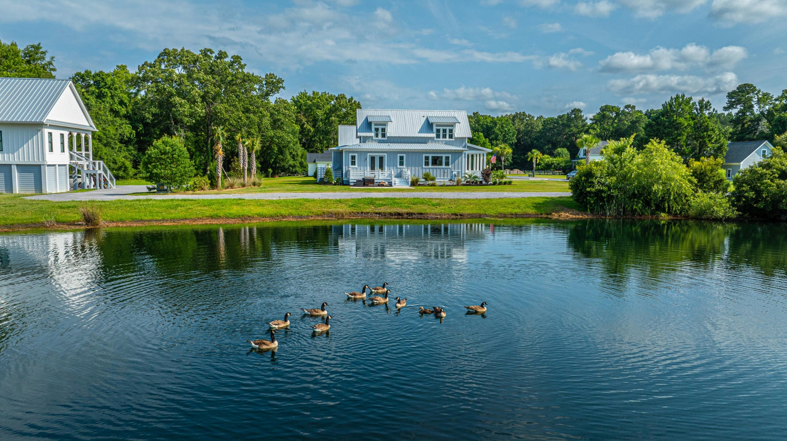
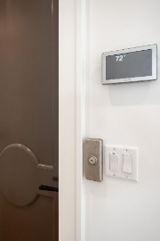
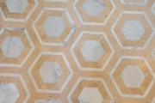


1125 Hitchfield Lane
Cedar Plantation | Awendaw, SC 29429
MLS# 24015516 | $909,400
Open House Thursday June 20th from 11 - 1
Stop by and tour this exquisite lakefront home
OWNER MOTIVATED
Suzi Baldrick
Mobile 843-442-3149
suzi.baldrick@carolinaone.com
Carolina One Real Estate
1503 Palm Blvd
Isle of Palms, SC 29451-2280

