Slide 1
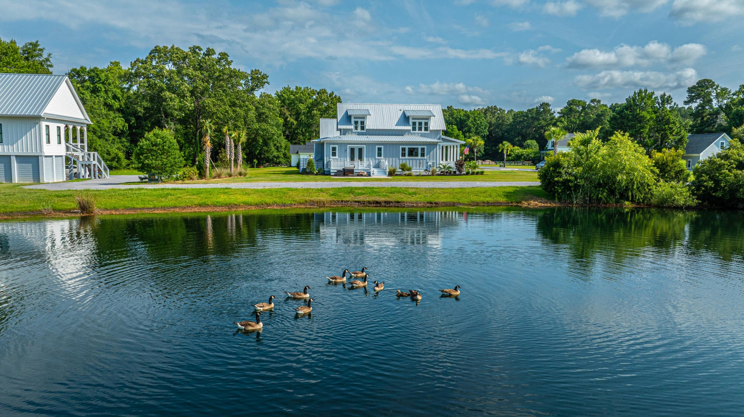
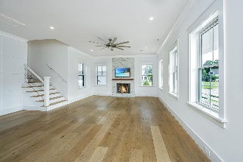
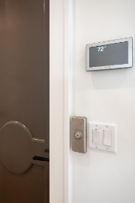
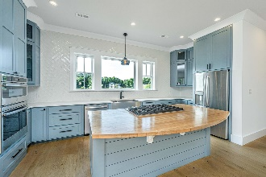
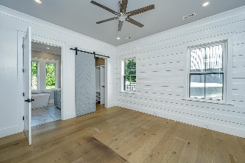
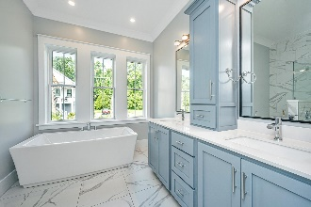
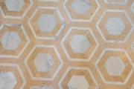
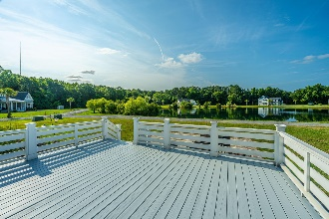


1125 Hitchfield Lane
Cedar Plantation | Awendaw, SC 29429
MLS# 24015516 | $909,400
Open Houses This Weekend
Stop by Saturday or Sunday 12-2
OWNER MOTIVATED
Suzi Baldrick
Mobile 843-442-3149
suzi.baldrick@carolinaone.com
Carolina One Real Estate
1503 Palm Blvd
Isle of Palms, SC 29451-2280

