Slide 1
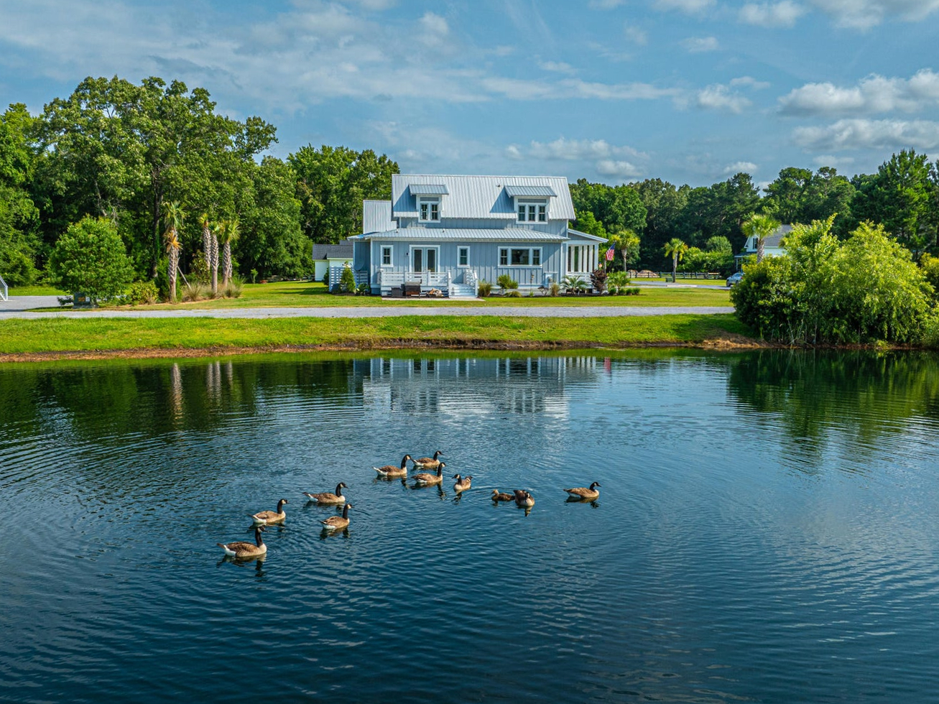

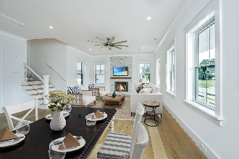


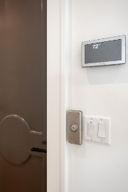
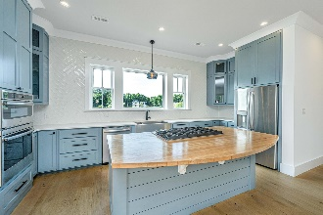

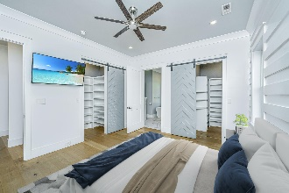
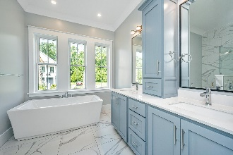
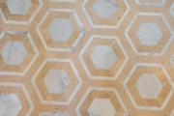
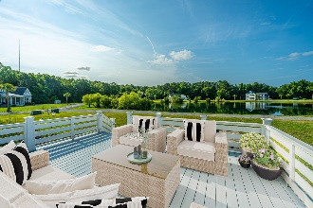


1125 Hitchfield Lane
Cedar Plantation | Awendaw, SC 29429
MLS# 24015516 | $875,000
Holiday Weekend Open House
Stop by Saturday 11 to 1pm or Sunday 2 to 4pm
OWNER MOTIVATED
Suzi Baldrick
Mobile 843-442-3149
suzi.baldrick@carolinaone.com
Carolina One Real Estate
1503 Palm Blvd
Isle of Palms, SC 29451-2280

