Slide 1
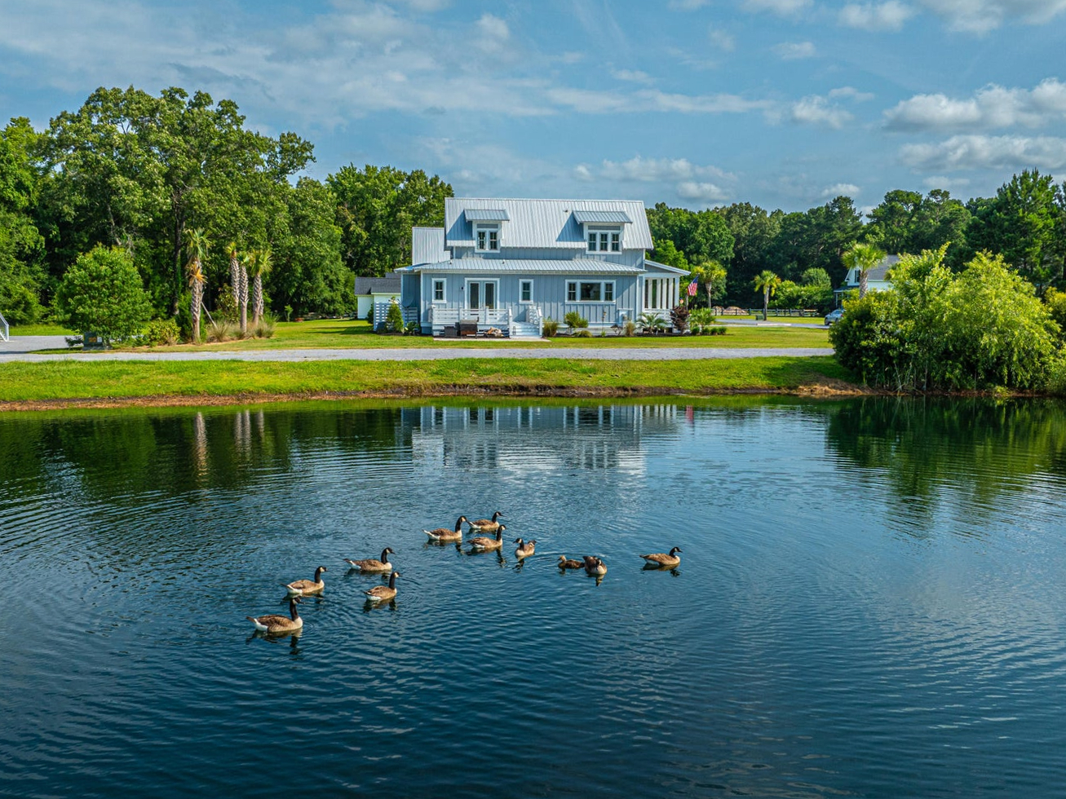

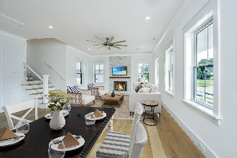
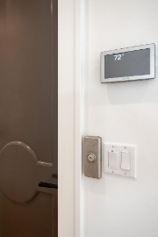
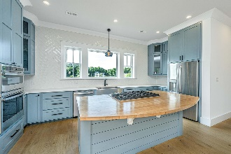

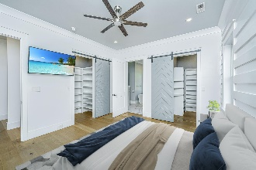
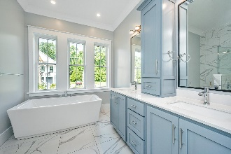
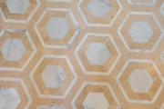
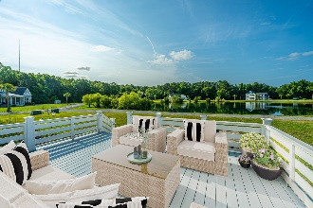


1125 Hitchfield Lane
Cedar Plantation | Awendaw, SC 29429
MLS# 24015516 | $875,000
Open House This Saturday
Please join us Saturday from 12 to 2pm
OWNER MOTIVATED
Suzi Baldrick
Mobile 843-442-3149
suzi.baldrick@carolinaone.com
Carolina One Real Estate
1503 Palm Blvd
Isle of Palms, SC 29451-2280

