Slide 1
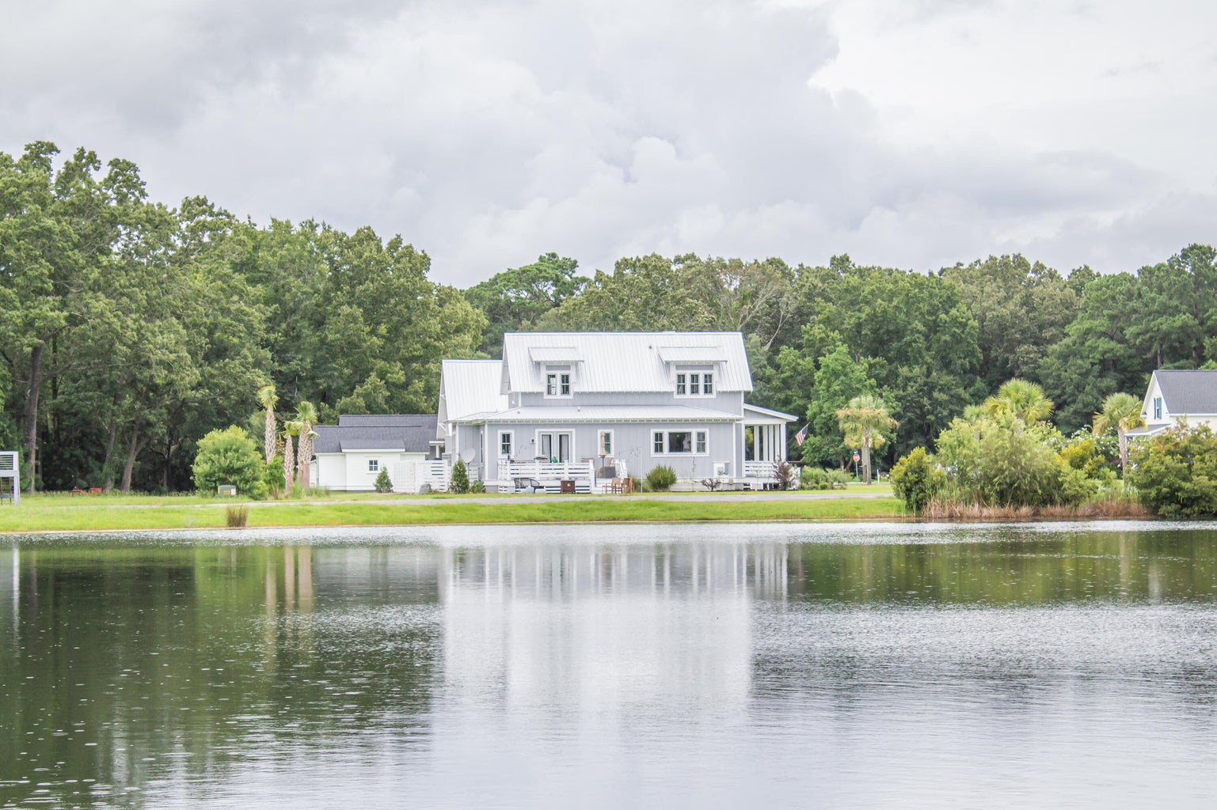
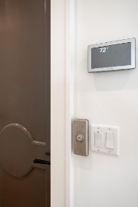
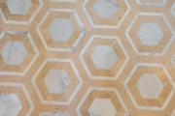


1125 Hitchfield Lane Cedar Plantation | Awendaw, SC 29429 MLS# 23017370 | $899,000
Open House Sunday 1-3
Stop by and tour this exquisite lakefront home
OWNER MOTIVATED
Suzi Baldrick Mobile 843-442-3149
suzi.baldrick@carolinaone.com
www.CarolinaCoastalTeam.com
Carolina Coastal Group Carolina One Real Estate
1503 Palm Blvd
Isle of Palms, SC 29451-2280

