Slide 1
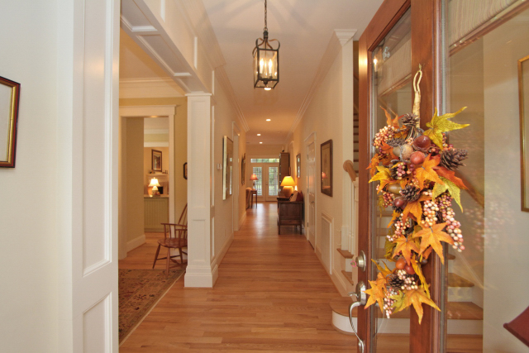
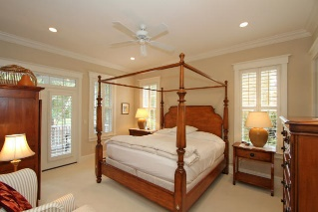
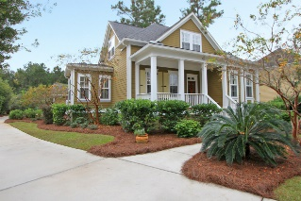
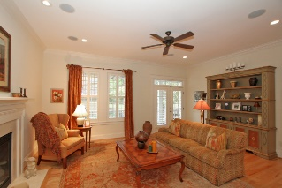
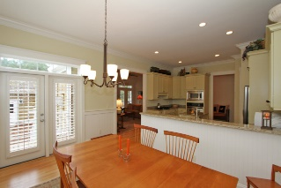
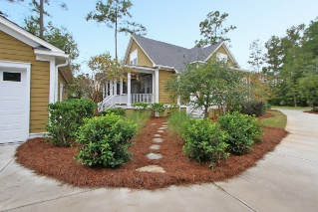


1126 Ayers Plantation Way Dunes West Mount Pleasant MLS# 15027350 $588,500 3 Bedrooms | 3½ Baths 2,510 sq ft
MAJOR PRICE REDUCTION!
FIRST FLOOR
Soaring 10 ft Ceilings
Architectural Woodwork
Master Suite with Luxurious Master Bath
Bountiful Crown Moldings and Wainscoting
Hardwood Floors and Seven (7) Inch Baseboards
Kitchen*Granite, Stainless Steel Appliances, and Work Island
Formal Dining Room
Family Room with Fireplace/Gas Logs
8 ft x 30 ft Screened Porch overlooks pond and wooded lot.
Laundry Room *Deep Sink, Cabinets, Linen Closet, Hookups
Half-Bath
SECOND FLOOR
Two Large Guest Bedrooms
Two Full Baths (one with tub and shower)
Walk-in Closet Plus Walk-in Storage + More
ADDITIONAL INFORMATION
Detached 2 Car Garage Buffered by a Private Wooded Lot
Rain Bird Irrigation System
Gutters and Downspouts on Both the House and Garage
Plantation Shutters Throughout Entire Home
Dual Zoned Heating and Air Conditioning
Carolyn J Parsons GRI, REALTOR, CRS, SRES, ABR
Mobile - (843) 224-0588
cparsons@carolinaoneplus.com
www.carolynparsons.com
Carolina One Real Estate
628 Long Point Rd
Mt Pleasant, SC 29464

