Slide 1
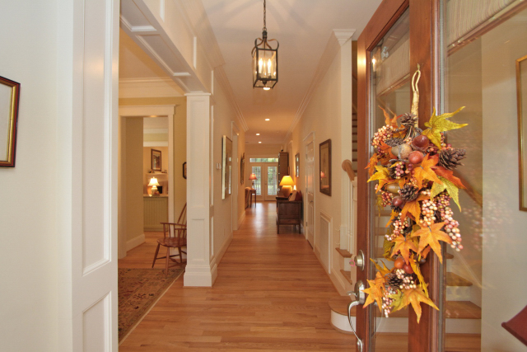
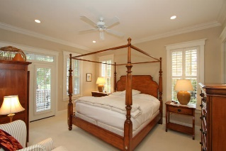
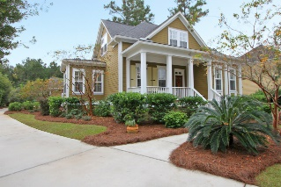
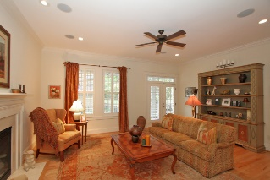
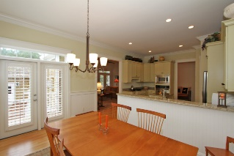
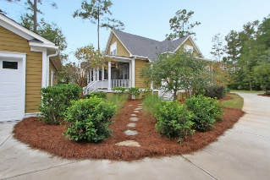


1126 Ayers Plantation Way
Dunes West
Mount Pleasant
MLS# 15027350
$625,000
3 Bedrooms | 3½ Baths
2,510 sq ft
CLASSIC CHARM + QUALITY PREVAILS
FIRST FLOOR
Soaring 10 ft Ceilings
Architectural Woodwork
Master Suite with Luxurious Master Bath
Bountiful Crown Moldings and Wainscoting
Hardwood Floors and Seven (7) Inch Baseboards
Kitchen*Granite, Stainless Steel Appliances, and Work Island
Formal Dining Room
Family Room with Fireplace/Gas Logs
8 ft x 30 ft Screened Porch overlooks pond and wooded lot.
Laundry Room *Deep Sink, Cabinets, Linen Closet, Hookups
Half-Bath
SECOND FLOOR
Two Large Guest Bedrooms
Two Full Baths (one with tub and shower)
Walk-in Closet Plus Walk-in Storage + More
ADDITIONAL INFORMATION
Detached 2 Car Garage Buffered by a Private Wooded Lot
Rain Bird Irrigation System
Gutters and Downspouts on Both the House and Garage
Plantation Shutters Throughout Entire Home
Dual Zoned Heating and Air Conditioning
Carolyn J Parsons
GRI, REALTOR, CRS, SRES, ABR
Mobile - (843) 224-0588
cparsons@carolinaoneplus.com
www.carolynparsons.com
Carolina One Real Estate
628 Long Point Rd
Mt Pleasant, SC 29464

