Slide 1
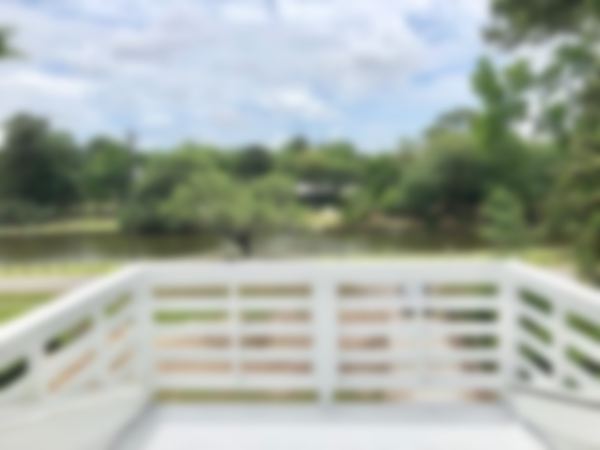
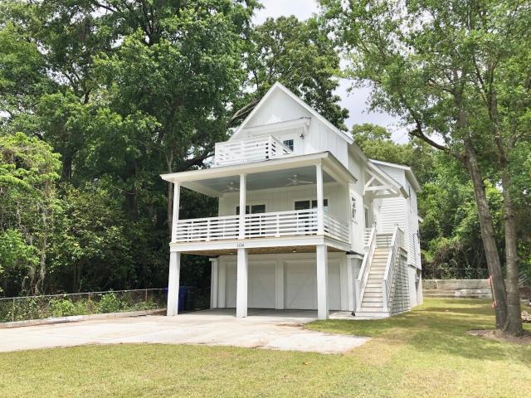

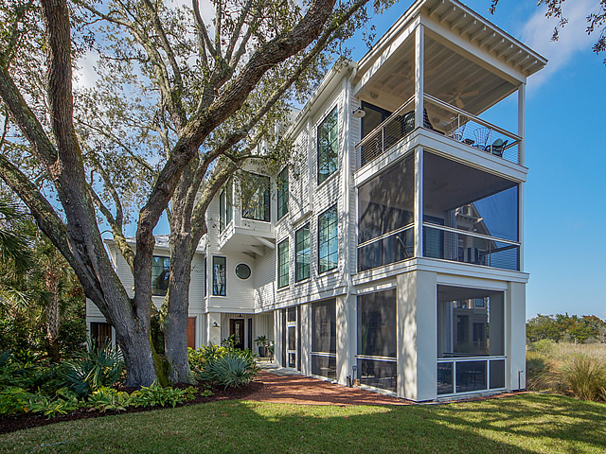
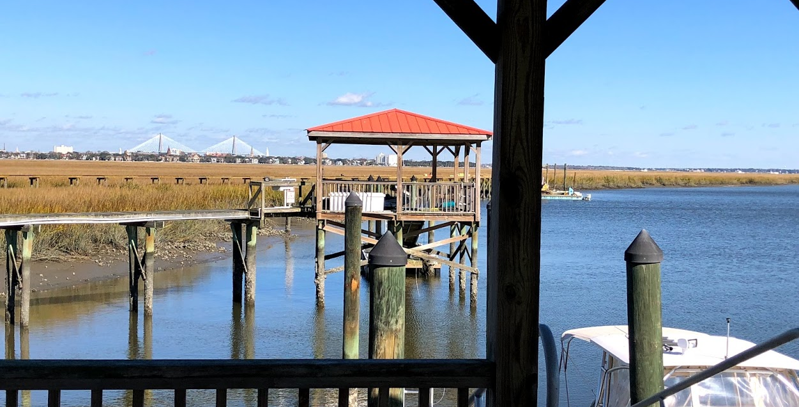
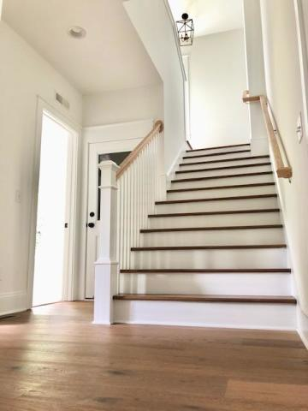
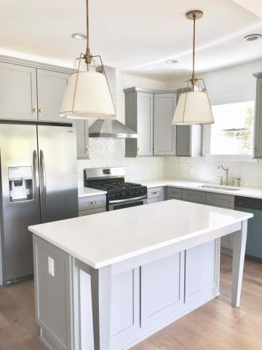
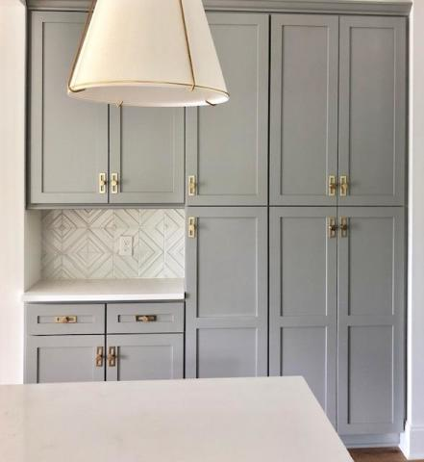
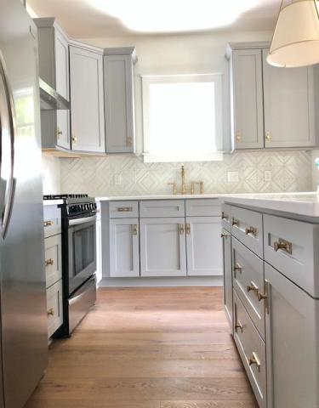
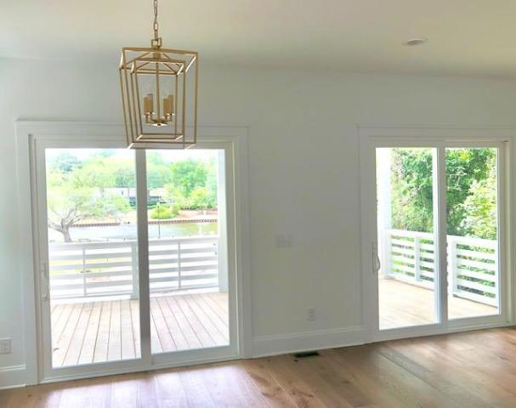
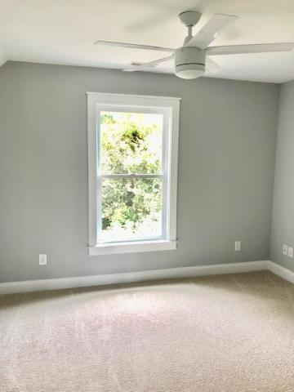
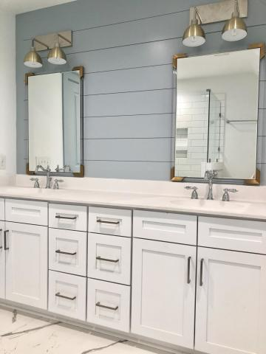
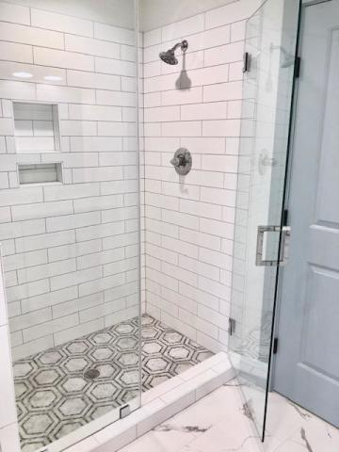
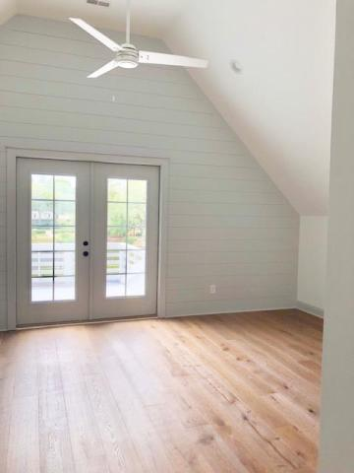
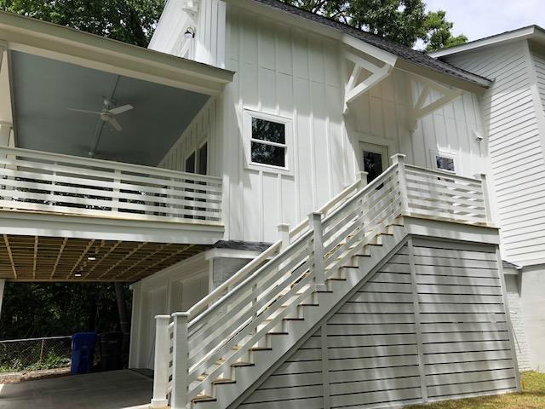
PUBLIC OPEN HOUSE
Saturday, May 11th 1-4pm
1126 Buist Avenue
Park Circle ~ North Charleston, SC 29405
MLS# 19003200 ~ $499,999
LOCATION, LOCATION, LOCATION!!!!
NEW CONSTRUCTION IN PARK CIRCLE
This is a one of a kind lot that offers beautiful views of Quarterman Lake as well as a wooded and private surrounding.
Kara Delpino
(843) 860-4166
kara@hbrtwn.com
www.karadelpino.com
Harbourtowne Real Estate
672 Marina Drive, Ste 110
Daniel Island, SC 29492

