Slide 1
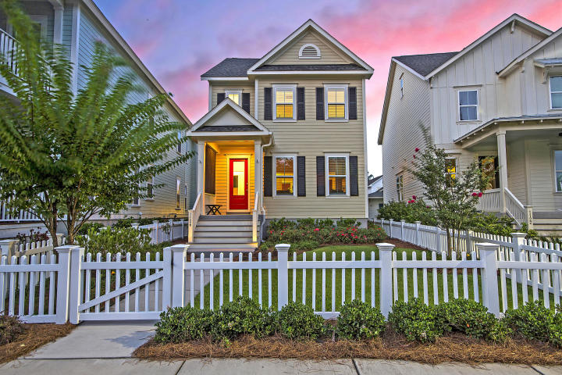
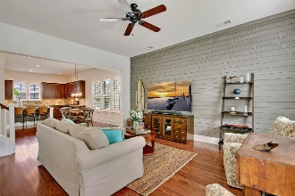
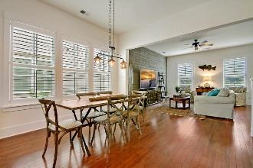
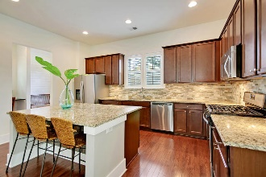
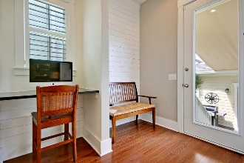
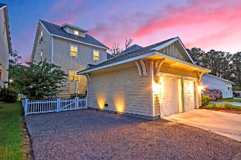
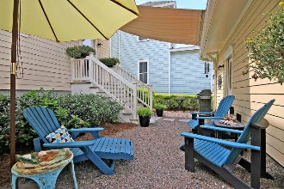
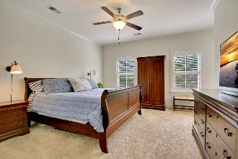
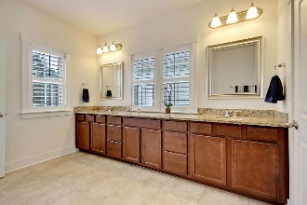
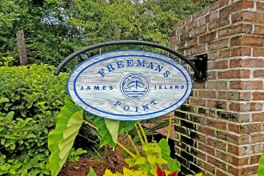
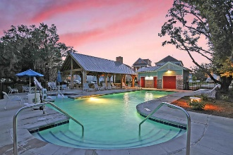
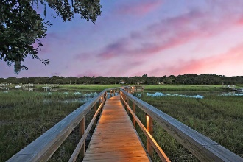
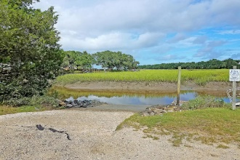
Drop by and enter to win a gift certificate to Duck Donuts!
Major Price DROP!
Now Less Than $500k
1126 John Mcenery Road
Freeman's Point ~ Charleston, SC 29412 ~ MLS# 18023459 ~ $499,800
Take your boat out on the water, soak up the rays at Folly Beach, or shop the streets of downtown Charleston within minutes with this move-in ready home that offers the look & feel of new construction without the wait or inconvenience. Brimming with custom upgrades & coastal charm, this nearly-new 3-story home features a bright & airy open floor plan; shiplap, v-groove, and board & batten walls; plantation shutters; stone backsplash; hardwood floors; custom lighting; high ceilings; granite counters; SS appliances; custom-made hurricane shutters; & views of protected green space out front & back! All of that, plus Freeman's Point offers a dock & a boat landing, waterfront walking trails, a sparkling pool, a playpark, a dog park, & a picnic pavilion for the exclusive use of its residents!
Additional details include:
Light-filled and flexible floor plan offers open living space connecting the family room, dining area, and kitchen, along with a large storage closet, spacious powder room, and office space/mudroom on the main floor; the master suite, two bedrooms, another full bath, and laundry on the 2nd floor; and a 4th bedroom suite/guest suite/bonus room on the 3rd floor, which would also make a great game room, media room, play room, or additional office space.
Open kitchen features a huge island and breakfast bar, gas cooking, upgraded cherry cabinetry, granite counters, stainless steel appliances, custom stone backsplash, recessed lighting, wood flooring, a giant pantry/storage room off the kitchen, tons of counter prep space, and loads of cabinet storage space.
Master suite features crown molding, plantation shutters, a walk-in closet, built-in Pottery Barn light sconces, and a large ensuite bath, which offers a large shower with tile surround, a giant granite vanity with his and her sinks, tile flooring, and a separate water closet.
Fully-fenced yard features Xeriscape landscaping, which requires little water or upkeep -- very low-maintenance, yet lovely!
Backyard features a charming seating area, a grill area, and a custom shade the covers the walkway from the home to the garage and protects you from the sun and weather.
Plenty of off-street parking available for all of your guests with the large custom parking pad, driveway, and 2-car detached garage, which also features built-in storage shelving and a kayak suspension system that will convey with the home.
This home is uniquely situated with protected green space both out front and back, which will never be developed. Green space in back features a plot of wildflowers, majestic live oaks, and backs to gorgeous lowcountry marsh.
Transferable termite bond in place with HomeTeam.
Builder and certain manufacturer warranties still in effect!
Homes like this don't stay around long!
Julie Nims julie@mattoneillteam.com 843-580-6310

