Slide 1
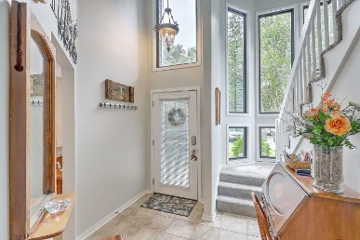
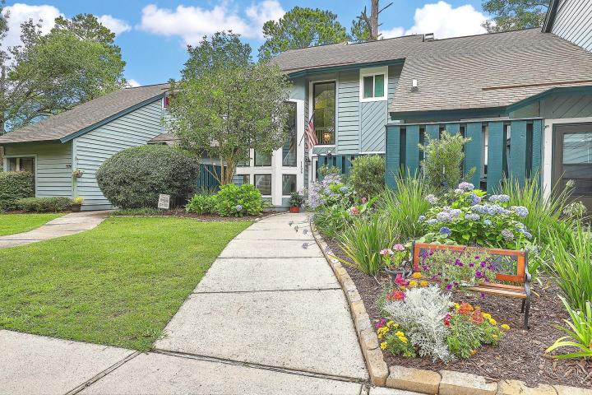
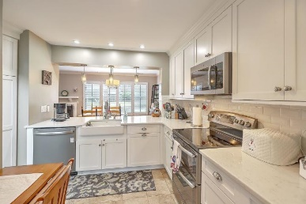
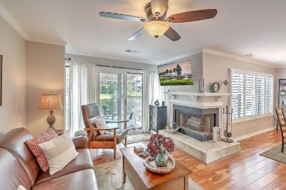
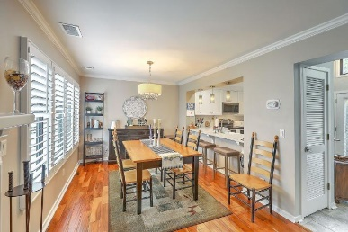
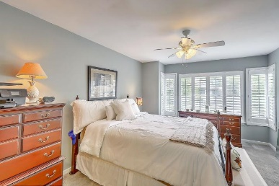
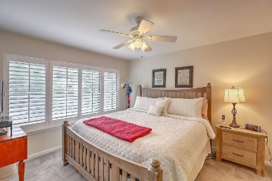
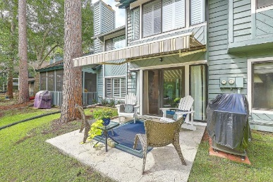
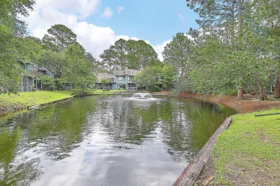


1126 Shadow Lake Circle 58 Snee Farm Lakes ~ Mount Pleasant, SC 29464 MLS# 20016632 ~ $289,900
Price Improvement ~ Gorgeous Water Views
$1,000 Buyer's Agent Bonus
For Ratified Contract That Can Close By 9/27/2019
Fabulous Water Views from almost every room in this light filled, beautifully updated condo located in the heart of Mt Pleasant - Highly sought after Snee Farm! This Bright Open floor plan is perfect for entertaining friends & family or just relaxing in your new home or patio while enjoying those fantastic water views! Completely remodeled kitchen & baths, beautiful new hardwood flooring, new HVAC, Plantation Shutters, fresh paint etc. all make this a true must see, move in ready home. Dual masters upstairs with those fabulous water views and newly renovated baths. The neighborhood pool is just steps away from your back yard. Located just minutes from the beaches, town center, downtown, shopping, restaurants, I526 etc. Make your appointment to view this home today!
Maggie Curtis
REALTOR, EPRO, LMC, ABR
(843) 693-8207
maggiecurtis@comcast.net
Bob Curtis
Realtor
(843) 425-1965
thebobcurtis@comcast.net
Coldwell Banker Residential Brokerage | 1127 Queensborough Blvd. 103 | Mt Pleasant, SC 29464

