Slide 1
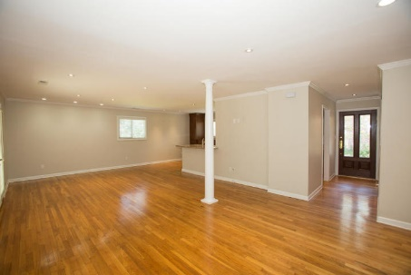
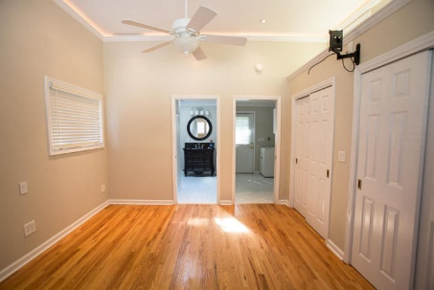
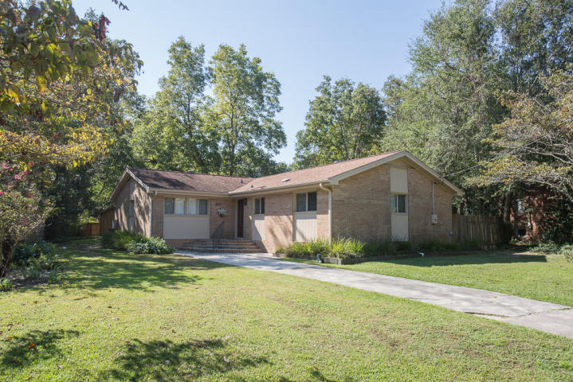
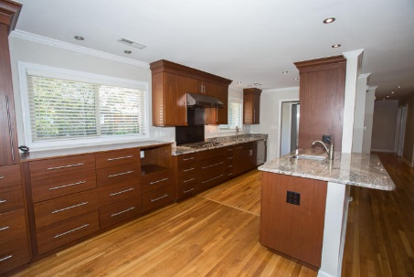
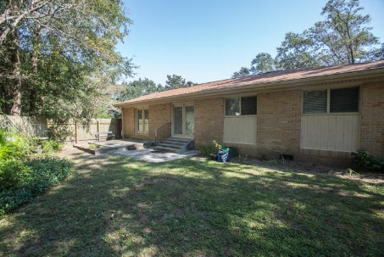
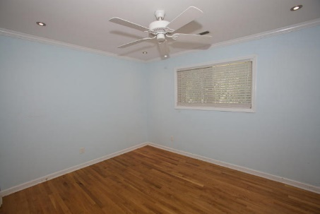
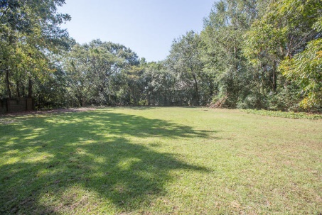


Motivated Seller! Great Location!!
1127 Darwin Street
Lawton Bluff · Charleston
MLS# 17026496 · $415,000
Completely remodeled 4 bedroom 3 bath home on James Island. Hard wood floors and can lighting throughout. Beautiful designer kitchen with custom cabinetry, granite counter tops, Viking stainless steel appliances and under cabinet lighting. Large master bath with walk in shower. Huge, private back yard with 12x18 storage shed. Geo thermal HVAC and tankless water heater. Home is in excellent condition and convenient to down town and Folly Beach. Must see!
Michael Dew
O (843) 870-7000
M (843) 870-7000
michaeledew@gmail.com
www.michaeldewrealestate.com
AgentOwned Charleston Group
902 Savannah Hwy
Charleston, SC 29407
Real Estate ● Mortgage
Insurance ● Business Brokerage

